Slide 1
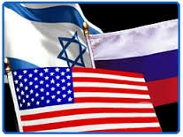
Russian and US Roles in the Middle East: The View from Israel
Dr. Yuri Teper
The Hebrew University of Jerusalem
Wilson Center, Kennan Institute – 05.09.2017

Slide 2
Main goals
Outline Russia’s and US changing engagement in the Middle East.
Identify factors that helped maximize Russia’s regional leverage and diluted the US influence.
Demonstrate the changing Middle Eastern setting with respect to both local and global players.
Draw out implications for the future.

Slide 3
Comparative analysis of US and Russian roles from the Israeli perspective
4 key spheres (2009-2016):
Handling of Regional Allies & Commitments
Nuclear Deal with Iran
Syrian Civil War
The Palestinian Track

Slide 4
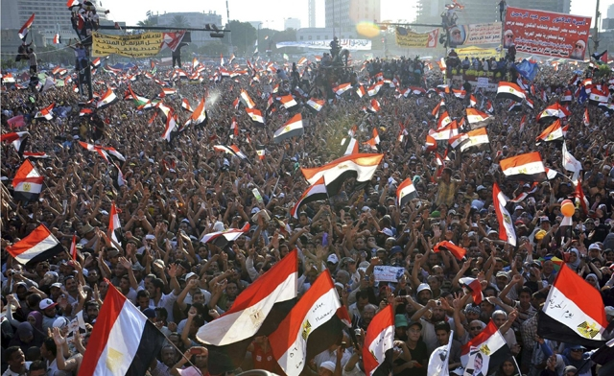
Allies & Commitments - US
Shifting away from traditional allies and commitments in favor of more pro-Iranian stance and the support of popular protest movements:
In Egypt US shift reduced the chances for organized power-transition\sharing.
The Gulf states sought security cooperation with Israel.
In Iraq the shift was associated with increased anarchy, greater IS and Iranian influence.

Slide 5
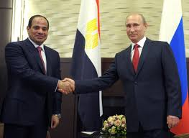
Allies & Commitments - Russia
Russia opposed the Arab Spring.
Russia has tried to fill the void left by the US and enthusiastically supported Al-Sisi in Egypt.
Russia stubbornly supported al-Assad, Russia’s only regional ‘client’.

Slide 6
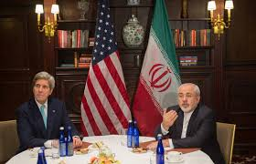
Iranian nuclear deal
American-led deal is perceived in Israel as a strategic security challenge.
US covert negotiations and the imposed deal created a deep mistrust.
Russia’s more cautious approach to Iran was overturned after the nuclear deal.
Russia is still (exaggeratingly) perceived as the party that exerts most influence on Iran.

Slide 7
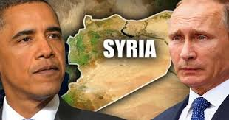
Syria – US vs. Russia
US uncertain navigation among questionable opposition groups, dominated by Gulf states.
Russia provided unconditional support for al-Assad.
2013 Chemical Crisis was a watershed event:
It exposed US unwillingness to use force.
The US lost credibility.
Russia’s determination and decisiveness, were highlighted.
It signaled Russia’s grand return to the region.

Slide 8
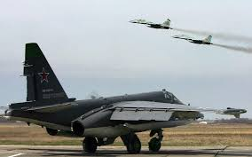
Syria – US vs. Russia
Russian intervention (2015) – a mixed blessing:
Posed tactical difficulties and potential danger for Israel.
Balanced the powers in Syria, diverted the focus from Israel and eroded sides.
Russia’s accommodation of Israel’s vital interests in Syria was highly appreciated.
Strategically, Russia is still treated with much suspicion.

Slide 9
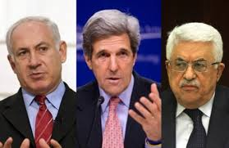
The Palestinian track
US
Forcing talks on both sides of the conflict, often without diplomatic preparation.
Publicly announcing maximalist agenda cornered the parties.
Lack of credible backing to the process for both sides.
Russia
Little actual involvement in the process.
Overtly pro-Palestinian public and diplomatic stance.

Slide 10
Conclusions
America’s role as a security guarantor and mediator for its allies has been undermined.
In general, (perceived) determinacy and readiness to act + consistent policy = maximizing leverage, and vice versa.
Obama’s ‘idealist’ and post-modernist outlook did not match the pre-modern ME realities and both Putin’s and Netanyahu’s ‘realist’ approach.
The “New-Cold-War” paradigm is invalid and misguiding.

Slide 11
Policy implications
The importance of having agreed mutual expectations and clear game-rules with the allies.
Discreet work with the governments should be stressed over public diplomacy.
The goals and aspirations should be tempered and correlated with the level of desired involvement.

