Slide 1
Russian Labor Protests in Challenging Economic Times
Irina Olimpieva
St. Petersburg Center for Independent Social Research
Stephen Crowley
Oberlin College
Kennan Institute, May 16, 2016

Slide 2
Sources of data
ROSSTAT http://www.gks.ru/ (only legal strikes: number, participants, days lost)
Center for Socio-Labor Rights trudprava.ru Piotr Biziukov monitoring of labor protests since 2008, based on mass media and internet: forms of protests, number, location, scale, reasons, duration, participants, etc.
Center for Monitoring and Analysis of Socio-Labor Conflicts SPb State University of Trade Unions http://www.gup.ru/, since 2014
Center for Economic and Political Reforms cepr.su, since 2015

Slide 3
Rosstat
 | 2008 | 2009 | 2010 | 2011 | 2012 | 2013 | 2014 | 2015
Strikes | 4 | 1 | 0 | 2 | 6 | 3 | 2 | 5

Slide 4
Rosstat
 | 2008 | 2009 | 2010 | 2011 | 2012 | 2013 | 2014 | 2015
Strikes | 4 | 1 | 0 | 2 | 6 | 3 | 2 | 5
CSLR
 | 2008 | 2009 | 2010 | 2011 | 2012 | 2013 | 2014 | 2015
All protests | 92 | 272 | 205 | 263 | 285 | 277 | 293 | 409
Stop-actions | 60 | 106 | 88 | 91 | 95 | 102 | 97 | 168

Slide 5
Source:
Center for Social and Labor Rights

Slide 7
Monthly Labor Protests Relative to GDP Growth
Sources: Center for Social and Labor Rights; OECD.

Slide 8
How does the current wave of protests compare with past labor protests in Russia?
Wage arrears as a main reason of protests (CSLR: 48%(2015) - 54% (2016), FNPR: 60%)

Slide 9
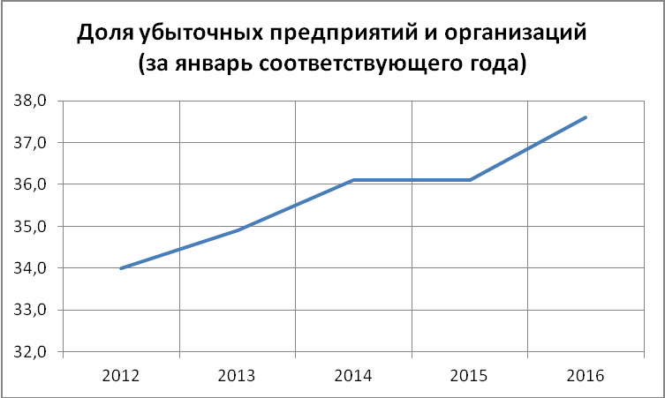
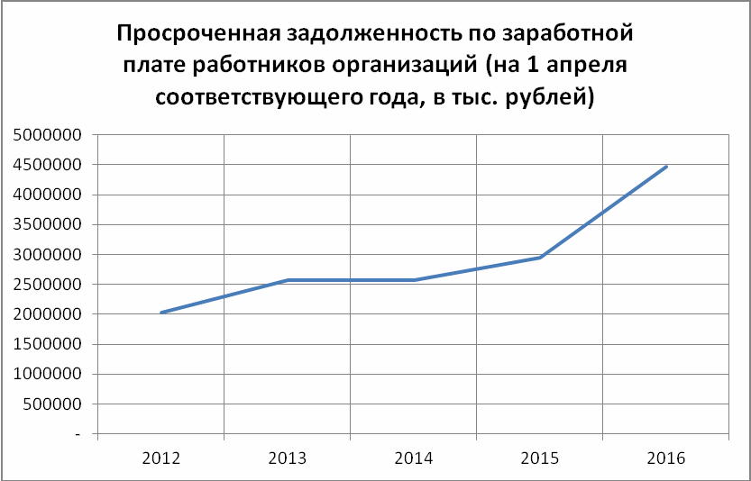
The share of unprofitable enterprises and organizations (in January of a corresponding year)
Wage arrears in organizations (as on April 1 of a corresponding year)
Source: Rosstat data, charts from the CEPR Report on the 1st quarter of 2016 cepr.su

Slide 10
Wage arrears for certain types of economic activity (million rubles)
 | 2016
 | Jan 1 | Feb 1 | March 1 | Apr 1
Manufacturing | 1153,9 | 1240,1 | 1329,8 | 1566
Mining | 203,3 | 215,3 | 207,6 | 213
Agriculture | 189,2 | 181,7 | 199,8 | 188
Construction | 833,9 | 811,2 | 918 | 1021
Education | 10,3 | 32,3 | 39,6 | 21
Health | 15,6 | 29,9 | 29,3 | 25

Slide 11
How does the current wave of protests compare with past labor protests in Russia?
Wage arrears as a main reason of protests (over 50%)
Extreme forms of protest (6-11%)

Slide 12
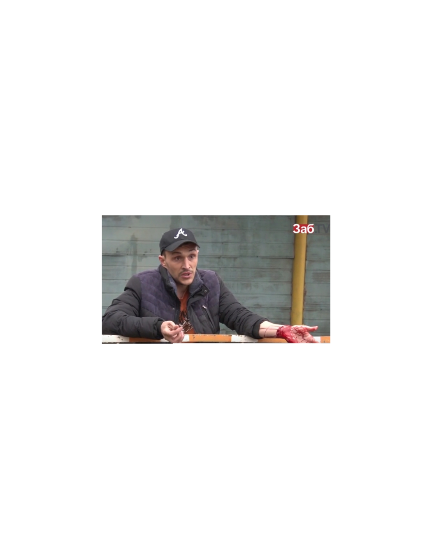

Slide 13
How does the current wave of protests compare with past labor protests in Russia?
Wage arrears as a main reason of protests (over 50%)
Extreme forms of protest (6-11%)
The scale of protest is less than could be expected
(due to the “Russian labor market model”)
The scale of protest is still incomparable with the 90s (in 1996 - 8,278 strikes with 663,900 participants)
‘Pure’ economic demands, local character

Slide 14
«We are not “fifth column”. I love my country and I hate America. Many of us participated in anti-Maidan but today we are fighting for our rights and the rights of all Russians — introduction of tax payments would affect all consumers»
(Leader of the trade union) http://www.rbc.ru/politics/19/11/2015/564dd7a09a79471bb0b58dcd

Slide 15
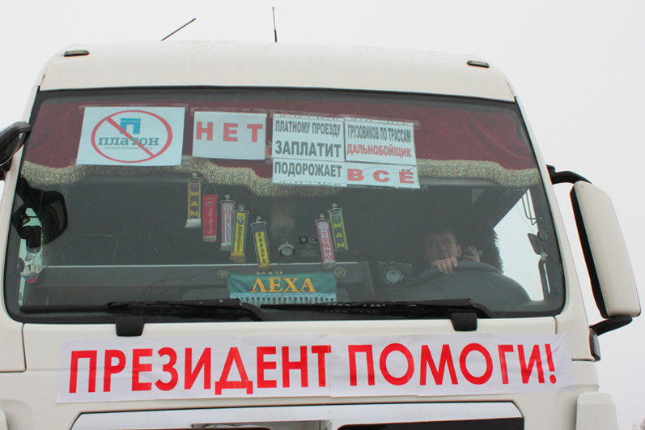
President - help us!

Slide 16
How does the current wave of protests compare with past labor protests in Russia?
Wage arrears as a main reason of protests (over 50%)
Extreme forms of protest (6-11%)
The scale of protest is less than could be expected
(due to the “Russian labor market model”)
The scale of protest is still incomparable with the 90s (in 1996 - 8,278 strikes with 663,900 participants)
‘Pure’ economic demands, local character
Participants: Distancing from political parties and local authorities

Slide 17
Are these protests likely spread? Prospects for protest growth.
Decline in the share of protests in the largest cities, growing protest activities in small cities and mono-towns (20% according to FNPR, 40% growth)
The growth in the number of the regions involved in the protests
Contradictory trends in organization:
spontaneous character, the number and share of informal ‘stop-actions’ (CSLR 6-10% legal protests)
the growth of inter-regional protests, solidarity protests within the regions, “network” protests (Bizyukov)

Slide 18
“Netness” and “catness” (Charles Tilly)
Netness – the role of trade unions
FNPR – grass-root organizations vs headquarters, ‘late participation’, lack of institutional support, focus on direct political involvement (electoral and lobbying strategies) rather than on protest activities, specific ‘political exchange’ model
Free unions – growing organizational potential since 1990s, developed networks, MPRA as a new form of trade union organization (“hub”), inter-regional and inter-sectoral protests (e.g., trade union Uchitel’)

Slide 19
Catness - perception of belonging to a common category with others
From labor protests to ‘taxpayers’ protests (truck drivers protest)
Protests by “budget sector” workers
Given need to increase revenue, cut expenditures, these protests will likely grow
Potential to merge with other forms of social protests

Slide 20
Year | No. of Strikes
2000 | 817
2001 | 291
2002 | 80
2003 | 67
2004 | 5933
2005 | 2575
2006 | 8
2007 | 7
2008 | 1
2009 | 1
2010 | 0
2011 | 2
2012 | 6
2013 | 3
2014 | 2
Rosstat

Slide 21
Can labor protests challenge Putin’s political regime?
Pro
Economic challenges, and there for hardships, to continue for foreseeable future
Budgets to prevent mass layoffs and wage arrears will shrink further
How does the regime dial back to an “acceptable” amount of expenditure to maintain employment, while keeping to an “acceptable” amount labor protest?
Labor conflict likely to be a chronic rather than acute challenge
Contra
Wage arrears are still not ‘critical’
Particularities of ‘social contract’ and legitimacy of Putin’s regime
Ideology, propaganda, Russia as a besieged fortress
Trade unions, official and free alike, distance themselves from politics
Growing fear among population to express openly political discontent
Discrepancy in social base of the protest

Slide 22
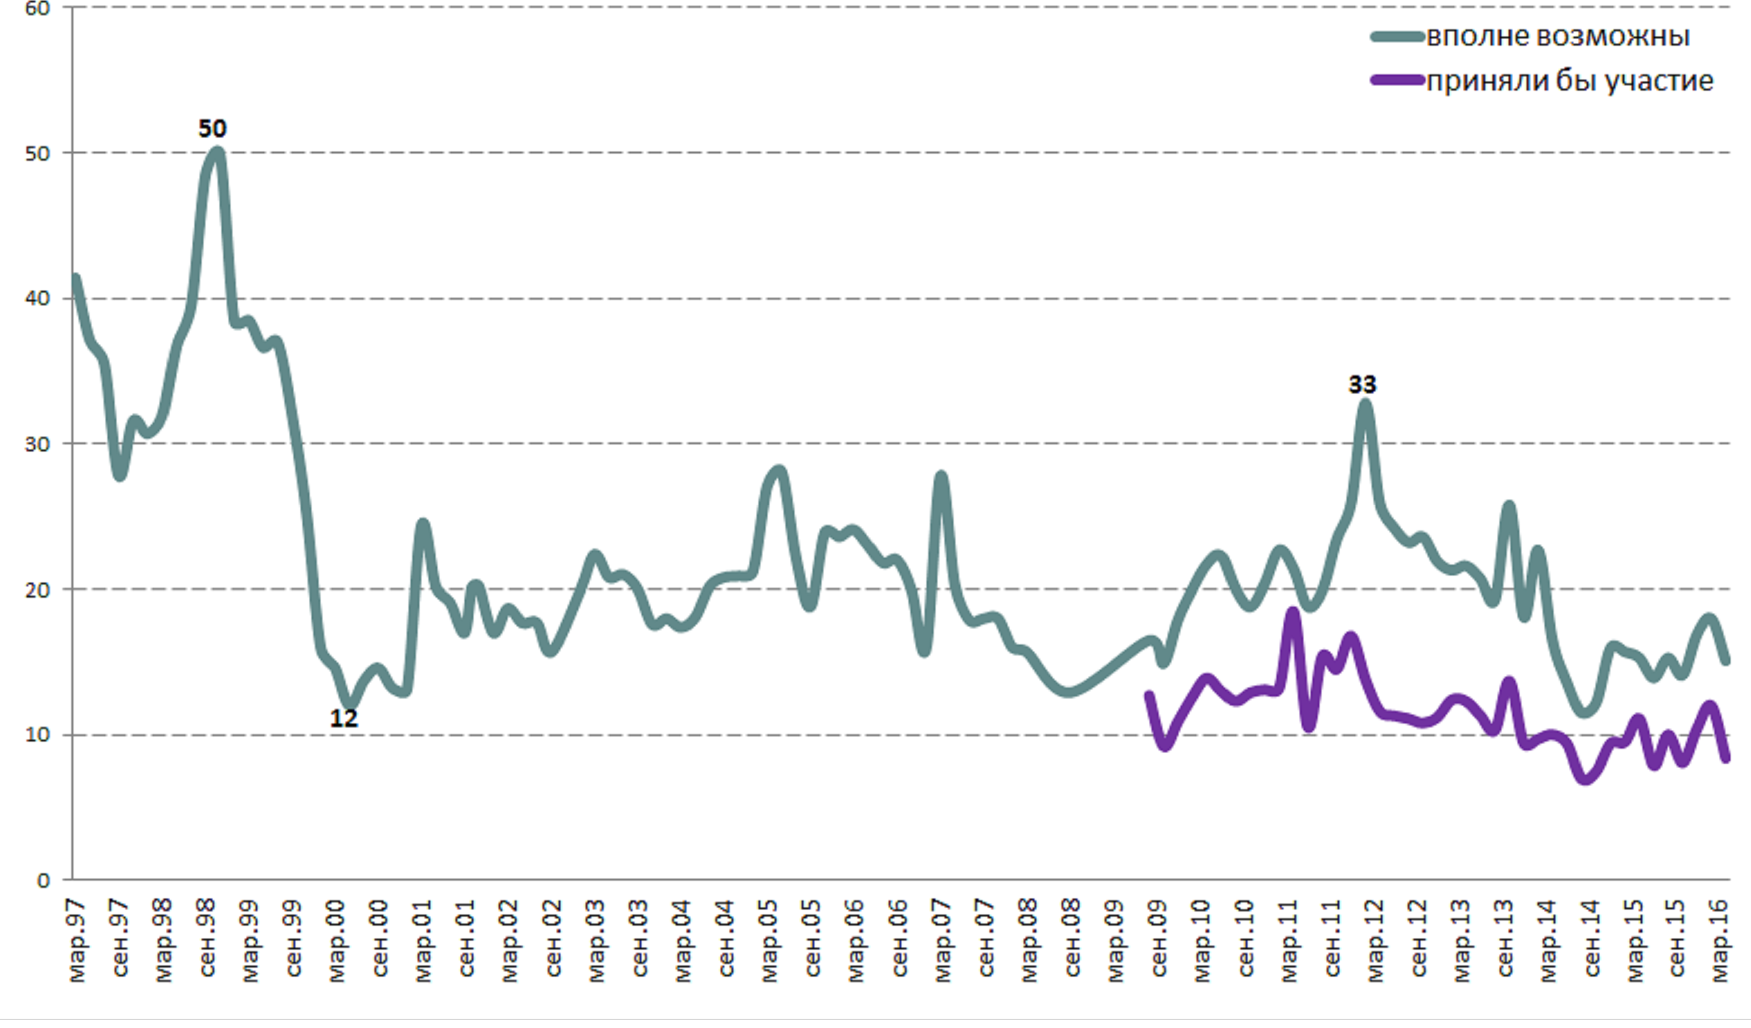
Potential for political protest in your town/city
Quite possible
I would participate
source: Levada Center

Slide 23
Potential for economic protest in your town/city
Quite possible
I would participate
source: Levada Center

