Slide 2
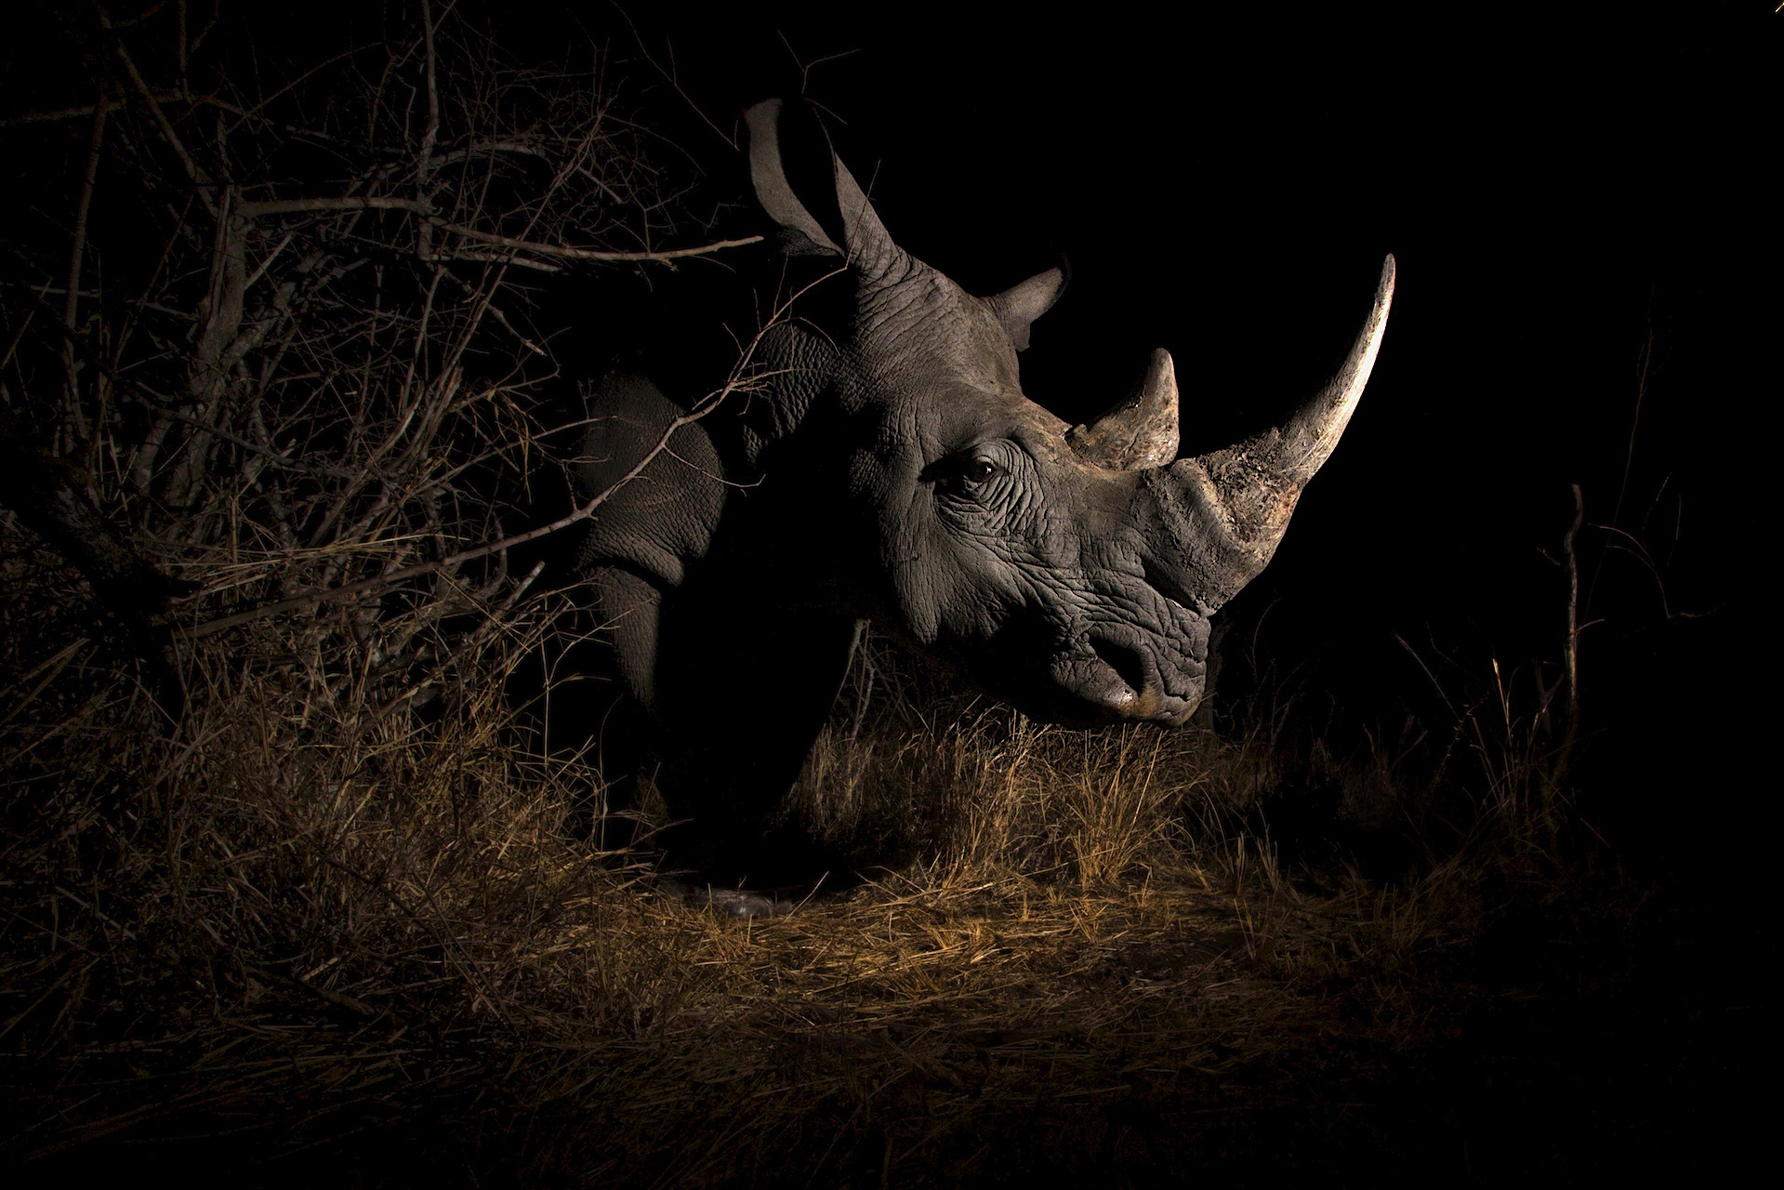

Slide 4
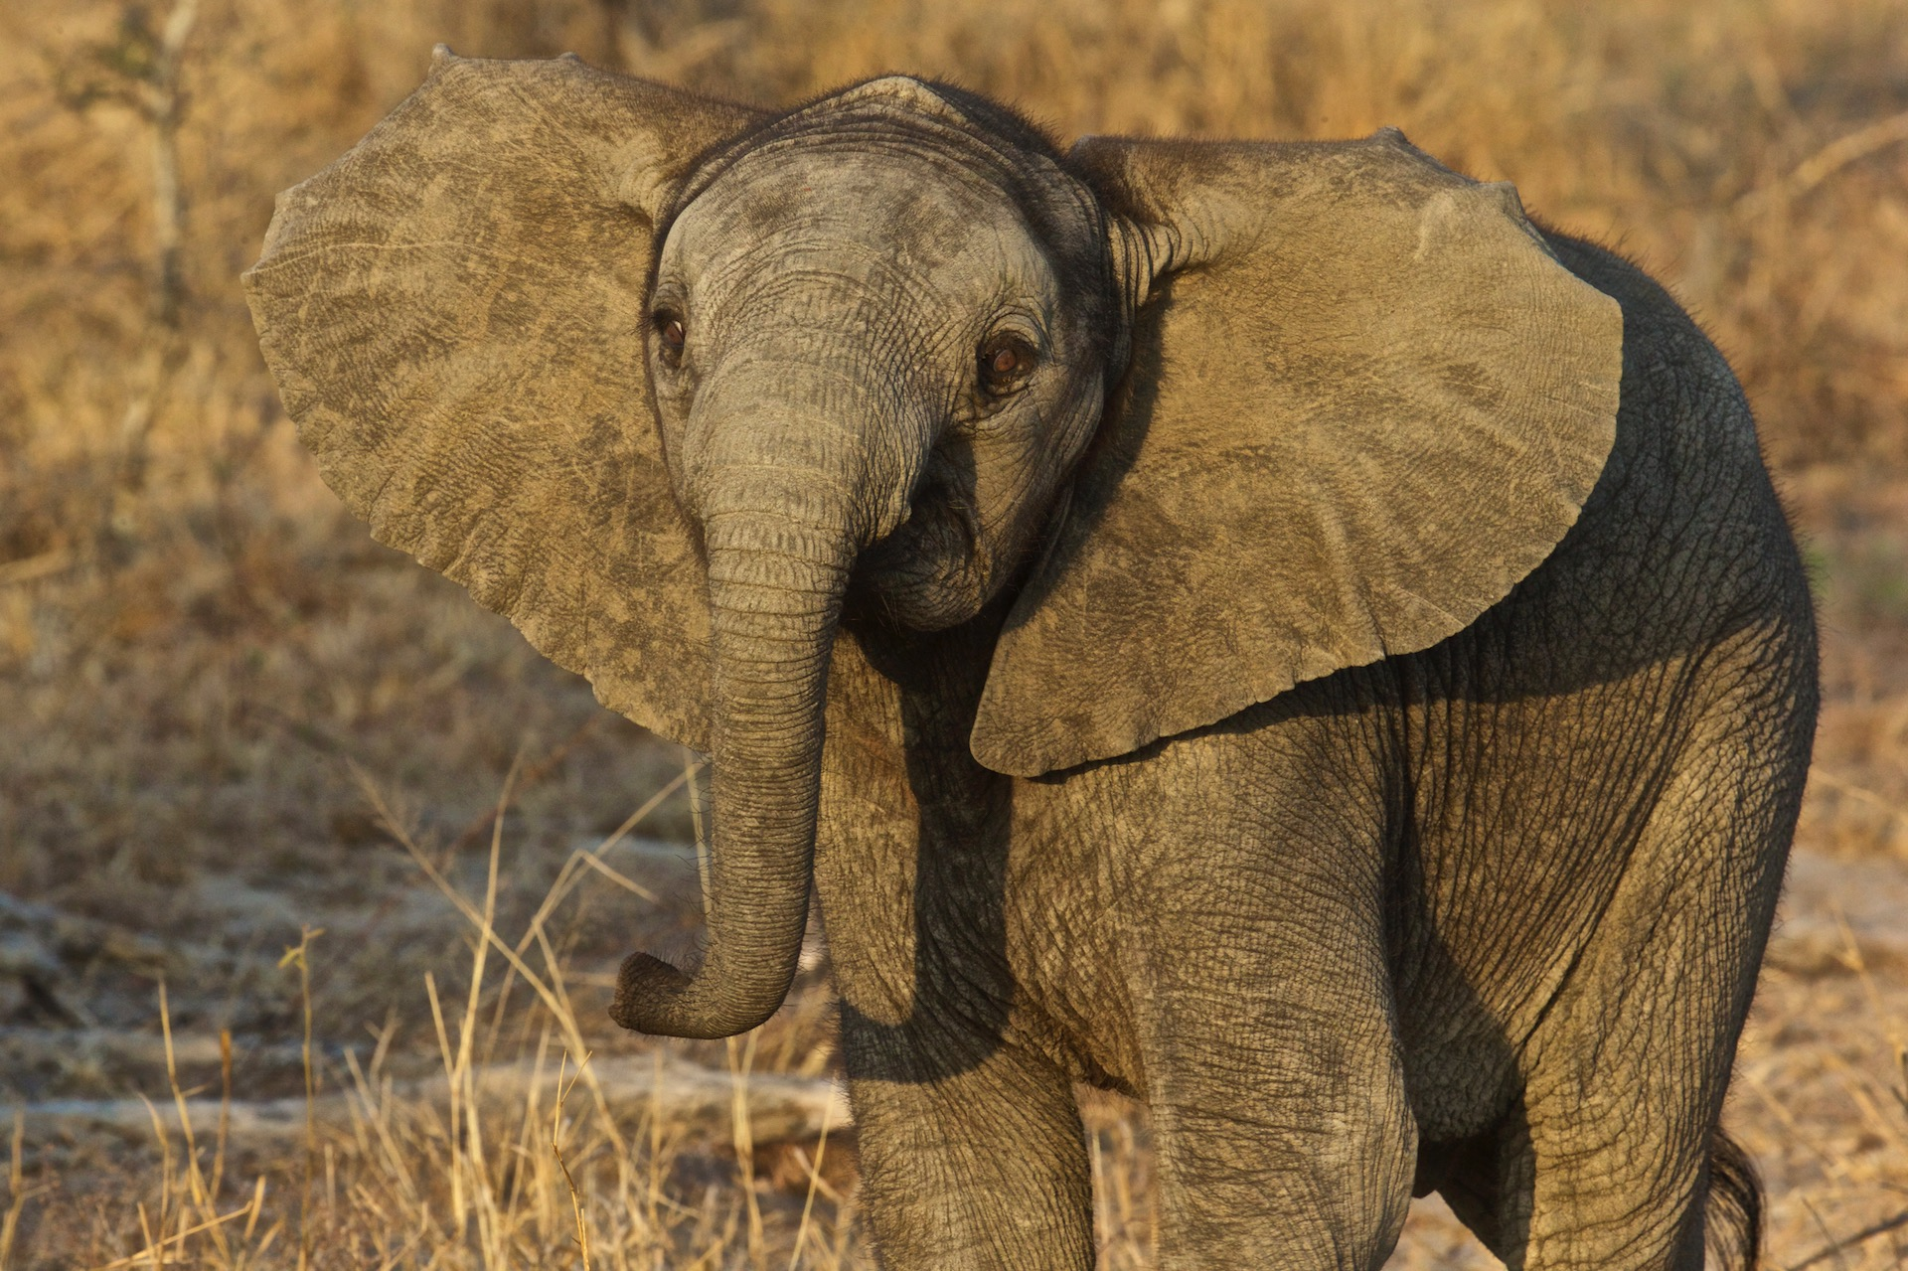

Slide 5
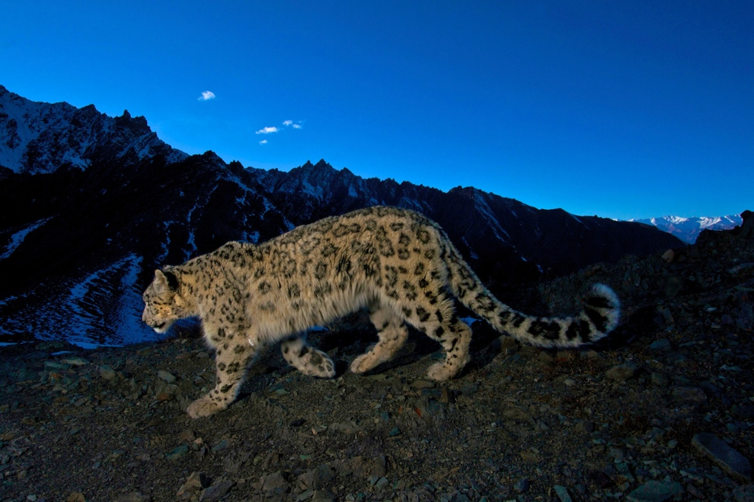

Slide 6
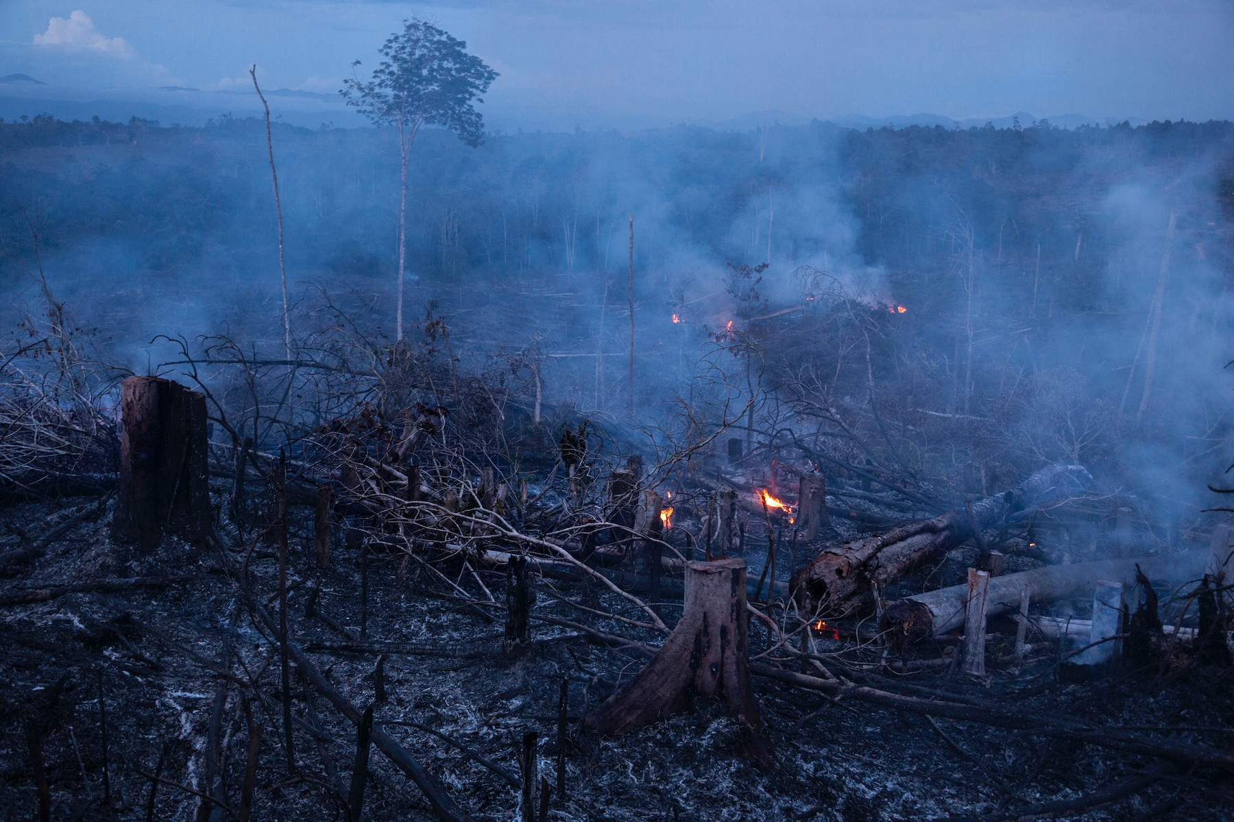

Slide 7
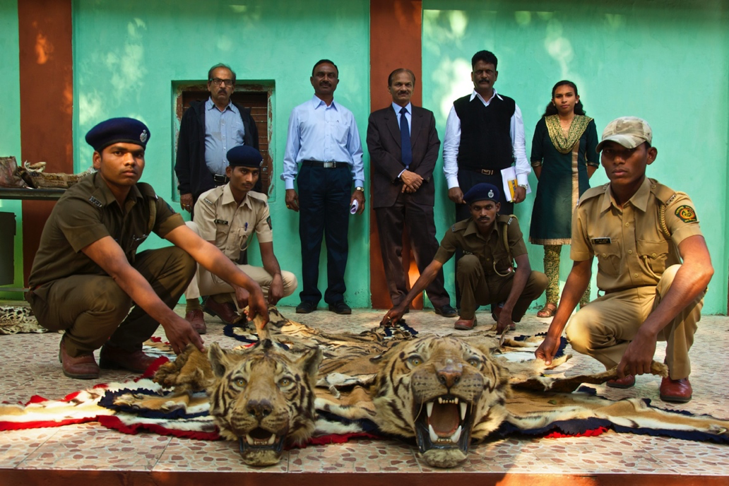

Slide 8
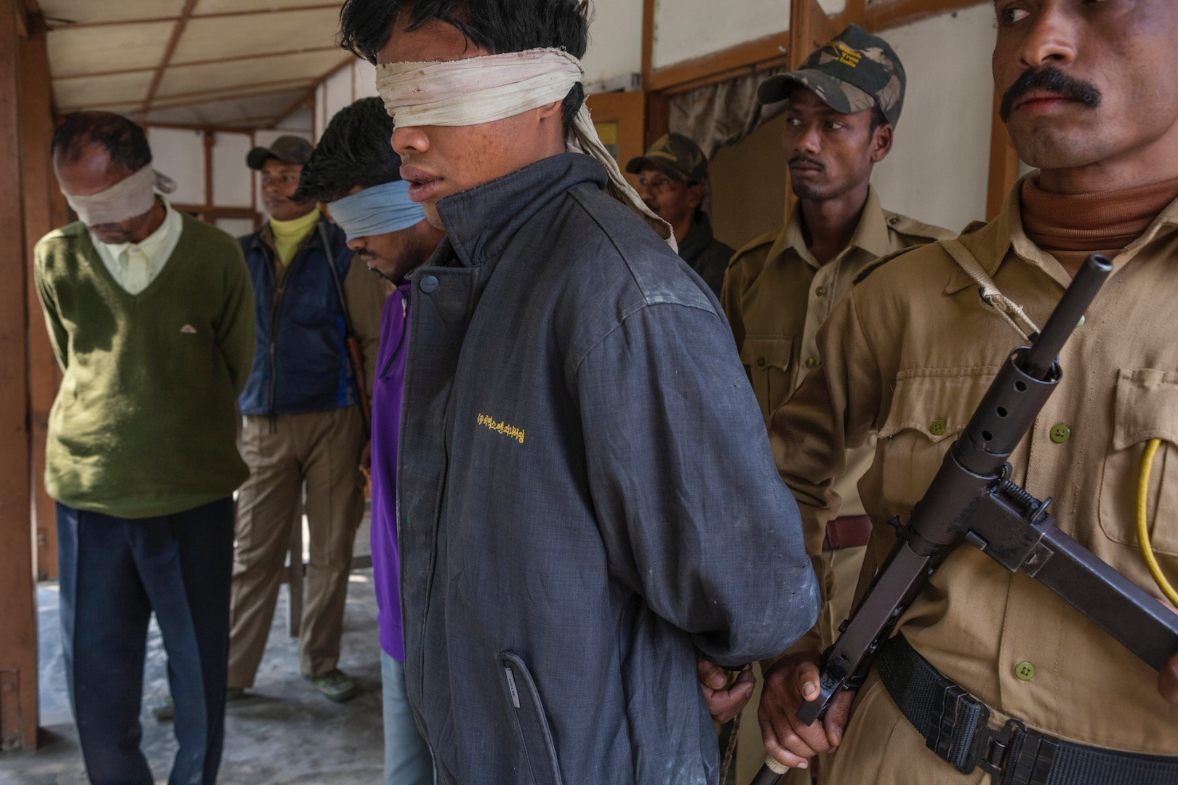

Slide 9
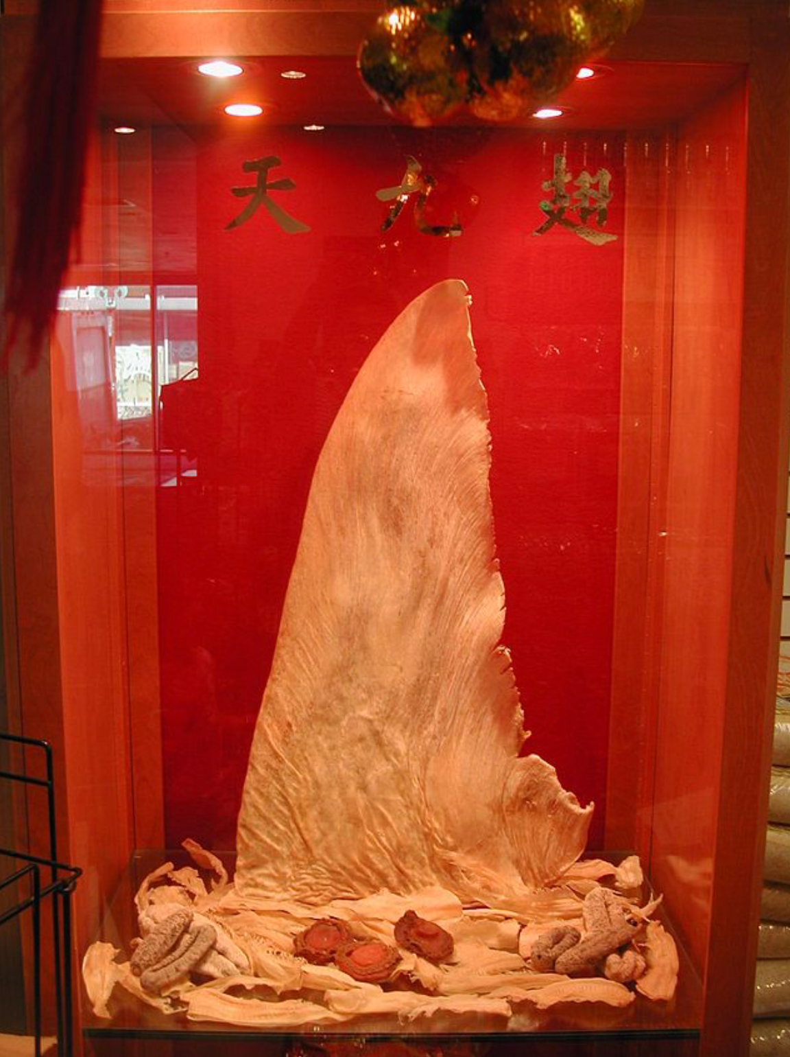
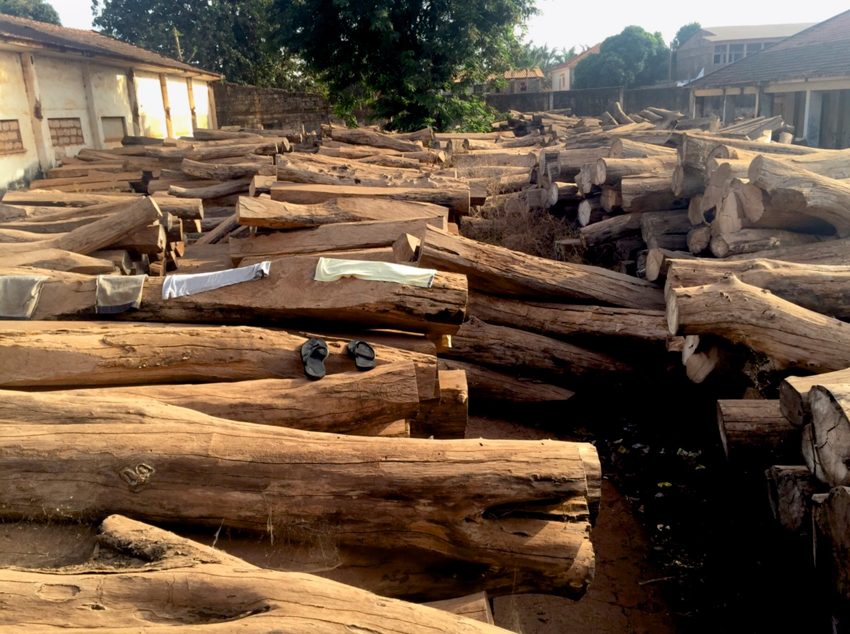
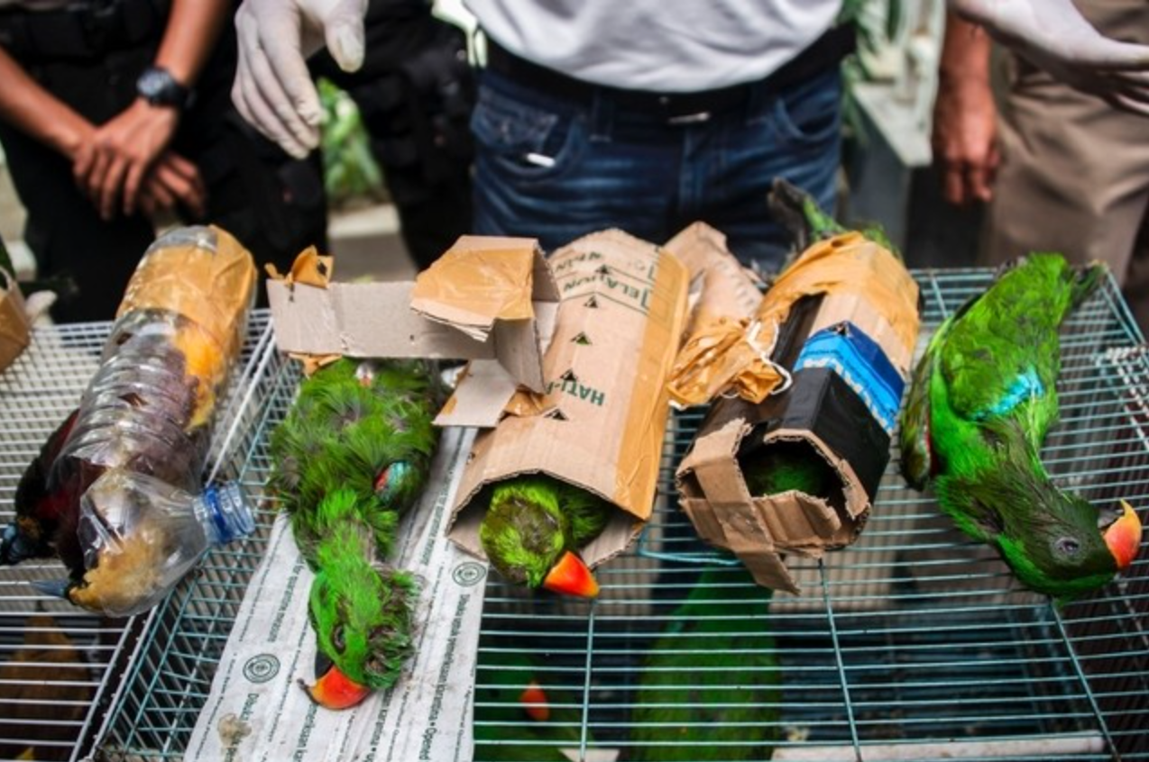
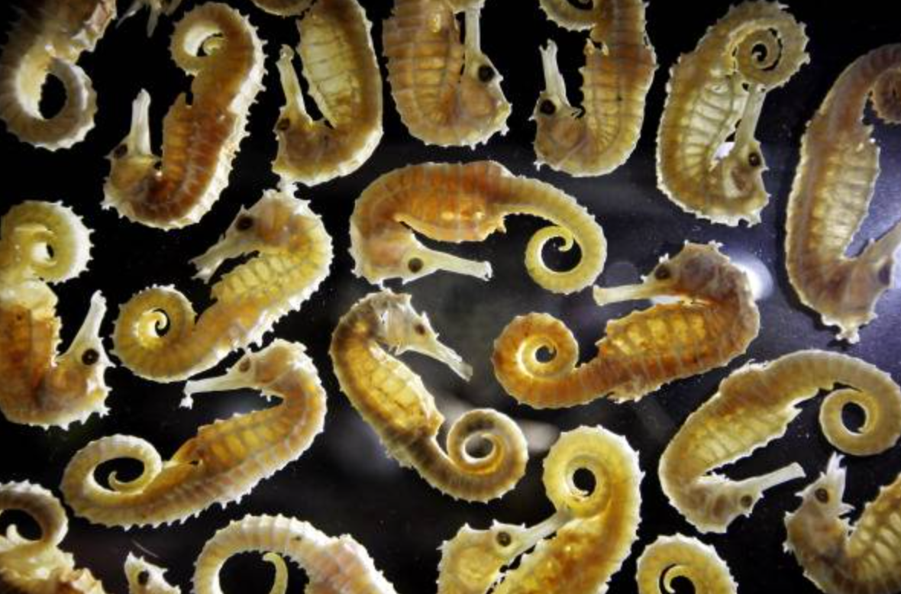

Slide 10
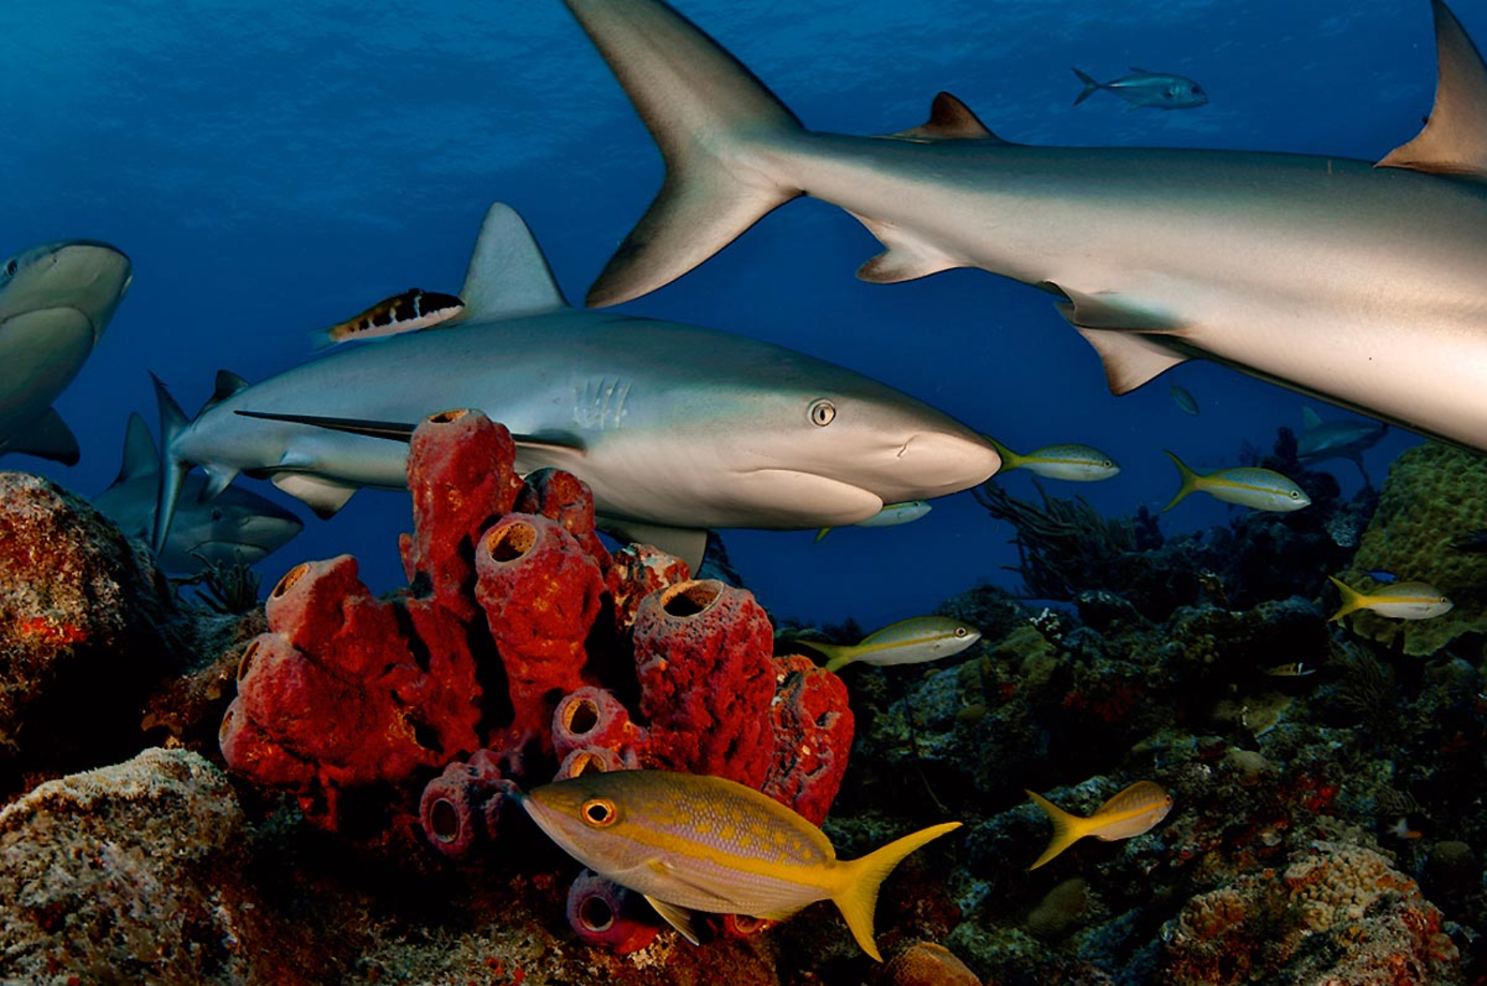

Slide 11
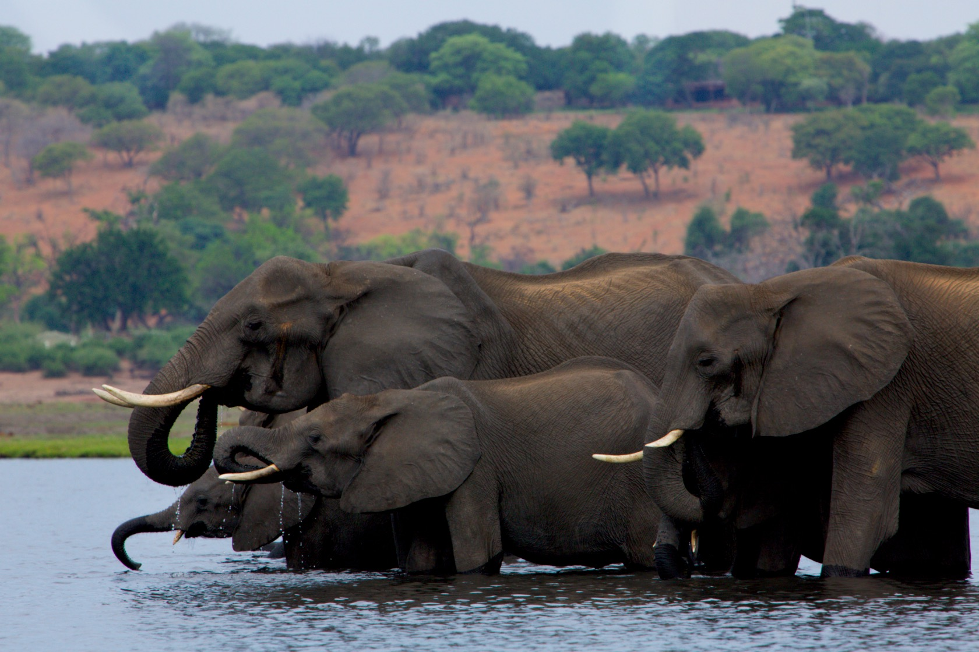

Slide 12
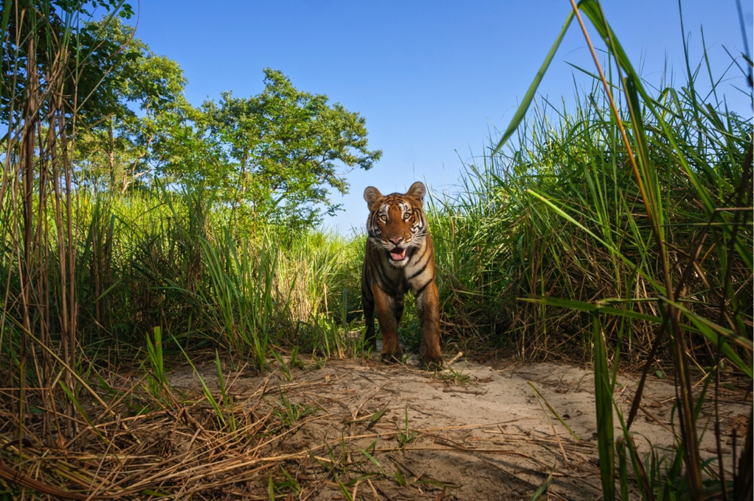
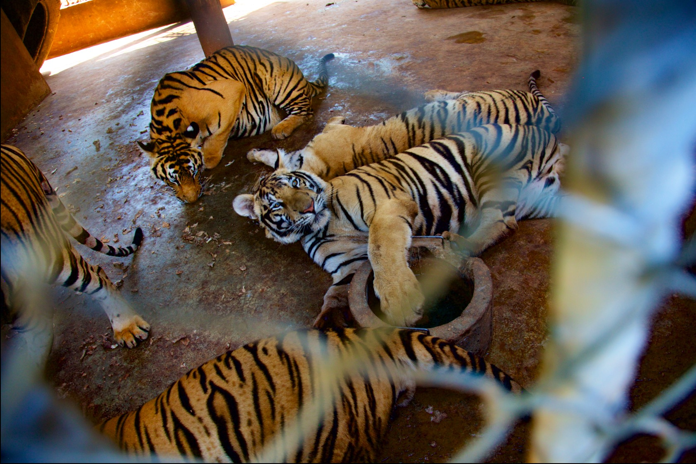
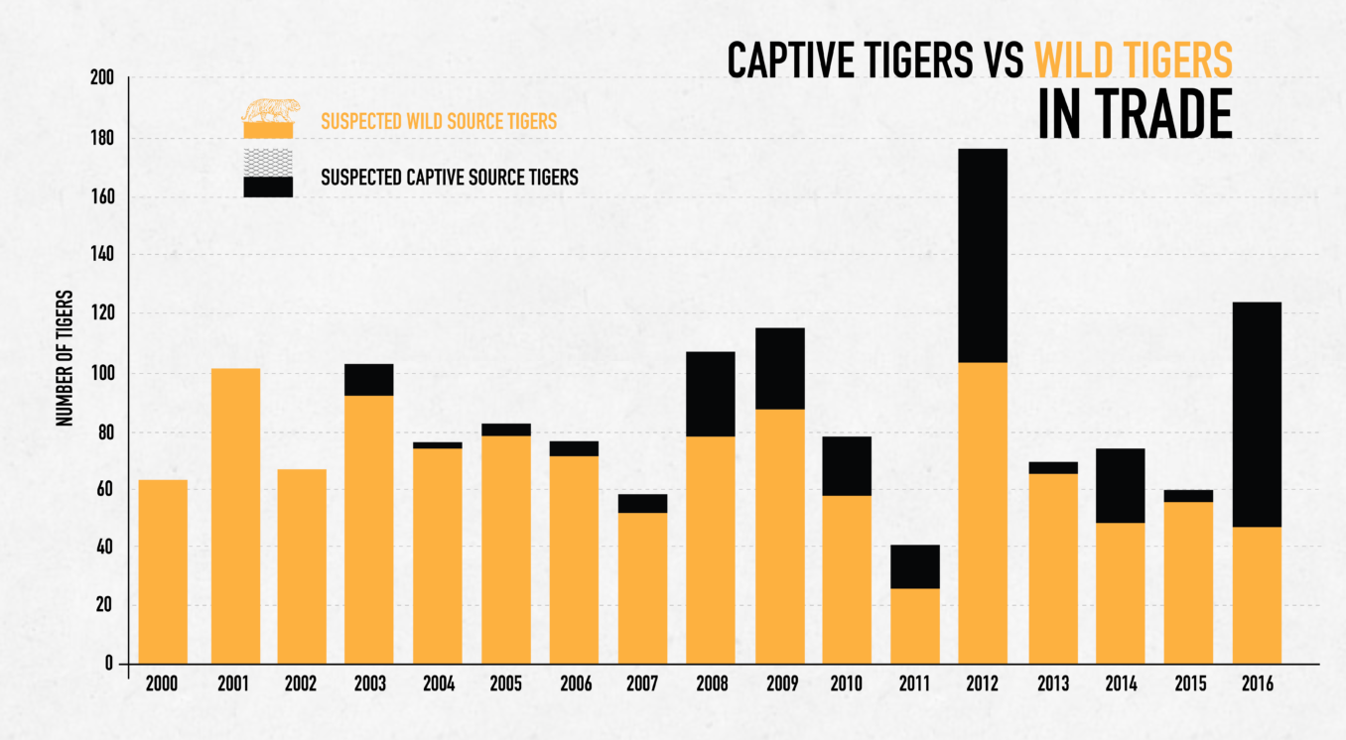

Slide 13
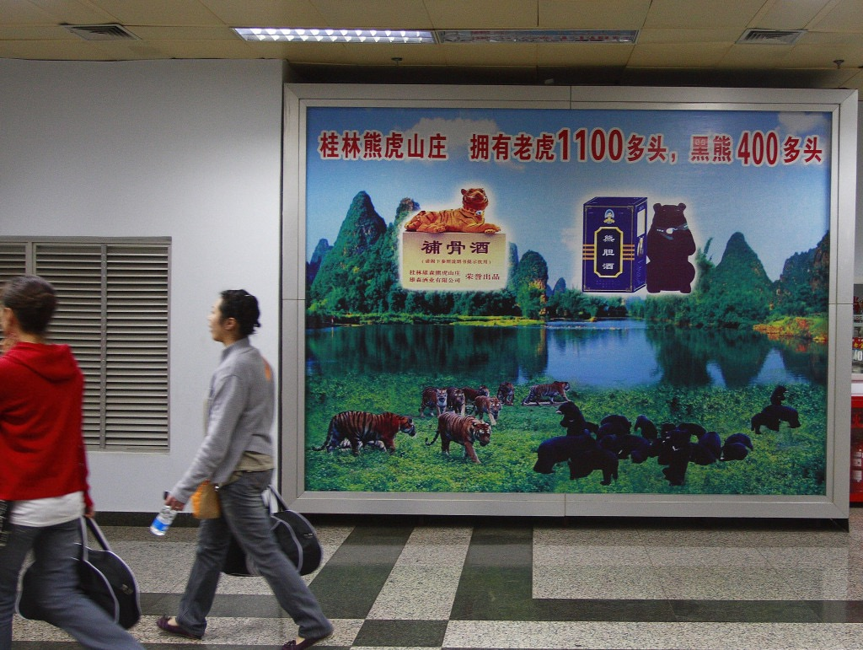

Slide 14
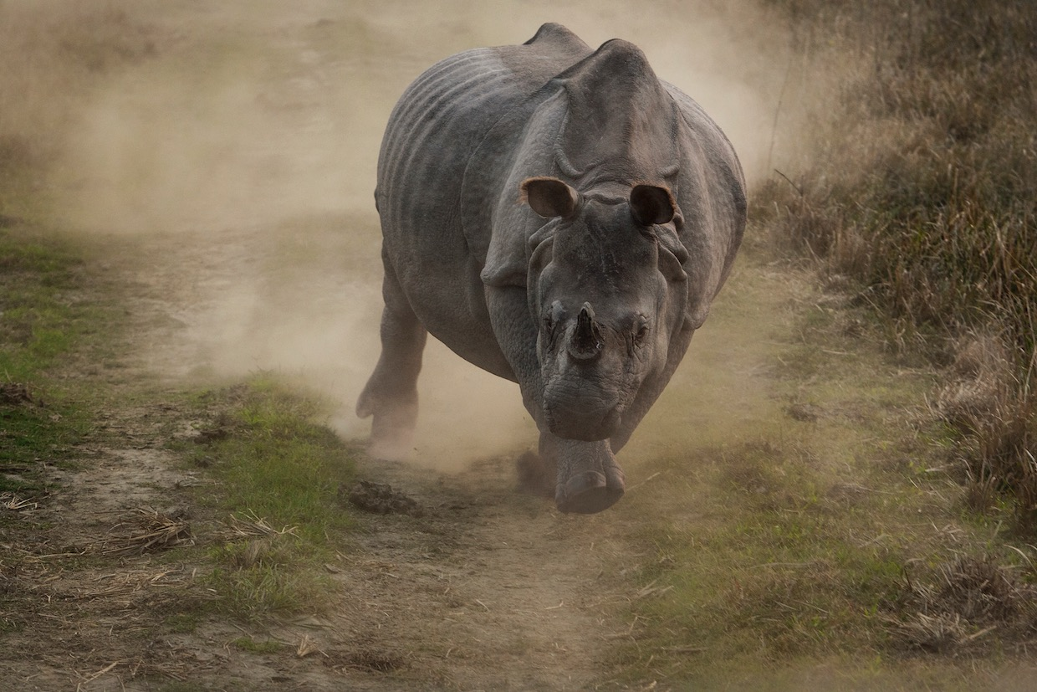

Slide 15
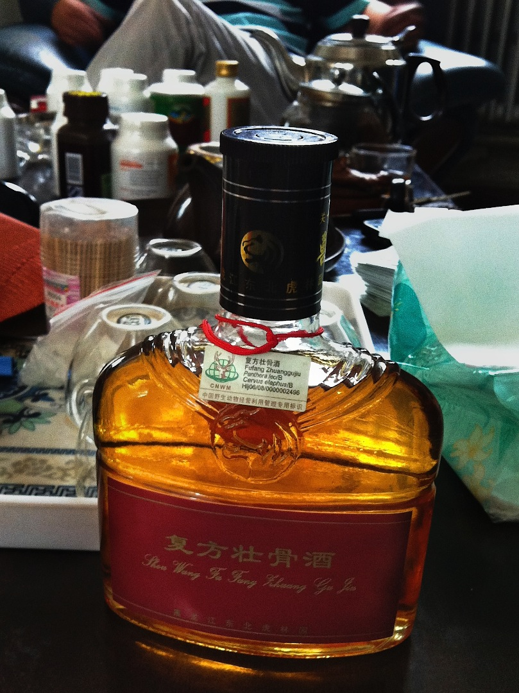
“Wealth is replacing health as a primary form of consumer motivation.”
~From a 2014 report prepared for the CITES Secretariat
Tiger bone wine

Slide 16
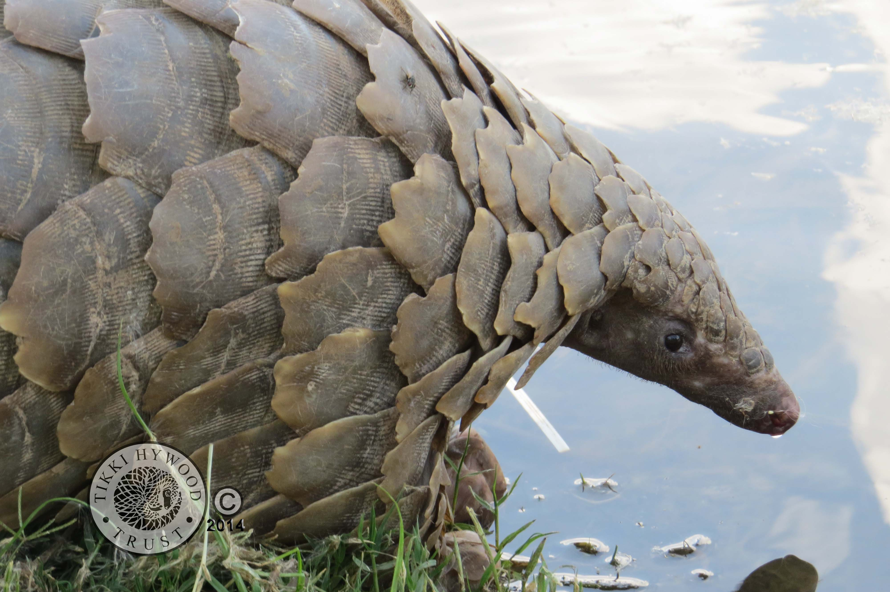

Slide 17
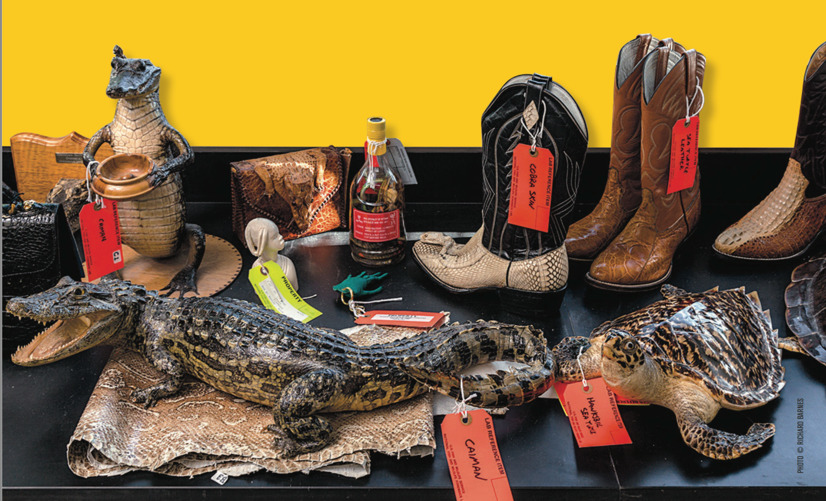

Slide 18
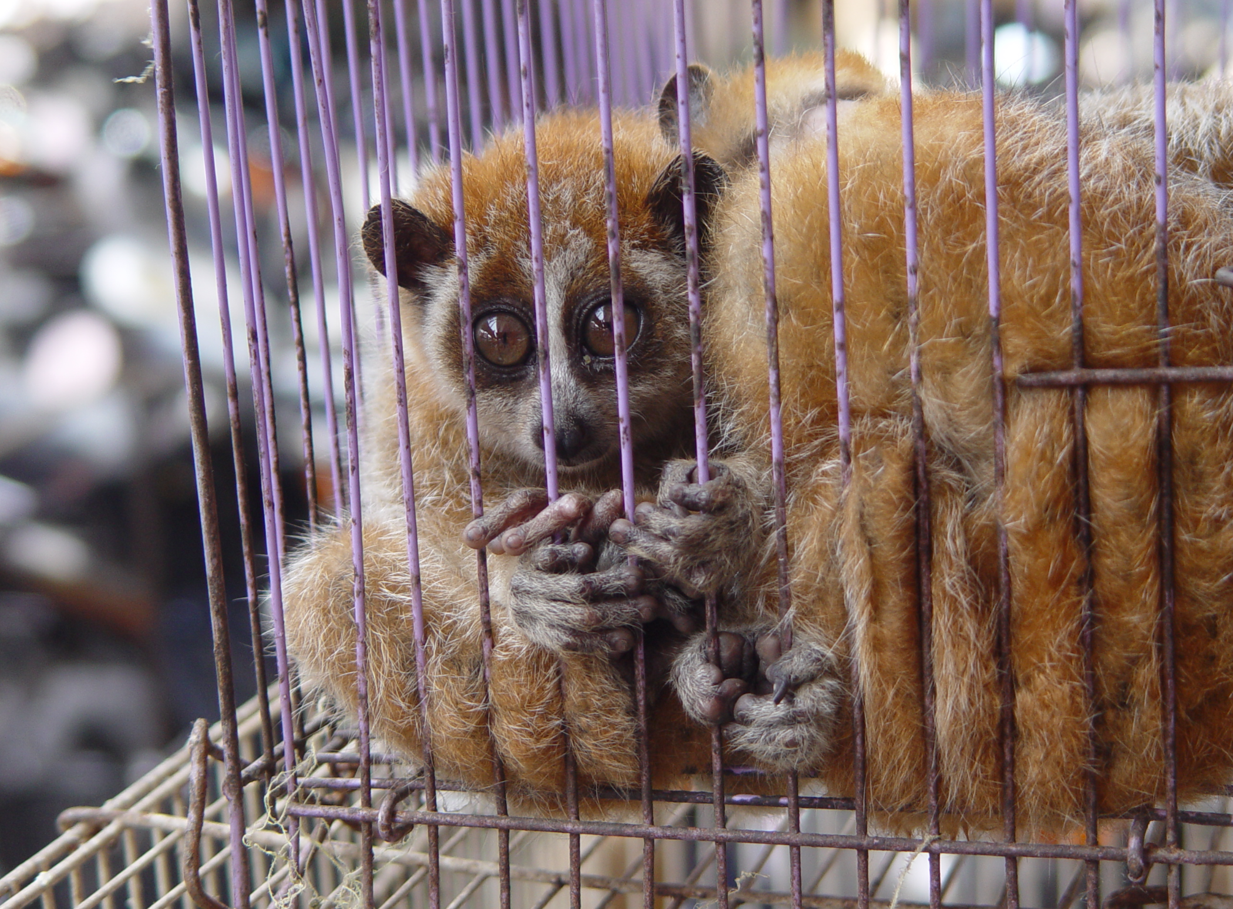
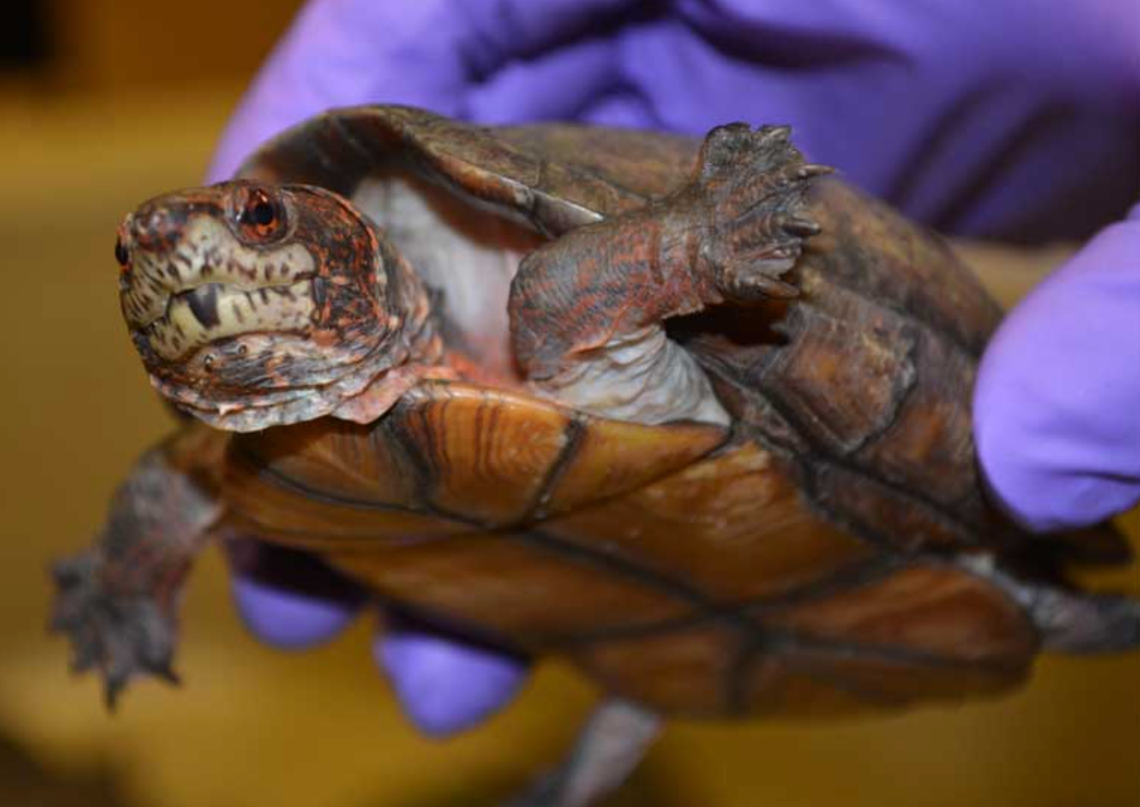
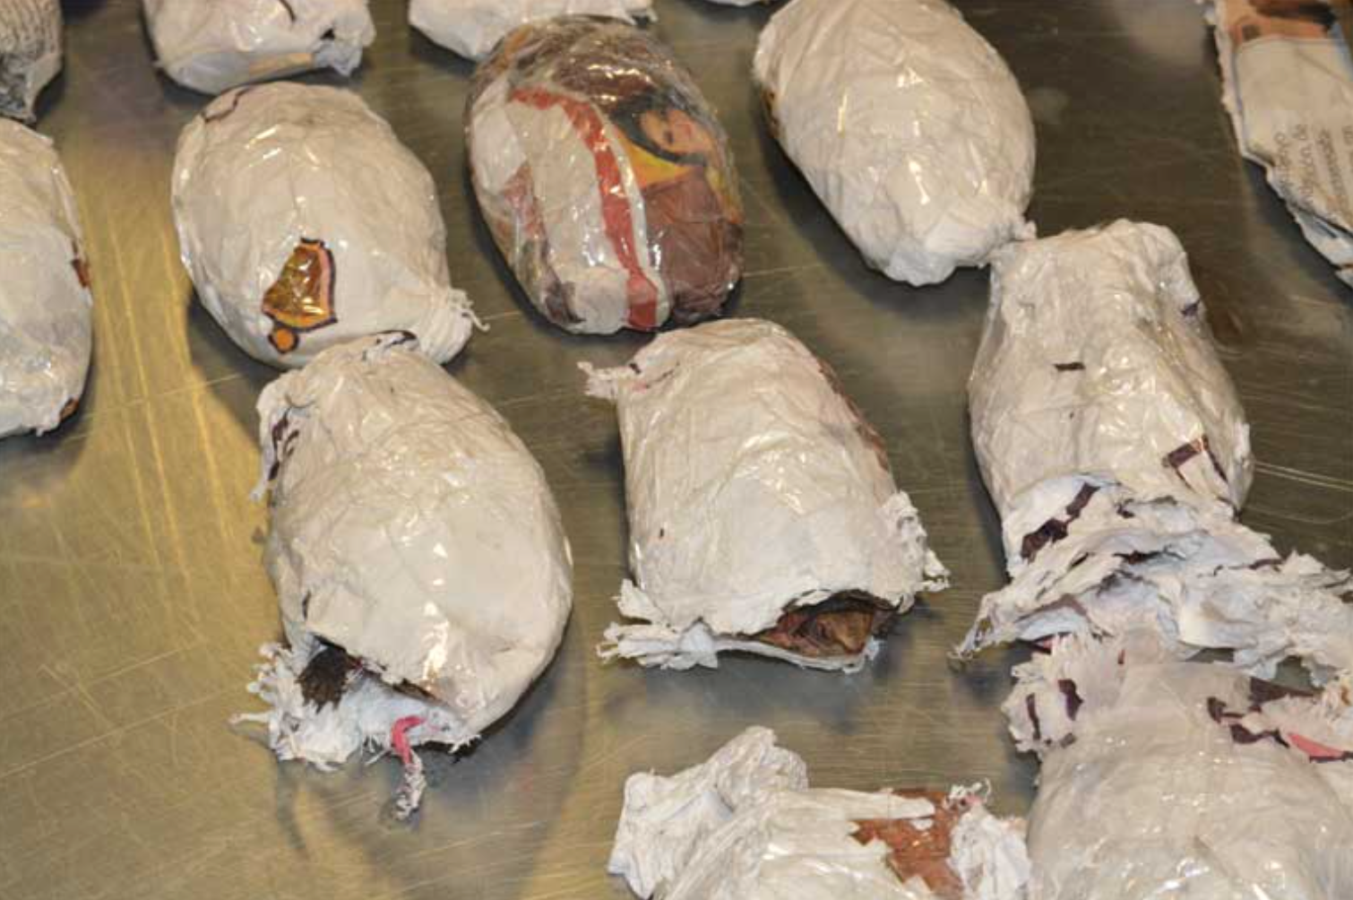
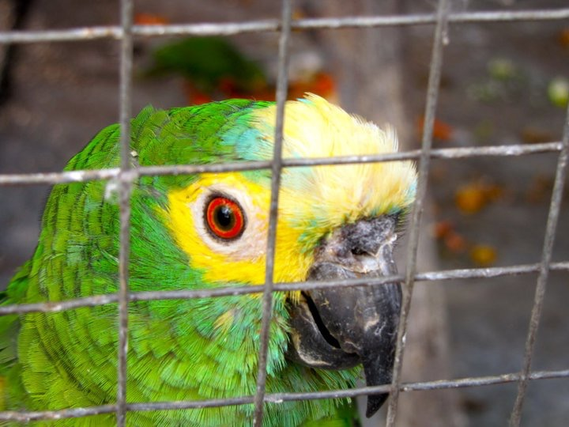

Slide 20
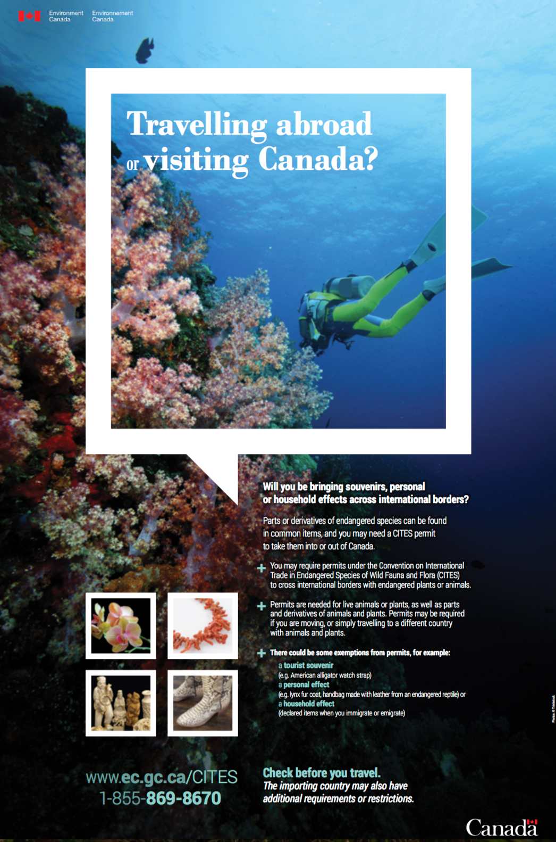

Slide 22
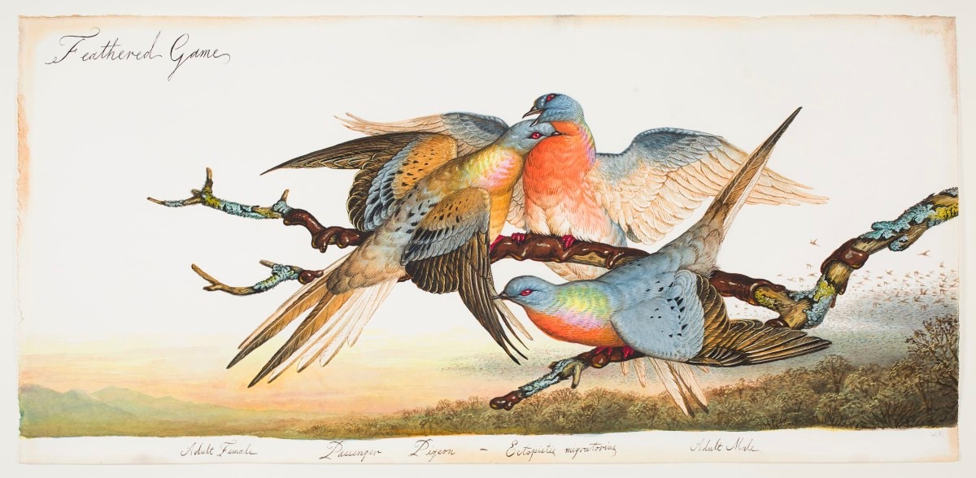

Slide 24
~Appendix I includes species threatened with extinction. Trade in specimens of these species is permitted only in exceptional circumstances.
~Appendix II includes species not necessarily threatened with extinction, but in which trade must be controlled in order to avoid utilization incompatible with their survival.
~Appendix III contains species that are protected in at least one country, which has asked other CITES Parties for assistance in controlling the trade.

Slide 25
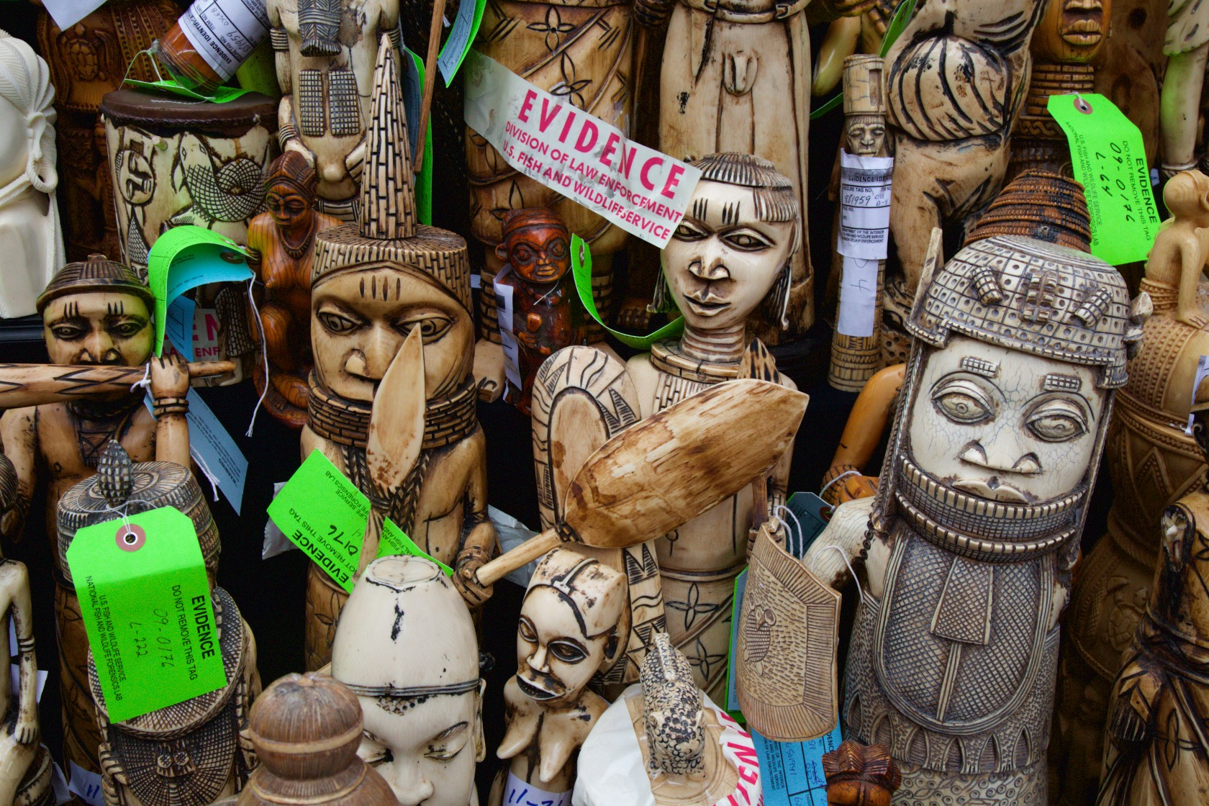
Ivory confiscated by the U.S. Fish and Wildlife Service

Slide 26
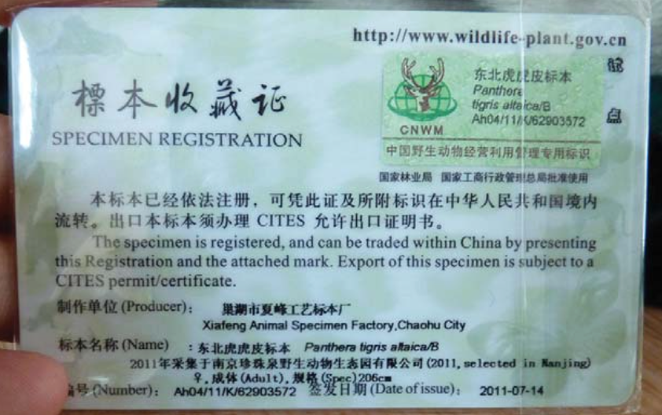
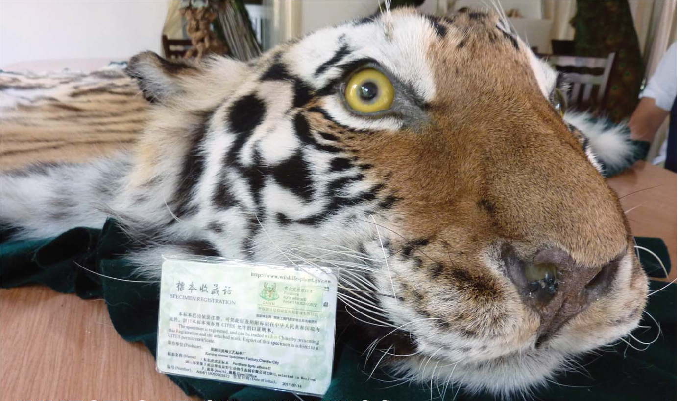

Slide 27
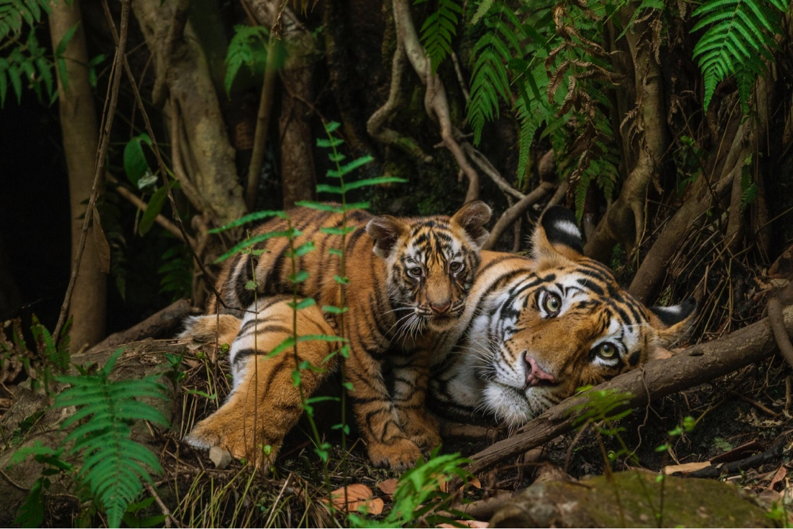
Image copyrights: Steve Winter / National Geographic, Brian Skerry / National Geographic, Sharon Guynup, Judy Mills, The Tikki Hywood Trust, Greg Allikas, Liz Bennett / WCS, Richard Barnes, The Save the Tiger Fund, The U.S. Fish and Wildlife Service, Defenders of Wildlife, and The Environmental Investigation Agency.

