Slide 1
The Rise of Patient Capital: The Political Economy of Chinese Finance in Latin America
Wilson Center Presentation
Prepared by
Professor Stephen B. Kaplan
George Washington University
June 14, 2018

Slide 2
China, an Emerging Global Creditor

Slide 3
Policy Banks Loan Helped Fuel Latin American FDI and Trade

Slide 4
How Does China’s Patient Capital Compare to Market-Based Credit?
Long maturity structure
  Similar to other bilateral lenders, but China is unique in its scale.
  Average maturity of Chinese loans is 17 years, compared to only 5 years for private creditors.
  Reflects infrastructure-oriented nature of global financing.
High risk tolerance
  Chinese policy bank investors are more likely to stay with their investment through good times and bad.
  Gaining cheap assets, market share, or improving key logistical skills such as marketing, distribution, and local engineering capabilities are key to promoting internationalization of Chinese firms.
  Compared to Western finance’s emphasis on profitable projects, policy banks are charged with catalyzing finance in “strategic credit spaces,” to create economic activity in risky environments.
    Risk appetite is not limitless, however, as policy banks have become awash in risk in places like Venezuela and Pakistan.

Slide 5
Patient Capital’s Characteristics
Non-Conditional Lending
  Unlike Western stringent policy conditionality:
    Chinese investors tend not to impose onerous policy conditions.
    Official doctrine of non-intervention in domestic affairs.
      Five Principles of Peaceful Coexistence.
    Financing is instead secured through loans collateralized by:
      Future commodity deliveries.
      Guaranteed contracts with Chinese firms or contractors.
      Commitments to buy Chinese machinery.

Slide 6
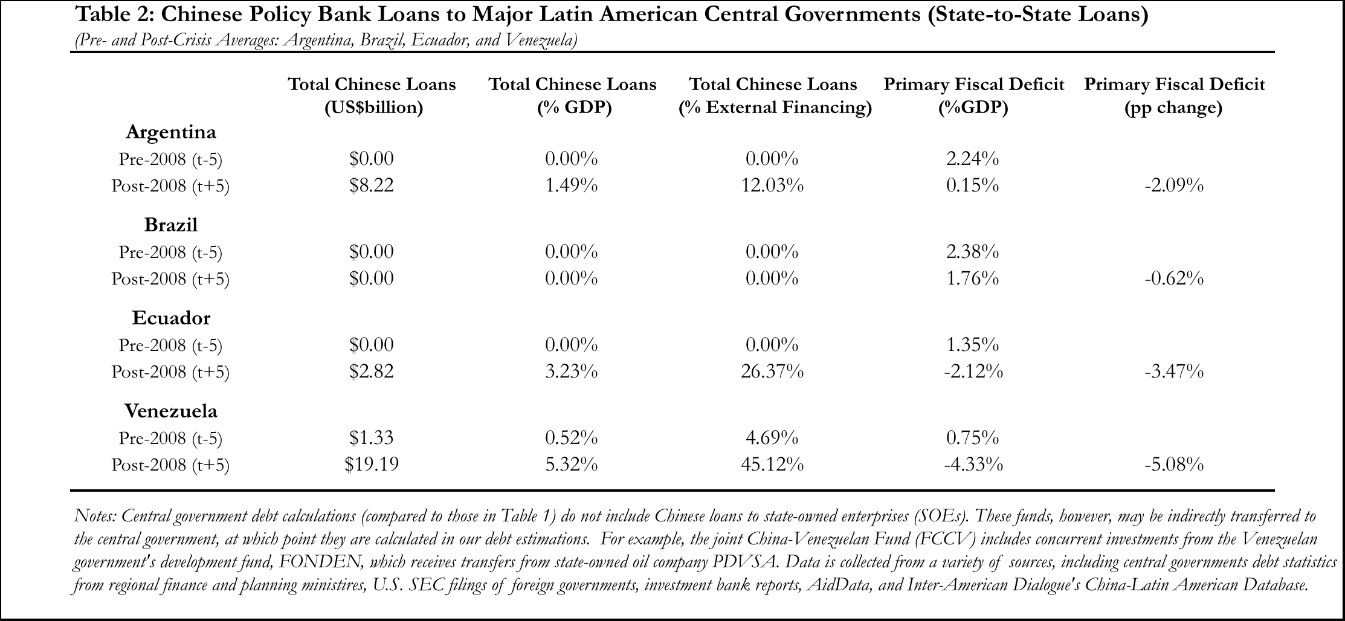
Chinese Growing Share of
Latin America’s External Financing

Slide 7
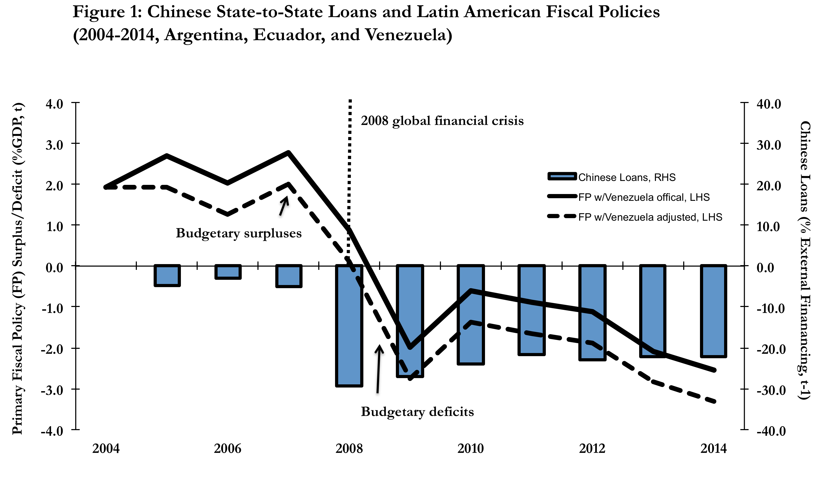
Patient Capital Enhances Policy Flexibility

Slide 10
Latin America’s Debtor Perspective
Benefits
  Long-term financing better aligns with region’s development horizon.
  Addresses the region’s infrastructure deficit. Investment was a mere 0.6 percent of GDP in the 2000s compared to 3 percent rates in the 1980s.
    Chinese policy banks have primarily targeted the energy sector; the onus is on Latin America to identify railway, highway, port, and airport projects.
Costs
  Commercial conditionality – loans are tied to Chinese firms, products, and machinery.
    Latin America must negotiate to increase its share of local content.
  Middle income trap – industrial upgrading is a key feature of China’s LA development plan, but only 1/10th of Chinese FDI has been destined for LA manufacturing sector; 2/3 of the investment has gone to Brazil.
    How does LA compete when its labor costs are higher than Africa and S.E. Asia?

Slide 11
Latin America’s Debtor Perspective
Costs
  Indebtedness: lack of policy conditionality creates a moral hazard problem.
    Venezuela - After receiving China’s state-to-state financing for more than a decade, Venezuela avoided the austerity that would have typically come with first the global financial crisis, and then the 2014 commodity downturn.
    The country is now struggling to repay its outstanding Chinese debts (totaling $17-$20 billion) amid its historic crisis and dwindling state-oil production (nearing 1 million barrels per day; less than half of 2013 output).
    Current sanctions impeding creditors from refinancing Venezuela’s debt, the government lacks new financing options.
      This means it’s unlikely that Venezuela will be able to pay more than $10 billion in foreign debt obligations coming due this year — equivalent to the country’s reserves.
    China has renegotiated terms of old loans, but refused to be a lender of last resort; it has not extended any new funds to Venezuela since 2016.
      Policy banks might need their balance sheet reserves to help address domestic financial pressures back home.

Slide 12
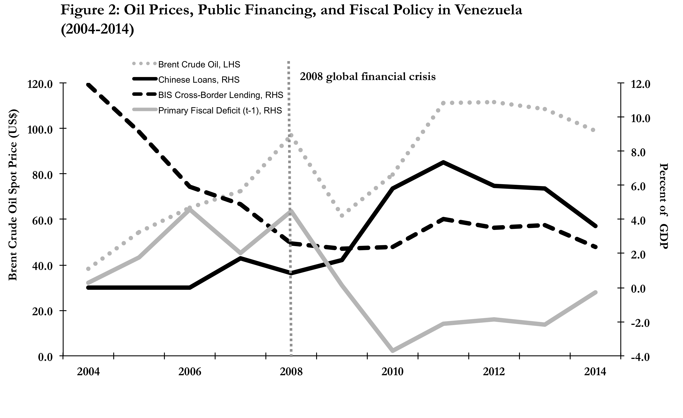
Venezuela’s Financing Shift and Fiscal Policy

Slide 13
China’s Creditor Perspective
How ensure prudent governance that leads to successful investments, given non-intervention principle?
  Administrative guidance, monitoring, and state-to-state diplomacy aimed at ensuring success on commercial project level.
Sustained expansion of government debt in heavy industry and infrastructure yielded high growth, but also non-performing loans.
  Compared to low yielding U.S. Treasury investments, investing in project finance globally has a higher return. From a portfolio perspective, China can absorb some bad loans.
  But, it’s easier to administratively control local governments domestically, than national governments internationally.
  What does China do when it misprices investment risk repeatedly in places like Venezuela, Indonesia, and Sri Lanka?

Slide 14
China’s Diversified Strategy
China is also altering its investment channel to have more of a market-governance character in the wake of the 2014 commodity downturn.
  China is increasingly using equity rather than debt financing.
  Diversifying exposure away from sovereign government to firm level.
  State-backed equity funds now directly invest in manufacturing, logistics, agriculture, and even technology.
    $50 billion in Latin America funds; $55 billion in Silk Road Fund.
Moving toward multilateralism.
  Acquiring new investment partners, including Chinese commercial banks, multilateral institutions (i.e. World Bank,IDB), and local development banks to share investment burden.
  Asian Infrastructure Investment Bank (AIIB), operating with private procurement through international bidding.
    70% of projects jointly financed with World Bank.

Slide 15
China’s Diversified Strategy
The private sector is accounting for a larger share of FDI to Latin America.

Slide 16
China’s Diversified Strategy
Chinese loans are commercial, more than geopolitical in Latin America.
  Three-quarters of Latin American policy bank loans have targeted energy sector, which has an electric generation capacity that’s better than Emerging Asia or Africa.
  80 percent of policy bank loans during the past two years went to centrist / center-right governments in Argentina, Brazil, and Peru. These are also not autocracies!
  Growing presence of Chinese commercial banks in Latin America.
Growing role of Western sovereign risk metrics.
  Sovereign risk analysis increasingly in places like Sinosure are using Western tools to evaluate sovereign risk.
  Increasingly China is investing in market-oriented economies like Brazil, Colombia, Chile, Argentina, Mexico, and Peru.

Slide 17

    "The old saying holds. Owe your banker one thousand pounds and you are at his mercy; owe him 1 million pounds and the position is reversed.”
    -John Maynard Keynes

Slide 20
A Multi-Method Research Design
A large-N empirical investigation (preliminary results) of the relationship between Chinese state-to-state financing and fiscal policy.
  17 Latin American countries.
  1990-2015.
  Testing the international and domestic dimensions.
  Wide variation in exposure to Chinese bilateral financing.

Slide 21
Comparative Case Study Evidence
Case Selection
Countries: Argentina, Brazil, Ecuador Venezuela.
Similar along economic and political indicators
  Presidential, high middle income South American countries.
  Mixed-market economies
    WSJ/Heritage Foundation’s Index of Economic Freedom.
    World Bank’s Doing Business Survey.
Maximize main independent variable of interest:
  Domestic investment channel for Chinese lending.
  Central government vs. corporate entities (including SOEs).

Slide 22

China’s Strategy as an Emerging Creditor
What’s China’s motivation? Why invest abroad?
IR Grand Strategy Perspective
  Using China Development Bank (CDB) and China Exim Bank as tools to achieve strategic international goals.
    Improves China’s access to commodities, raw materials, and energy supplies.
    Expand global influence and soft power through development finance; South-to-South cooperation; empowering developing countries.

Slide 23
China’s Strategy as an Emerging Creditor
The IPE Perspective
  Using China Development Bank (CDB) and China Exim Bank as tools to achieve strategic national economic goals.
    Replaces ‘undervalued currency’ as main tool of export promotion.
      Secure new export markets to replace those lost to the U.S. recession.
    Internationalization of firms with Go Global Strategy.
      Promote Chinese firms with international lending and investment.
      Extend web of regional Chinese contractors, suppliers, and workers.
      Firms gain valuable overseas experience in marketing, distribution, logistics, and local engineering capabilities.
      Internationalization of the renminbi through commercial transactions.

Slide 24
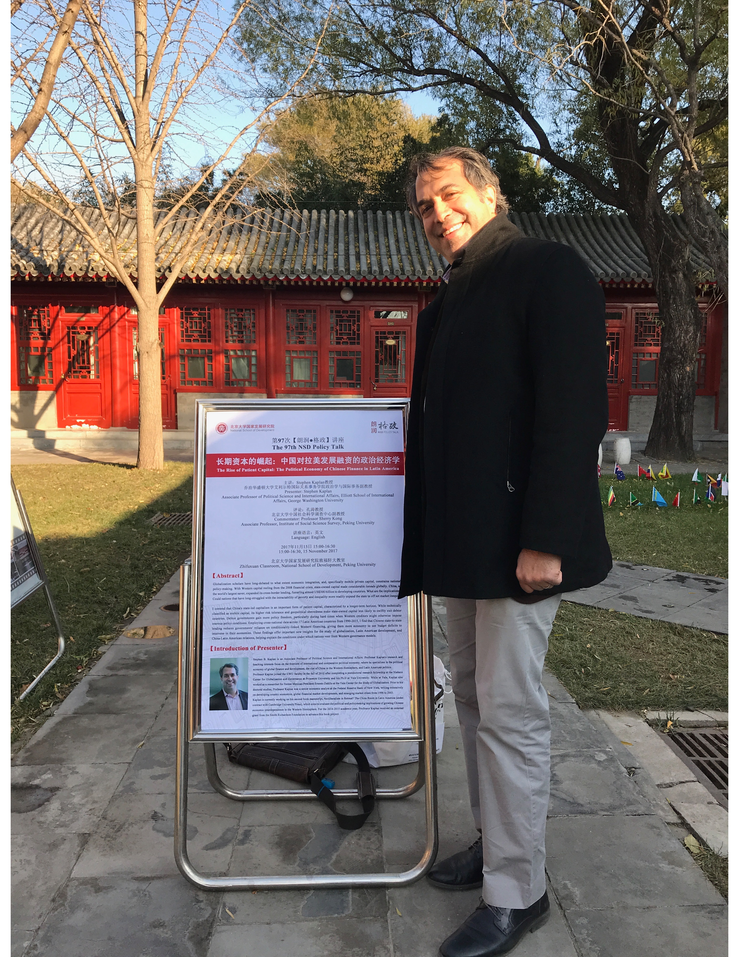
Recent field research trip to China
Interviews
  Scholars, practitioners, and officials from think tanks, government ministries, policy banks, government insurance agencies, and sovereign investment funds.
Bottom Line: Foreign Economic Policy:
  Importance of domestic goals.
    Reducing income inequality.
      Cross-border infrastructure spending and trade zones aimed at boosting economic activity and domestic incomes in the poorer Western provinces.
    Alleviating domestic overcapacity.
      Debt-fueled state-led credit expansion has supported growth, but also created massive overcapacity in several sectors (i.e. cement, aluminum, steel, shipbuilding, power generation, solar panels, wind turbines, construction machinery, textiles, and heavy engineering).

Slide 25
China’s Economic Philosophy
Internationalize Domestic Development
  New structural economics - Infrastructure investment-led development.
    Improved infrastructure unleashes economic bottlenecks, allowing countries to better use key economic endowments.
    Creates productivity gains, growth, and ultimately more demand for Chinese goods and services.
    Roots in Western mainstream economics, but advocates for a larger government role beyond enabling market conditions or correcting market failures.
      Industrial policy – governments help innovation by providing market intelligence, technological transfer, equipment subsides, credit, and basic infrastructure.
      Infrastructure investment – rather than simply facilitating economic activity, infrastructure is an economic input independently capable of driving growth and productivity.

Slide 26
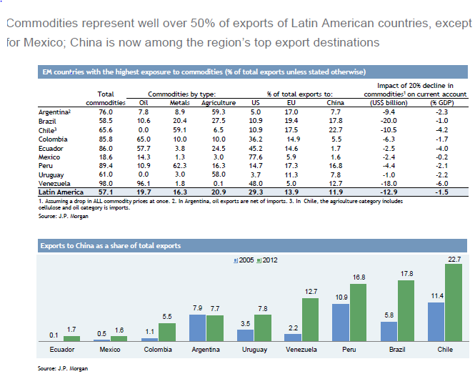
The Risks: Renewed Latin American Dependency

Slide 27
The Venezuelan Crisis:
The Economic Perspective
The Worst Economic Recession in Venezuela’s History
  GDP: shank by 26.4 percent between 2014-2017, and another 12 percent in 2017.
    Sharper contraction than the Great Depression in the US.
  Inflation: 254 percent in 2016; 652 percent in 2017, which was officially hyperinflation. 2018 forecast to surpass 1,000%.
  Foreign exchange reserves: Less than $10 billion.
  95 percent of hard currency comes from oil exports.
    But production has fallen by 17 percent between 2013-2017.

Slide 28
The Venezuelan Crisis:
The Economic Perspective
Oil production is at a 28-year low.
    1.6 million per day capacity, down 20 percent from last year.
    Below Venezuela’s OPEC target of 1.972 million per day.
    World’s largest oil reserves at 300 billion barrels, larger than Saudi Arabian reserves.
      But, to extract reserves, you would need $8 billion dollars of investments to yield 200,000 more barrels per day (Monaldi 2018).
How solve problem of lack of dollar revenues?
    Venezuela has been squeezing imports, one of the factors behind all of the country’s shortages.
    Now, the country doesn’t even have enough dollars to pay its foreign debt.

Slide 29
The Venezuelan Crisis:
The Economic Perspective
Venezuela’s debt crisis is worsening
  $9 billion due in debt payments in 2018.
    Venezuela $1.7 billion behind in its sovereign debt payments.
    Moody’s downgraded Venezuelan debt on Friday two notches to C, its default rating meaning that there is little prospect for recovery of principal and interest.
    Next government debt payment, August 2018, $1.05 billion.
US sanctions (executive order 13808) making debt renegotiation difficult, if not impossible.
    Prohibits any US entity or person from purchasing or dealing with new debt issued by Venezuela with maturities greater than 30 days.
China has refused to be a lender of last resort; it has not extended any new funds to Venezuela since 2016.

