Slide 1
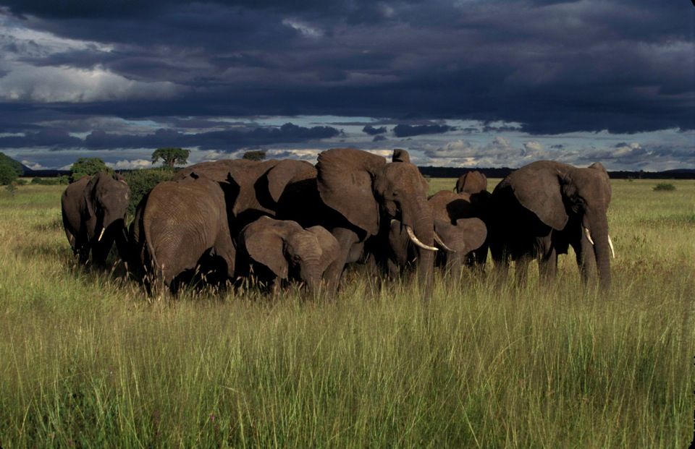


Closing Elephant-Sized Loopholes in the Illegal Wildlife Trade:
CITES CoP17 and the Path Forward
Woodrow Wilson Center
Washington, DC
May 25, 2016
Dr. Susan Lieberman
Vice-President, International Policy
Wildlife Conservation Society

Slide 2

CITES meetings of the
Conference of the Parties
CoP1 1976 Bern, Switzerland
CoP2 1979 San Jose, Costa Rica
CoP3 1981 New Delhi, India
CoP4 1983 Gaborone, Botswana
CoP5 1985 Buenos Aires, Argentina
CoP6 1987 Ottawa, Canada
CoP7 1989 Lausanne, Switzerland
CoP8 1992 Kyoto, Japan
CoP9 1994 Fort Lauderdale, USA
CoP10 1997 Harare, Zimbabwe
CoP11 2000 Gigiri (Nairobi), Kenya
CoP12 2002 Santiago, Chile
CoP13 2004 Bangkok, Thailand
CoP14 2007 The Hague, The Netherlands
CoP15 2010 Doha, Qatar
CoP16 2013 Bangkok, Thailand
CoP17 2016 Johannesburg, South Africa
₂

Slide 3

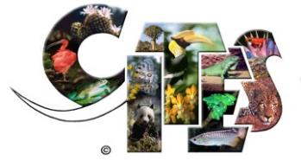
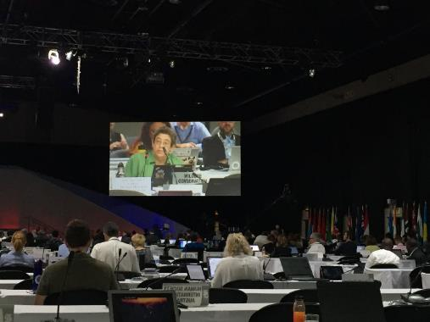
183 Parties, 152 attended
More than 3,500 attendees: Parties, IGOs, NGOs, media
62 “species proposals”—amending the Appendices
90 agenda items, >160 documents
>75 Decisions & Resolutions adopted
Many dealt with illegal wildlife trade/trafficking issues

Slide 4

CITES CoP17
Deadline for submission was 27 April
62 Species proposals
Many for species subject to significant illegal trade
47 fauna, 13 flora
15 mammals, 4 birds, 15 reptiles, 5 amphibians, 6 fish
Adoption: consensus or 2/3 majority
Implementation/enforcement issues
>170 documents, submissions, draft resolutions
4

Slide 5
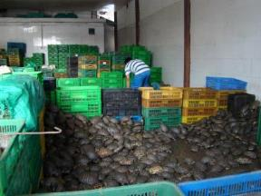
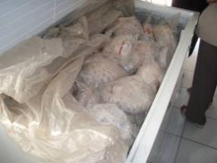
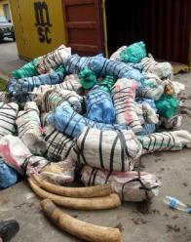
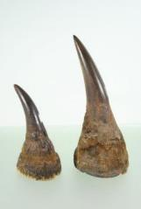
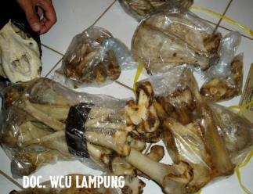
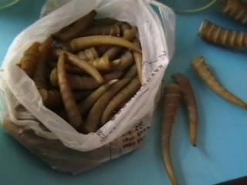
What is happening?
Poaching and trafficking in highly valuable body parts is:
increasingly run by organized criminal syndicates;
driven by high prices, particularly in East Asia; and
facilitated by weak governance and low capacity all along the trade chain, from source to market.

Slide 6
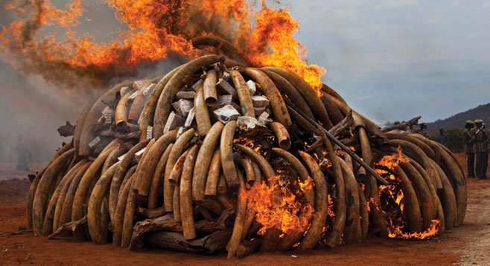
Wildlife Crime—needs to be seen as Serious Crime

Slide 7
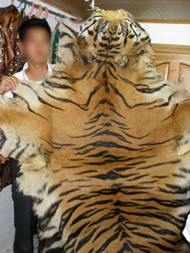
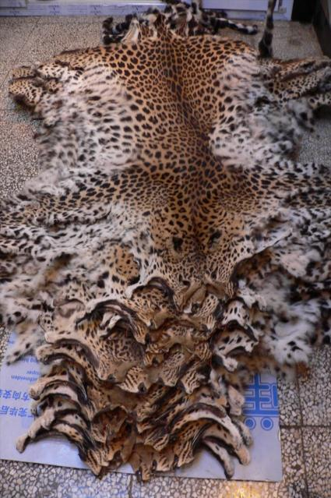
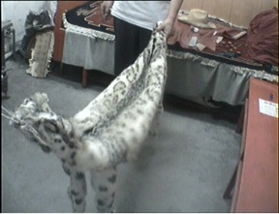
Since 2000, seizure records indicate that at least 5,700 Asian big cats have been traded illegally for skin, bones, other body parts and “farming”. Organized criminal networks in Asia are engaged in multi-species trade – wildlife and timber

Slide 8
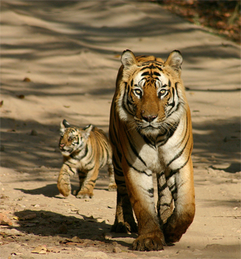
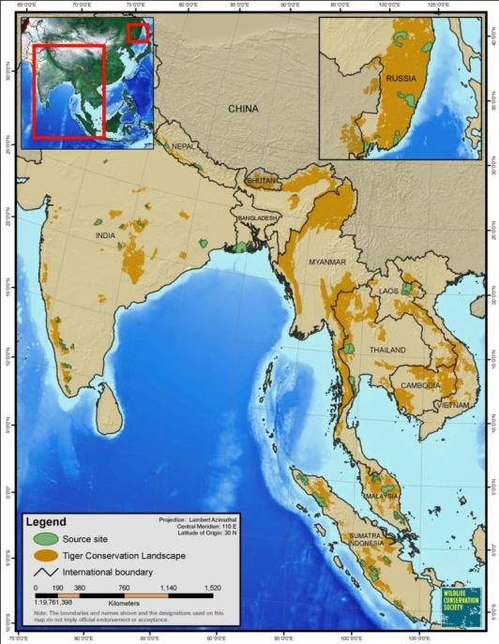
Across their entire range, from Sumatra to Siberia, only about 3,200 wild tigers remain – with only about 1,000 breeding females.
This isn’t due to loss of habitat:
70% of wild tigers are found in just 6% of their remaining habitat.

Slide 9
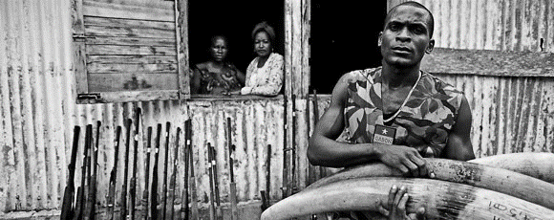
It Erodes National Security and the Rule of Law
Low Risk and High Reward
Weak deterrents and national legislation, poor prosecution rates
Increasing involvement of organised criminal groups
Linked to other illegal activities: drugs, weapons trade, human trafficking; funding armed militias

Slide 10
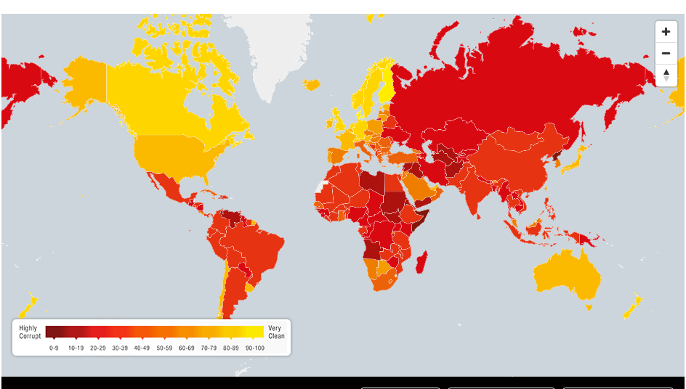

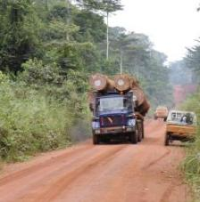
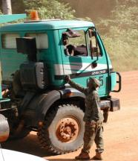

Along the entire trade chain, corruption is pervasive.
Transparency International: Corruption Perceptions Index 2015
Source: www.transparency.org/cpi

Slide 11
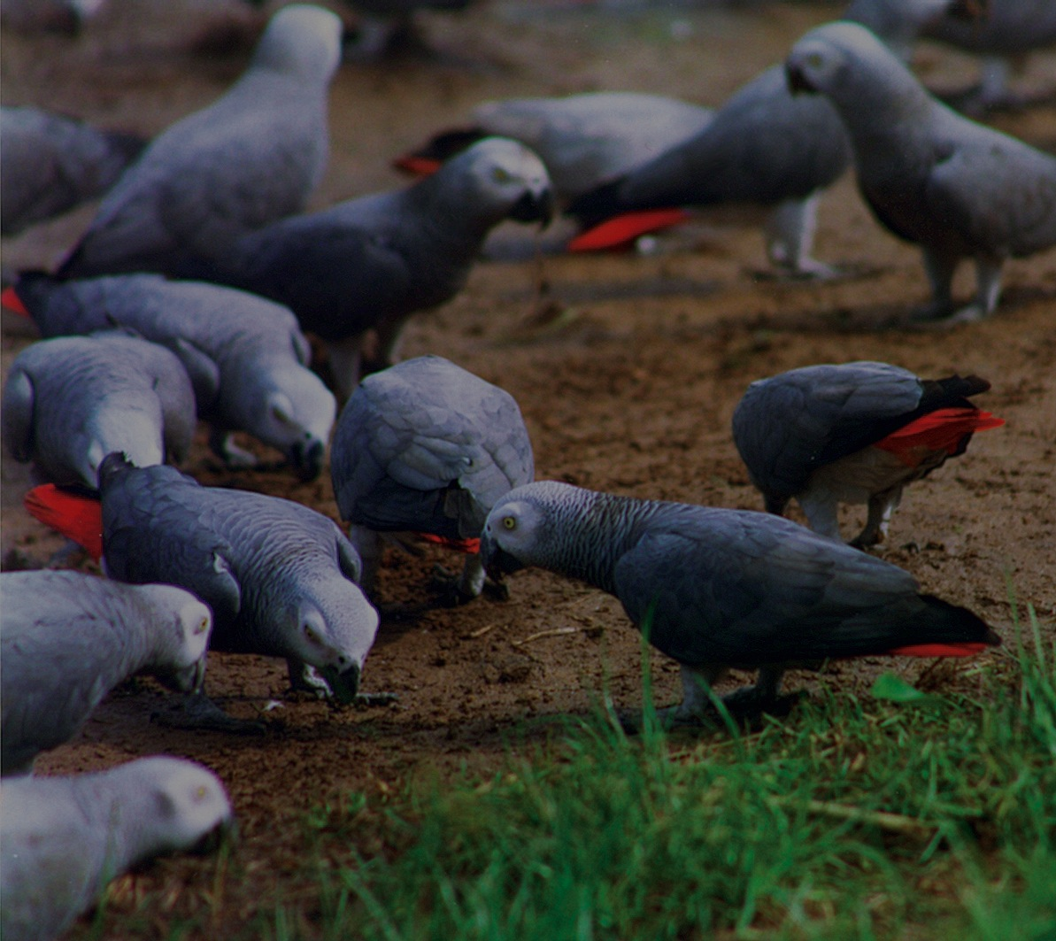

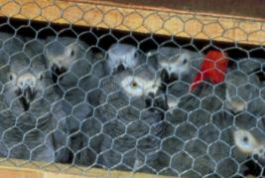
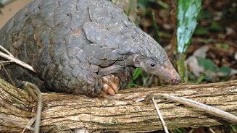
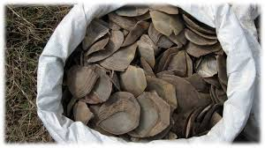
CITES CoP17
Some of the species proposals that related to IWT
Pangolins (African and Asian) from II to I (adopted)
African grey parrot: from II to I (adopted)
Lake Titicaca water frog to I (adopted)
African elephant—reopen commercial ivory trade: Namibia & Zimbabwe (rejected)
Southern white rhino—allow commercial horn trade: Swaziland (rejected)
11

Slide 12
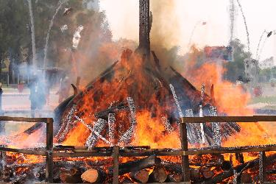
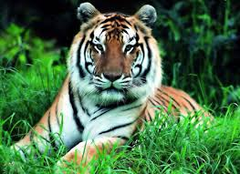
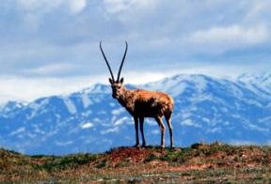
Implementation issues, focus on illegal trade
Elephants, ivory trade
National Ivory Action Plans
Ivory stockpile management
Closure of domestic ivory markets
Decision-making mechanism for re-opening ivory trade
Totoaba & vaquita
Tigers & other Asian Big Cats
Cheetahs
Helmeted hornbill
Tortoises & freshwater turtles; Ploughshare, Madagascar
Rhinoceroses, horn trade
Demand Reduction
Corruption
Other
12

Slide 13
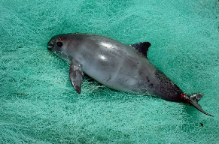
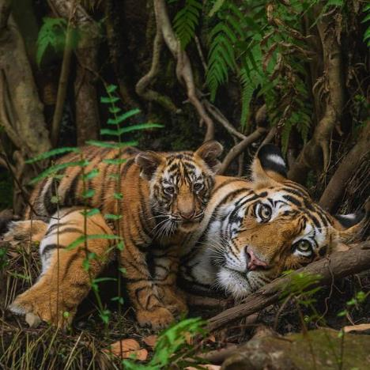
Species-specific implementation issues,
focus on illegal trade
Totoaba & vaquita
Enforcement enhancement, cooperation
Mexico, US, China
Tigers & other Asian Big Cats
Tiger farms (China, Lao, others)
Enforcement, legislation
13

Slide 14
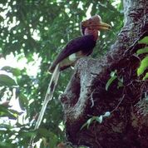
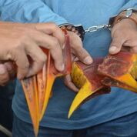
Species-specific implementation issues,
focus on illegal trade
Cheetahs
Live trade from Africa to Gulf
Helmeted hornbill
Enhanced enforcement, collaboration, attention, reporting
Indonesia, Malaysia, Brunei, Thailand, Singapore; China
14

Slide 15
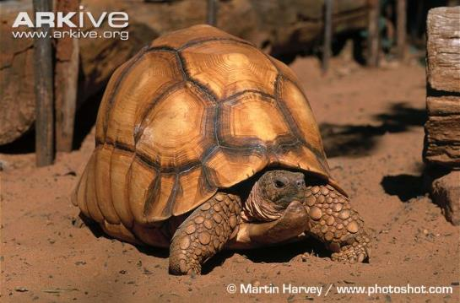
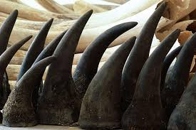
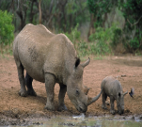
Species-specific implementation issues & IWT: cont.
Tortoises & freshwater turtles
Ploughshare tortoise, Madagascar
Enforcement, Task Force
Rhinoceroses, Horn trade
Vietnam, Mozambique, others
15

Slide 16
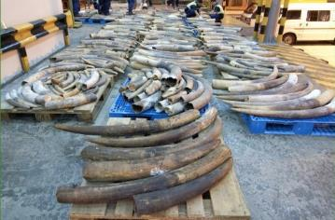
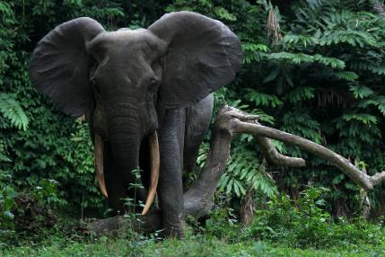
Species-specific implementation issues & IWT: cont.
Elephants, ivory trade
Closure of domestic ivory markets
National Ivory Action Plans
Ivory stockpile management
Decision-making mechanism for re-opening ivory trade
16

Slide 17

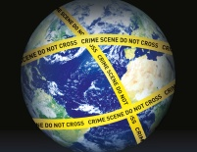


Broad Implementation issues & illegal trade
Demand Reduction
Corruption
UNCOC, UNTOC
Standing Committee
Other
Enforcement collaboration, communication, ICCWC, UNTOC, wildlife crime as serious crime
Combating wildlife cybercrime
False claims of “bred in captivity”
Disposal of confiscated specimens
Illegal wildlife trade in W and Central Africa
17

Slide 18
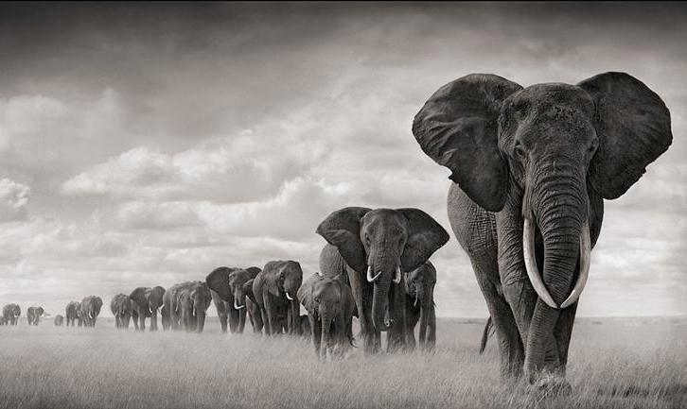

Thank
You
Images in this presentation can only be used with prior authorization—please contact the presenter with your request
slieberman@wcs.org

