Slide 1
U.S.-CHINA Water Forum
中美水环境政策研讨会
中国流域水环境治理PPP案例分析
Case Study of PPP Practice
On Watershed Management in China
中国水环境集团
China Water Environment Group
2015.11.17

Slide 2
1
PPP在中国
的推进情况
PPP in China

Slide 3
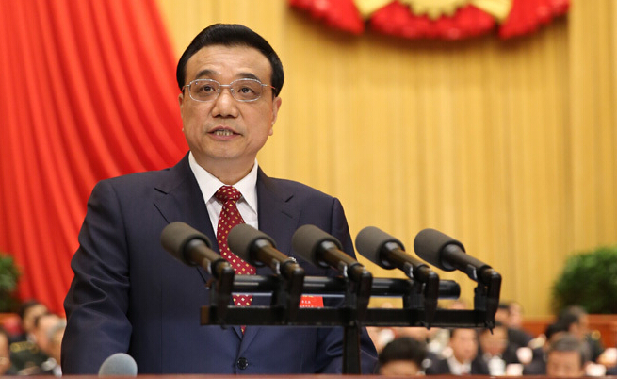
PPP在中国的推进情况 PPP in China
2000年后，中国已在污水处理厂等单个市政工程项目实施PPP模式
PPP has been used in sewage treatment plants since 2000 in China
2013年11月12日，党的十八届三中全会通过《中共中央关于全面深化
改革若干重大问题的决定》，允许社会资本通过特许经营等方式参与
城市基础设施投资和运营。
Social capital is allowed to participate in urban infrastructure investment and operations through the franchise. (Nov.12th, 2013)
PPP是提升国家治理能力的一次变革
PPP is a reform to enhance governance capacity
市场在资源配置中起决定性作用
Market plays a decisive role in the resource allocation
拓宽城镇化建设融资渠道
Broaden the financing channels of urban construction
政府转变观念，重监管和购买服务
Government changes idea, and pays more attention to supervision and purchase service
Li Keqiang, Premier of China's State Council
深化财税体制改革
Deepen fiscal and taxation system reform
Notes:
"Decision of the Central Committee of the Communist Party of China on Some Major Issues Concerning Comprehensively Deepening the Reform."

Slide 4
PPP在中国的推进情况 PPP in China
财政部PPP国家示范 PPP Demonstration Projects
2014年，第一批示范项目共30个，总投资1800亿元，涉水项目14个。
30 demonstration projects, total investment is 180 billion RMB, in which 14 projects are water affairs (2014)
2015年，第二批示范项目共206个，总投资6589亿元，涉水项目50个。
206 demonstration projects, total investment is 658.9 billion RMB, in which 50 projects are water affairs (2015)
经统计，2013年末至今共30个省份启动了PPP试点，推出2000多个招商项目，总投资约4万亿元。
30 provinces started over 2000 PPP projects with total investment of 4 trillion from the end of 2013 up to now
2015年4月16日国务院发布《水污染防治行动计划》(“水十条”) ，以水环境质量改善为核心，预计可拉动1.9万亿的环保产业投资需求。
“Action Plan for Water Pollution Prevention” (Apr. 16th, 2015) is expected to stimulate 1.9 trillion RMB industry need of environmental protection

Slide 5
PPP在中国的推进情况 PPP in China
2010年至2014年，I-III类水体从64.1%提升至71.2%，总体水质明显好转
Water of Grade One to Grade Three increased from 64.1% to 71.2% from 2010 to 2014
River environment in China has improved markedly
IV类及以下水体仍占近30%，水环境治理仍面临严峻挑战和巨大市场机遇
Water of Grade Four and below were still account for nearly 30%, Water environmental management is still facing severe challenges and huge market opportunity
七大流域和浙闽片河流、西北诸河、西南诸河水质状况
Water quality of ten major rivers in China
数据来源：2010年和2014年中国环境状况公报
Data source: 2010 and 2014 China Environment Bulletin
Notes:
Ⅰ类水质断面占2.8%，同比上升1.0个百分点；Ⅱ类占36.9%，同比下降0.8个百分点；Ⅲ类占31.5%，同比下降0.7个百分点；Ⅳ类占15.0%，同比上
升0.5个百分点；Ⅴ类占4.8%，劣Ⅴ类占9.0%，同比均持平。

Slide 6
2
典型案例
Typical Cases

Slide 7
A
南明河水环境综合治理PPP项目 Nanming River PPP project
Video of Nanming river PPP project, 5 minutes

Slide 8
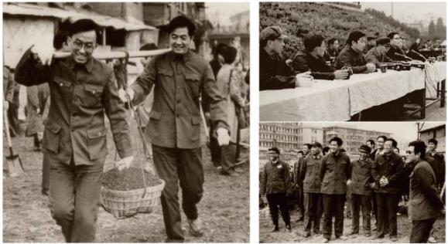
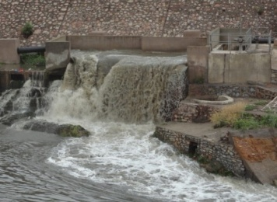
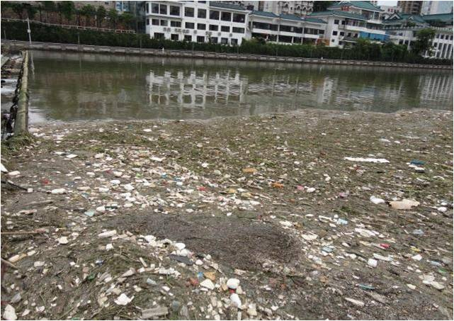
A
南明河水环境综合治理PPP项目 Nanming river PPP project
项目背景Background
南明河为长江流域乌江的支流，被誉为贵阳人民的“母亲河”。
The Nan Ming river is a tributary of Wujiang River in Yangtze river basin , and is known as the Mother River of Guiyang City
贵州省及贵阳市历来高度重视南明河水环境治理和保护，1986年时任贵州省委书记的胡锦涛亲率省、市机关干部到河段清淤。
The local government has devoted itself into the protection of Nan Ming River water environment, Hu Jintao dredged when he was secretary of Guizhou CPC Committee(1986)
2004年到2012年，贵阳市GDP增长超过4倍，带来巨大的环境压力，每天超过70万吨污水直排入河。
GDP of Guiyang increased over 4 times from 2004 to 2012, environmental pressure enlarged, and over 700,000 tons wastewater went to river straightly each day
主河道及部分支流水质变成劣V类，黑臭现象突出，治理南明河，成为贵阳人民的共同愿望
The main stream and branches water quality dropped down to worse than Grade Five. There was great need in the public and local government to improve the river water quality immediately
市西河
贯城河
河
Ⅴ
重劣Ⅴ
重劣Ⅴ
重劣Ⅴ
明
小车河
Ⅴ
重劣Ⅴ
Ⅲ
Ⅳ
南
重劣Ⅴ
Ⅳ
麻堤河
准Ⅴ
Ⅲ
重劣Ⅴ
花溪河
治理前2012.06
小黄河
Wastewater discharged to the river
Rubbish along the coast
重劣Ⅴ类
轻劣Ⅴ类
Ⅴ类
Ⅳ类
Ⅲ类

Slide 9
A
南明河水环境综合治理PPP项目 Nanming river PPP project
南
明
河
水
环
境
综
合
整
治
项
目
主河道36.4KM的截污、治污和出入口改造
Main stream (36.4km) sewage interception
Nan ming River watershed management
清淤及翻板坝改造
Dredging and tilting dam reconstruction
一期治理
First phase
六座污水厂TOT及提标改造（50万吨/天）
6 sewage treatment plants TOT and upgrading(500000t/d)
（Nov. 2012- May 2013）
沿河景观提升及监控平台
Landscape along the river and monitoring platform
新增污水厂及配套管网(56.5万吨/天)
Sewage treatment plants and pipe network(565000t/d)
二期治理
Second phase
五条支流共82KM的整治和生态修复
5 tributaries(82 km) regulation and ecological remediation
（Aug.2014 –Dec.2016）
水资源化利用（河道补水和中水回用）
Water resource utilization
污泥处置及资源化利用
Sludge disposal and utilization
三期治理
Third phase
调整产业结构,治理面源污染,实施水土保持,建立长效机制
Industrial structure adjustment, non-point source pollution control, soil and water conservation, long term mechanism
（2016-2025）

Slide 10
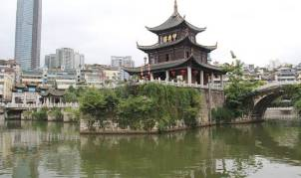
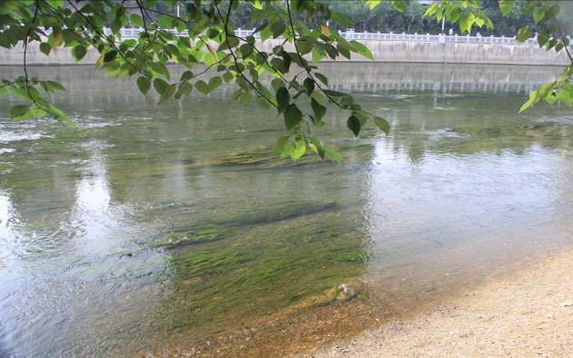
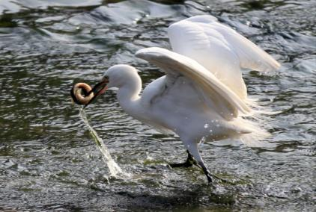
A
南明河水环境综合治理PPP项目 Nanming river PPP project
治理成效 Results
劣V类水体比例从51.0%大幅降至7.0%
Worse than Grade Five water decreased from 51.0% to 7.0% significantly
IV类以上水体从38.9%提升至67.2%
Better than Grade Four water increased from 38.9% to 67.2%
黑臭问题基本解决；
Black and odorous problems were solved basically
Time | Worse than Grade Five | Grade Five | Grade Four | Grade Three
2012.06 (Before treatment) | 51.0% | 10.1% | 8.8% | 30.1%
2013.06 (After first phase) | 17.4% | 22.0% | 28.2% | 32.4%
2015.06 (After first stage, second phase) | 7.0% | 26.8% | 31.6% | 35.6%

Slide 11
A
南明河水环境综合治理PPP项目 Nanming river PPP project
PPP经验 Experience
政府成立项目指挥部，打破“条块分割、多头治水”
The government set up the project headquarters, solving regional segmentation and forbidding the water management from many-side
中国水环境集团作为社会投资人，发挥投资、设计、建设、运营的优势，用2年时间,完成国外6到8年才能实现的治理效果，投资25亿元（国际同类项目投资额3-4倍）
China Water Environment Group was chosen as the social investor, and exerted the advantages of investment, design, construction, operation. It cost only two years (6-8 years for similar projects abroad to achieve same effect) and 2.5 billion RMB investment (3-4 times for similar projects abroad)
节约管网投资约10亿元，年节省运行费用0.3亿元；实现年生态补水近亿吨，年节省调水费用1.58亿元,污水处理厂节省建设用地72公顷
Pipe network investment saving: 1 billion RMB, annual operating expenses saving: 30 million RMB, annual water transfer expenses saving: 158 million RMB, and Land saving 70.2 ha
项目采用“特许经营+政府购买河道服务”的组合模式
Using combined mode "franchising + government purchase river service"

Slide 12
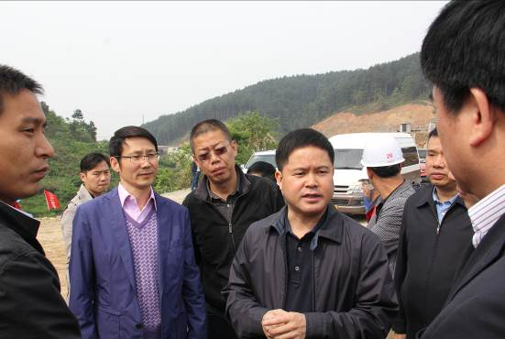
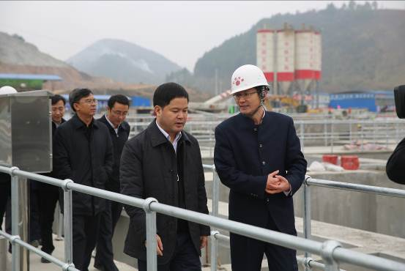
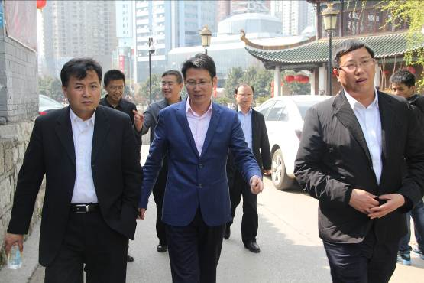
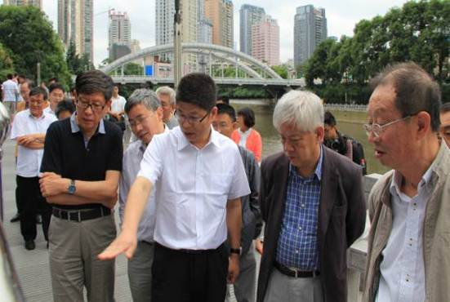
A
南明河水环境综合治理PPP项目 Nanming river PPP project
政府官员、专家多次考察南明河
Government officers and experts visiting Nanming river
Liu Wenxin (Mayor of Guiyang city) inspected Nanming river PPP projects
Jiao Xiaopin (Vice dean of China PPP center)
Citizen and Experts

Slide 13
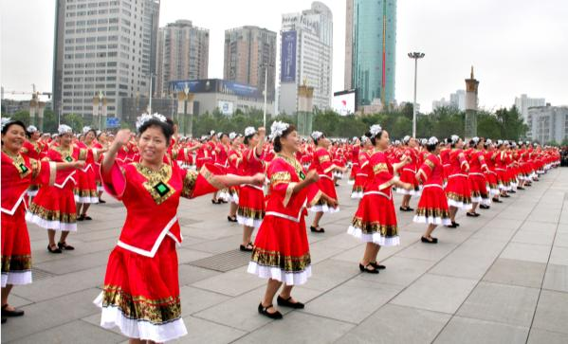
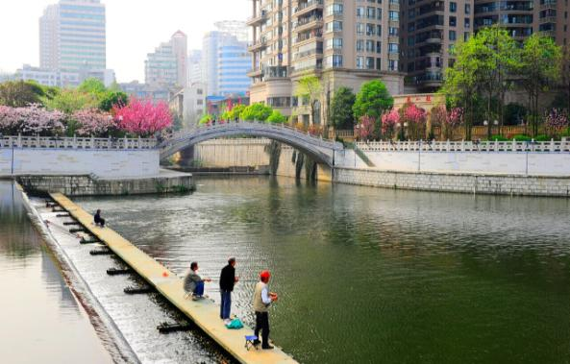
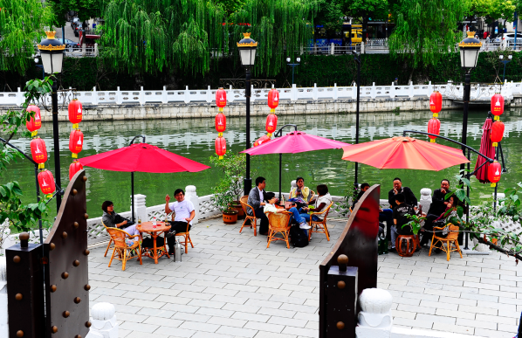
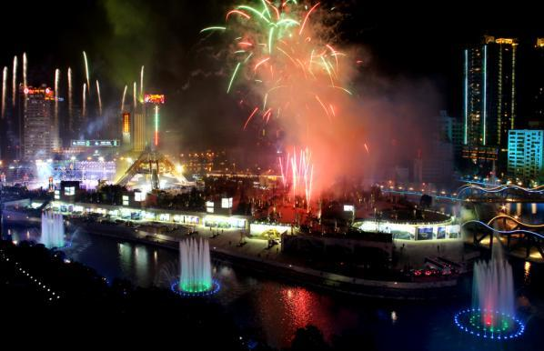
A
南明河水环境综合治理PPP项目 Nanming river PPP project
老百姓对治理效果十分满意，从离开黑臭河又回到河边
People are satisfied with the results, and come back to the river

Slide 14
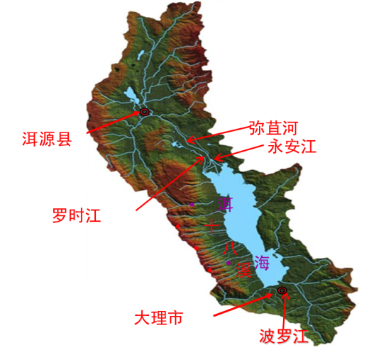
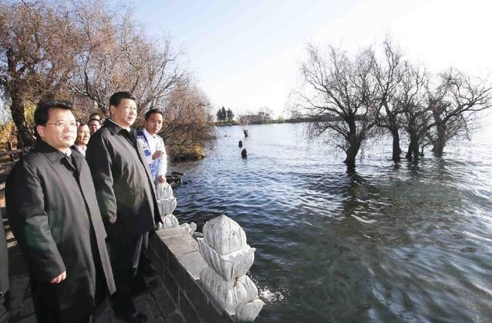
B
洱海水环境综合治理PPP项目 Erhai lake PPP project
洱海背景 Background
中国第七大淡水湖，湖面249km²，蓄水量30亿m³
7th largest freshwater lake in China, lake surface area 249km²，impoundage 3 billion m³
国际性休闲度假胜地
International leisure resort
国家、省、州、市对环境改善与生态保护高度重视
Government pays great attention to environmental and ecological protection
城镇化快速发展，污染负荷超过环境承载力2.5倍，由Ⅱ类向Ⅲ类水体水质转变，处于富营养化转型的敏感期
2.5 times over environmental carrying capacity, water quality is in transition from the Grade Two to Grade Three, and the sensitive period of eutrophication transformation.
2015年1月20日，习近平总书记亲临大理了解洱海生态保护情况，并叮嘱当地干部一定要改善好洱海水质。
President Xi Jinping investigated ecological protection in Erhai, and required the government of Dali to improve the water quality of Erhai. (January 20th, 2015)
Xi Jinping -- PRC President, CMC Chairman

Slide 15
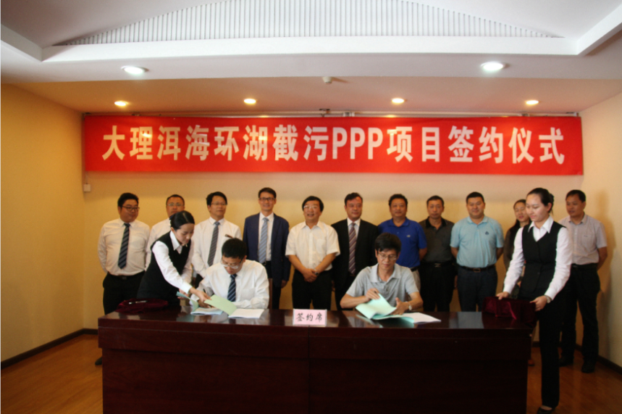
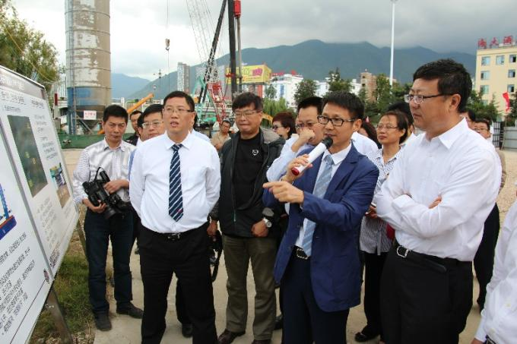
B
洱海水环境综合治理PPP项目 Erhai lake PPP project
2015年9月，中国水环境集团中标成为社会投资人，项目投资30亿元，力争两年半完成
China Water Environment Group was chosen as the social investor (September, 2015). The investment is 3 billion RMB, and time limit is two and half years
历时半年多的现场调研，采集2000多组数据，优化原方案，节省投资6.1亿元
Site survey over half year, over 2000 data, 610 million RMB saving of investment through scheme optimization
提出“海绵农田”创新思路，解决农村面源污染和洱海抽清排污问题
New concept “Sponge farmland”, solving agricultural non-point source pollution and exttracting clean water and discharging wastewater problem in Erhai
国家环保部高度重视，2015年10月陈部长亲临视察
MEP paid high attention to the project. Minister Chen Jining visited the project in November, 2015
大理市委书记孔贵华参加洱海项目签约仪式
Kong Guihua, Secretary of Dali CPC committee
attended signing ceremony of Erhai PPP project
中国水环境集团董事长侯锋向环保部部长陈吉宁介绍洱海项目
Hou Feng (President of CWEG) presented Erhai sewage interception project to Chen Jining (Minister of MEP)

Slide 16
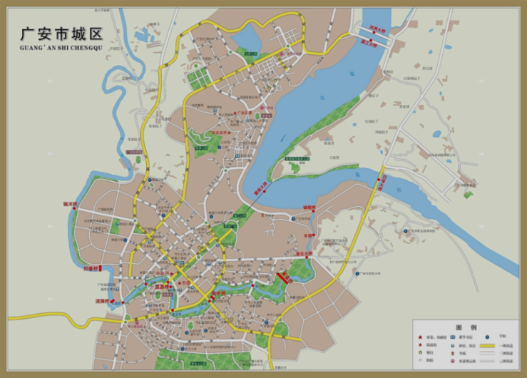
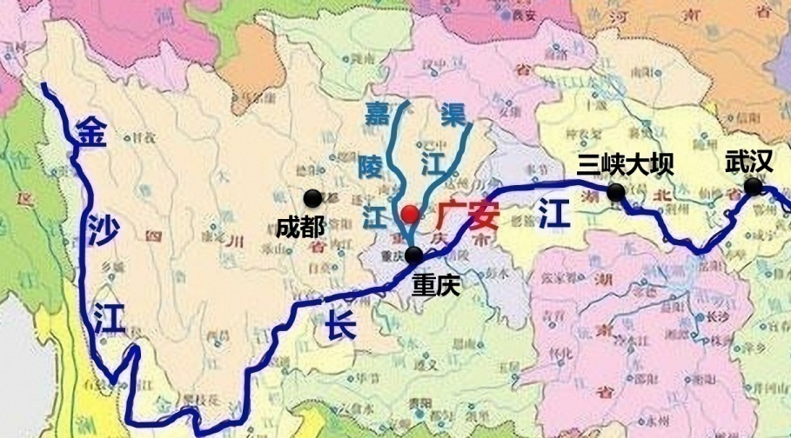
C
区域水环境综合治理项目 Regional Water Environment Improvement
广安“洁净水”行动综合治理PPP项目 Guangan City “Clean Water” PPP Project
项目背景 Background
中国改革开放总设计师邓小平故里
Hometown of Mr. Deng Xiaoping, Chief Designer of Chinese Reform
下游重庆市3000万人口的饮用水源保护区
Drinking water source protection area for 30 million people of Chongqing City
长江上游生态敏感区、三峡库区生物多样性保护区
Ecological sensitive area in upper-Yangtze River district，Biodiversity protection zone of three-gorge reservoir
市政府高度重视，成立市长、书记牵头的PPP领导小组
Set up PPP leading group, charged by the Mayor and
Secretary of Guangan CPC committee

Slide 17
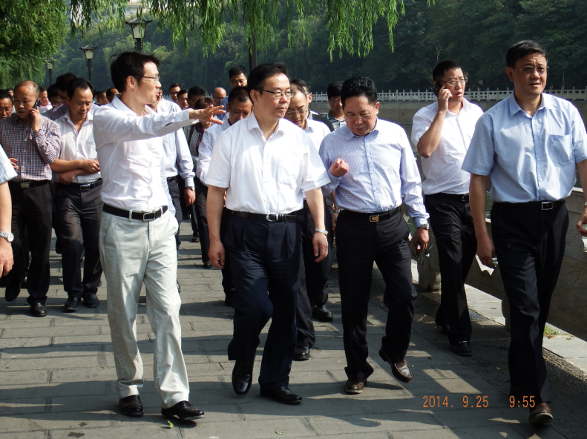
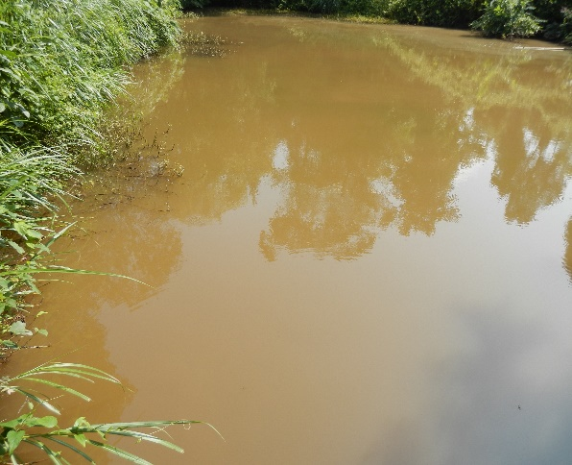
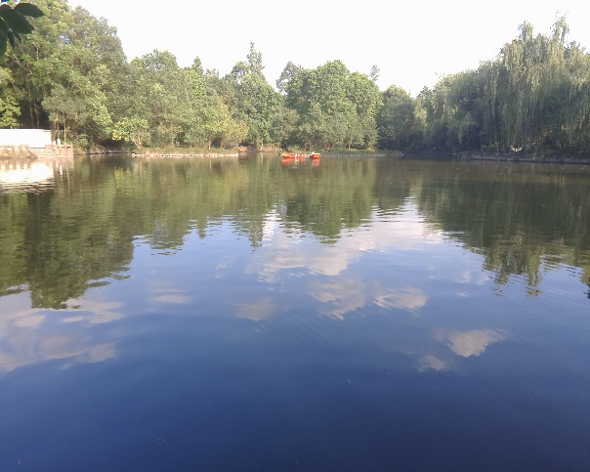
C
区域水环境综合治理项目 Regional Water Environment Improvement
项目内容 Content
广安市全区域，1市2个国家级园区3县108个乡镇
1 Downtown Area, 2 National economic development zones, 3 Counties, 108 Villages
饮用水源地保护
Drinking water source protection area
乡镇、城市污水污泥处理及资源化综合利用
Urban & Rural wastewater and sludge treatment and utilization
两条母亲河水环境治理
Two “Mother Rivers” water quality improvement
Hou Xiaochun, Secretary of Guangan CPC committee
小平故居“洗砚池”治理
Xiyan Pond Water Quality Improvement in front of Mr. Deng Xiaoping’s Old House
Before Treatment
After Treatment

Slide 18
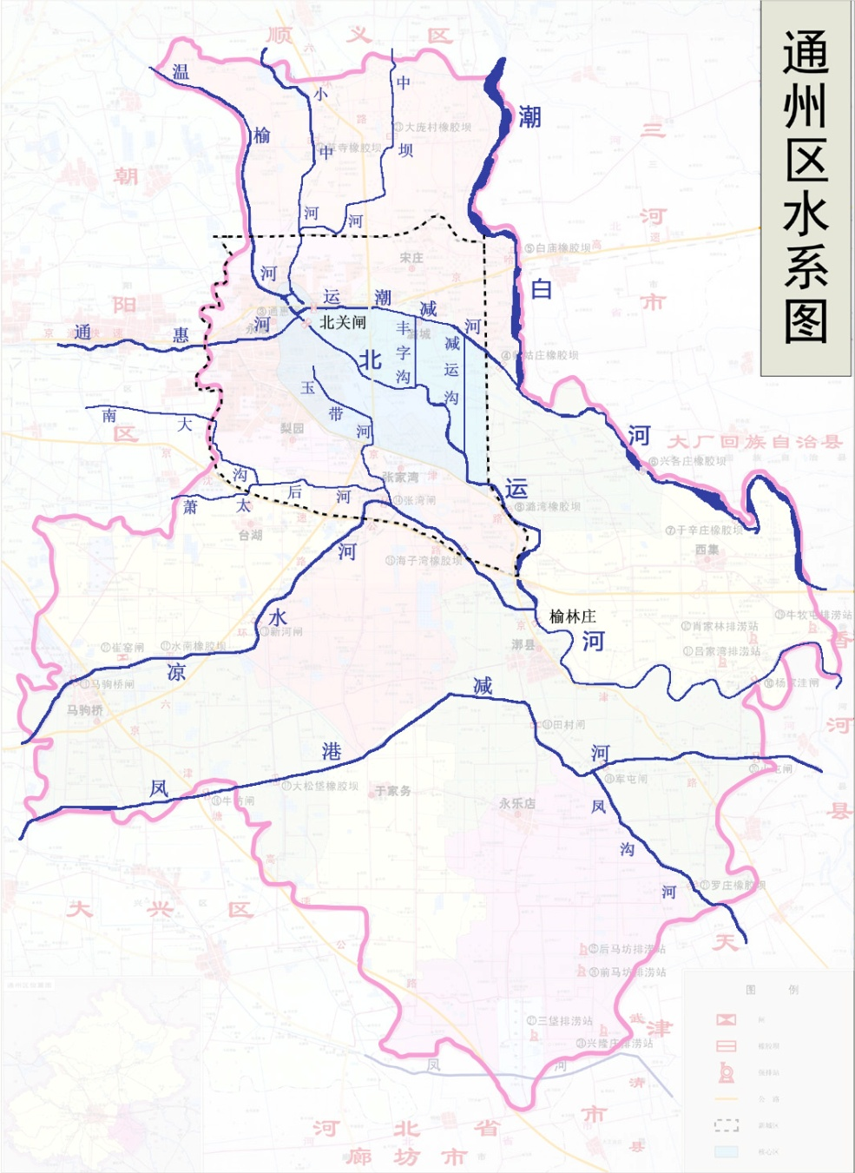
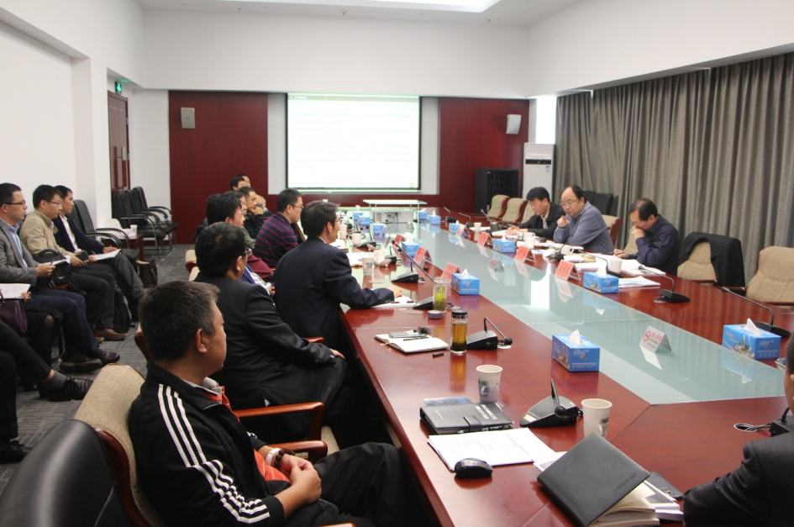
D
下沉式污水处理厂 Underground Wastewater Treatment Plant
北运河 North Great Canal
贯穿京津冀的海河重要支流，全长186公里
A historical river flowing through the City of Beijing, Hebei Province, and the City of Tianjin, with a total length of 186 km
碧水污水处理厂地处北京北运河核心段，是北运河生态补水的重要来源
Bishui WWTP locates at the center of North Great Canal section in Beijing, providing reclaimed water as the river ecological flowrate
Bishui WWTP
Beijing
Hebei
Yue Peng, Mayor of Tongzhou District

Slide 19
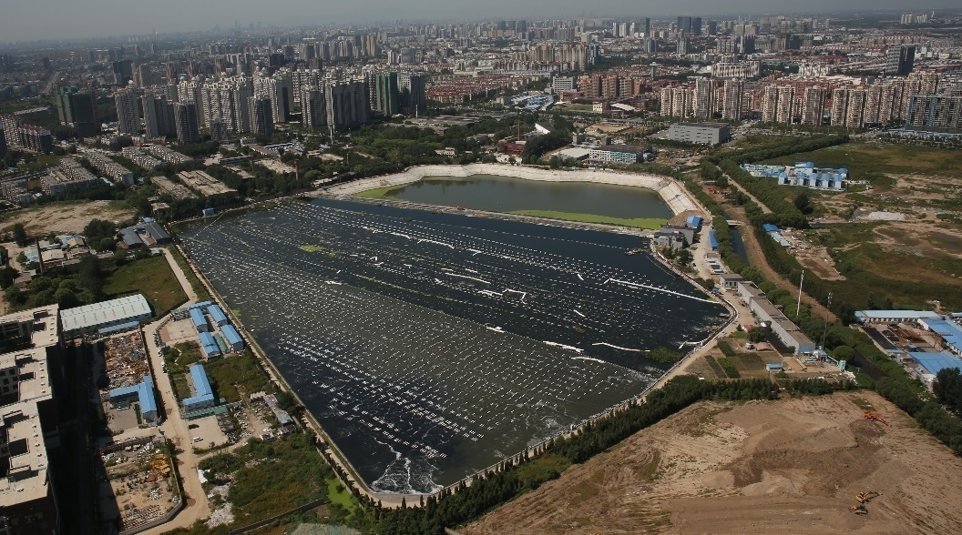
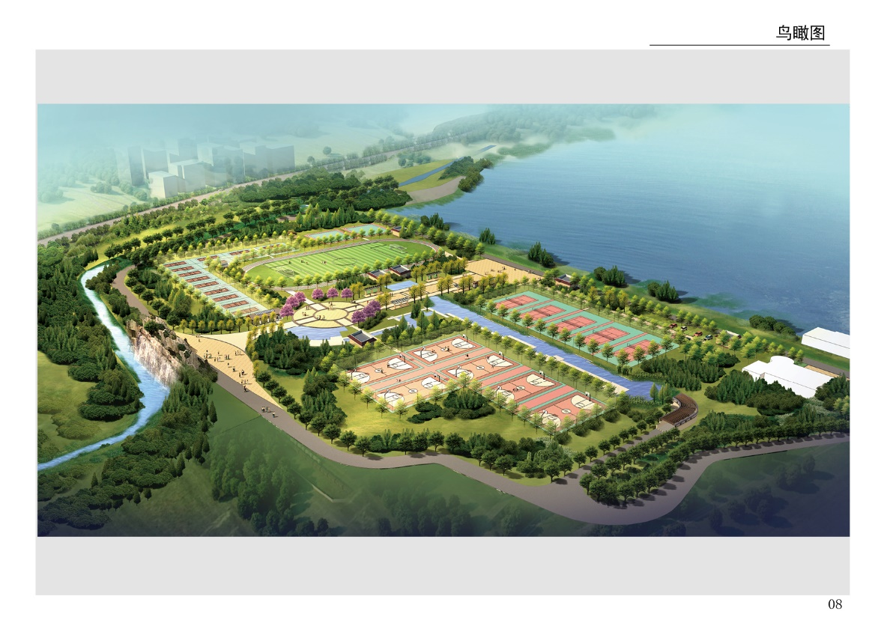
D
下沉式污水处理厂 Underground Wastewater Treatment Plant
北京碧水下沉式污水处理厂
Beijing Bishui Wastewater Treatment Plant
∗DCWWRR: Deep Cell Wastewater Reclamation and Reuse Process from US
美国引进DCWWRR深池曝气工艺
 | Year | Capacity (10³ ton/d) | Area (hectare) | Process | Hydraulic Retention Time |  | Effluent COD (mg/l) | Effluent NH₃ (mg/l) | Effluent TP (mg/l)
Built | 2000 | 100 | 22.7 | DCWWRR | 30 days | On the ground | 60 | 8 | 1.5
Upgraded | 2015 | 180 | 8 | A²/O | 12 hours | Under-ground | 30 | 1.5 | 0.3
Before Upgrading
After Upgrading

Slide 20
结束语
中国人均水资源占有量仅为世界平均水平的四分之一，作为人口超过13亿的大国，中国的水环境和生态环境保护更具挑战性，需要更多的投资，更多的好技术，愿与世界各国同仁协作，推动中美合作，共同促进中国《水污染防治行动计划》的落实和环保产业发展。

Slide 21
Thank you!

