Slide 1
Voices from the Field: Findings from the AFLAControl Program
Clare Narrod, JIFSAN, University of Maryland
On behalf of the team
International Food Policy Research Institute
International Center for the Improvement of Maize
and Wheat
International Crops Research Institute for the Semi-Arid Tropics
University of Pittsburgh
Uniformed Services University of the Health Sciences
ACDI/VOCA/Kenya Maize Development Program
Kenya Agricultural Research Institute
Institut d’Economie Rurale

Slide 2
Multi-disciplinary Research Team
Economic Impact
Health
Household level analysis (Income, Gender)
Trade
Perceptions of aflatoxin and WTP
KAP (Knowledge Attitudes Perception Actions)
Valuation of demand risk reduction measures
Auctions (consumer demand)
Disease Prevalence
Collection of prevelance data along value chains in different ecological zones
Risk Analysis
Predictive Risk maps
Risk assessment
Cost effectiveness analysis
Endpoints of interest: exposure
Market access/ income/ poverty reduction
Health
Communication and Advocacy

Slide 3
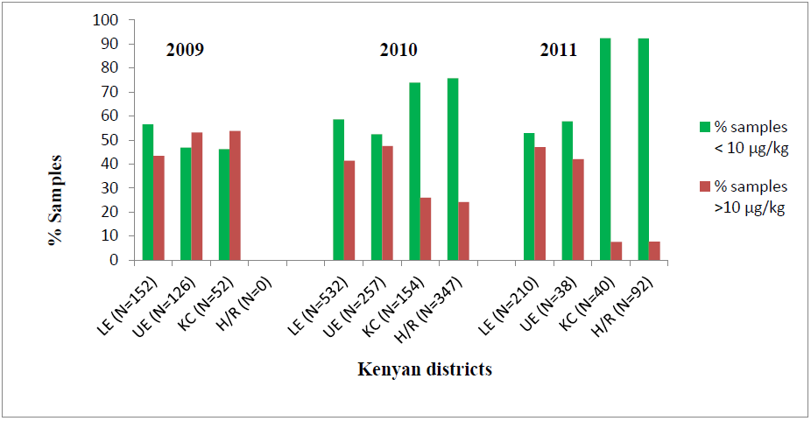
Prevalence Levels for Kenya (Mahuku et al - CIMMYT 2012)
samples from farmers’ fields
samples from farmers’ stores
samples from MARKETS
Prevalence data collected from different AEZs from 2009-2011 at pre-harvest, in storage (15 to 30 days interval), and in the markets (every month)
Total of 4,414 samples

Slide 4
Predictive Kenya Risk Map (Masuoka et al-USUHS, 2012)
Maxent Model- A widely-used and accepted ecological niche modeling program
Input:
Known locations of a species (aflatoxin) in terms of longitude, latitude
Environmental layers (climate, elevation, land cover, etc)
Output:
Probability map of species potential distribution
Information on importance of environmental variables (sensitivity analysis) –humidity and rain
Statistical evaluation of the model

Slide 5
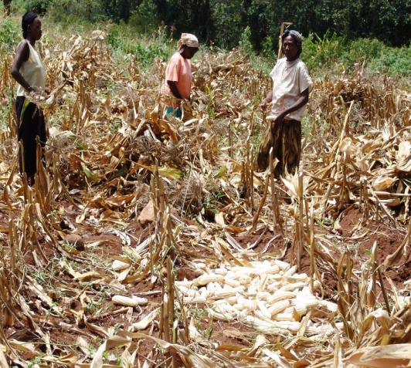
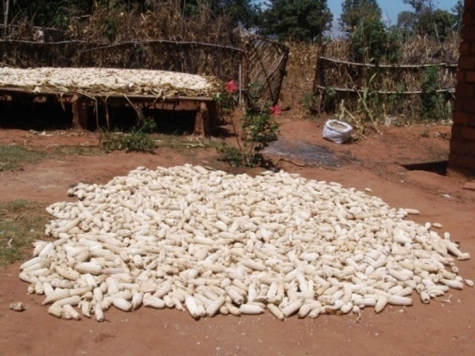
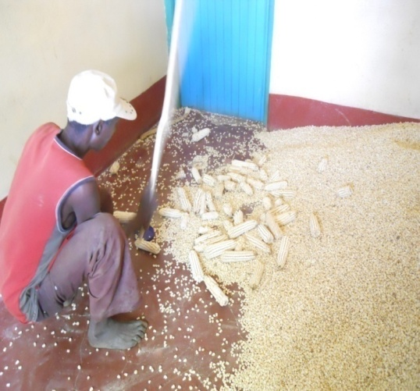
Socio economic field work (Tiongco et al, 2012)
Livelihoods impact:
Qualitative focus group survey
Quantitative household surveys
Household surveys : Oct 2010 –Jan 2011
Community level surveys : Oct 2010 –
Jan 2011
Socio-economic data collection: March
2011 at households where prevalence
collected
 | Total
Household Head is Female (%) | 18
Household Head’s Age (Yrs.) | 52
Household Head’s Education | 7
Household Head’s Farming Experience (Yrs.) | 26
Total Annual Income (KSH) | 200298
Total Value of Maize Produced | 12,873
Notes:
Quantitative surveys asked questions: Knowledge and awareness of aflatoxin (e.g., do they know what aflatoxin is, what causes it, how can it be identified) Aflatoxin risk perceptions (e.g., aflatoxin’s impact on human and livestock health; impact of soil, rain, storage on aflatoxin risk) Maize production/processing/consumption practices related to aflatoxin (e.g., what do they do with moldy maize, who consumes it, how can mold be minimized)

Slide 6
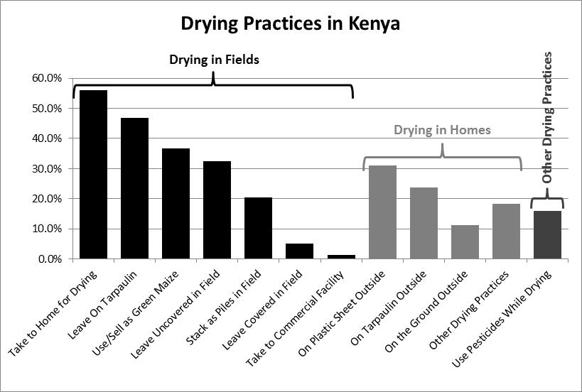
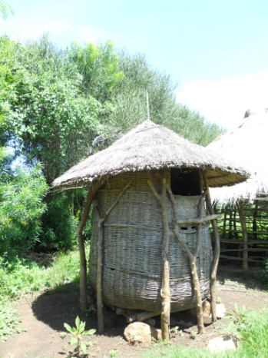
Drying Practices (Bett et al, 2012)

Slide 7
Sources of Information on Aflatoxin (Narrod et al, 2012)
 | Total | Male | Female | % of Those Who Know Aflatoxin | % Total Sample (511M/832 F)
Local Radio | 197 | 158 | 39 | 39.3% | 14.7%
Swahili Radio | 118 | 101 | 17 | 23.6% | 8.8%
Extension Officer | 65 | 8 | 0 | 13.0% | 4.8%
Neighbor | 38 | 158 | 39 | 7.6% | 2.8%
TV | 29 | 22 | 7 | 5.8% | 2.2%
English Radio | 14 | 11 | 3 | 2.8% | 1.0%
Newspaper | 8 | 105 | 13 | 1.6% | 0.6%
Buyers/Traders | 3 | 3 | 0 | 0.6% | 0.2%
Other Source | 37 | 30 | 7 | 7.4% | 2.8%
Note: Percentages are of respondents who had heard of aflatoxin (n=501),
total sample size (n=1343).

Slide 8
KAP Influence Diagram (Narrod et al, 2012)
Knowledge of causes of aflatoxin contamination
Household demographic characteristic
Actions to minimize risk of aflatoxin contamination
Attitudes towards high levels of aflatoxin contamination
Scale of production
Perception of aflatoxin risk associated with visual attributes
Being in regions with past cases

Slide 9
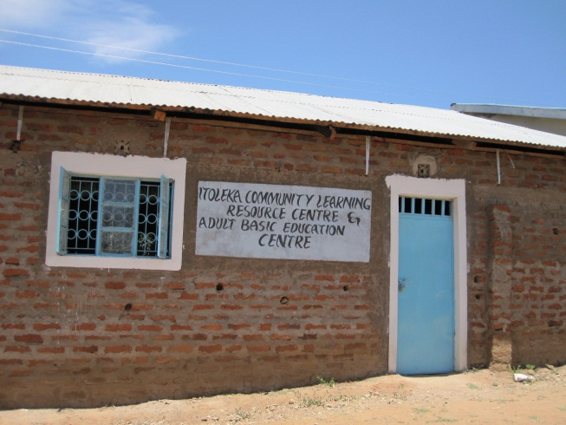
Results- Structural equation modeling
Education -- Pos. & significant effect on perception of risk
Education -- Neg. & significant effect on household’s reaction to extension or public health office regarding a potential risk in the village.
Female HH heads -- Higher knowledge about harmful effects of feeding moldy grains to humans & animals
HH in dry lands -- (where 2004 outbreaks)-- had higher perception of risk but limited knowledge of safety attributes & ways to reduce risk through improved storage practices (actions)
Scale of operation -- size of land cultivated or value of production -- had no effect on farmers’ actions.
Maize selling - no effect in terms of actions to reduce risk (not the case in terms of groundnuts in Mali)

Slide 10
Cost-effective risk reduction strategies
Effectiveness of these measures in practice under developing country conditions is not well understood
2-stage Delphi expert elicitation administered via email (2009)
Augmented information on effectiveness from literature, work by CIMMYT, and IITA

Slide 11
Women’s group

Slide 12
Remaining Gaps
Difficult to identify the level of effectiveness in African situation; need in field results
Levels of effectiveness assume correct application of methods; adoption studies needed
Estimates for cost of risk reduction technologies still in development highly uncertain; better cost estimates and understanding lifecycle of options needed
Most intervention studies done with the assistance of donor; don’t know what types of education methods needed to ensure long term adoption of effective aflatoxin risk reduction strategies beyond an intervention study
Development of low cost testing methods in development ($5-7); Do not know consumers willingness to pay to test maize
Deployment of low-cost testing in rural areas; Do not know feasibility

Slide 13
Sustain control only achievable
Educate families, farmers and governments about the health risks associated with mycotoxins & the social and economic costs of reducing this risk
Education ways to reduce the risk of contamination of maize and groundnuts with the application of appropriate agricultural, storage, &drying practices
Build the local capacity to support further activities to reduce mycotoxins in agricultural products, monitor mycotoxin levels in crops and the population, and
Provide the tools (data and risk management capacity) for locally-driven policy reform that will ensure food safety and trade opportunities in the region.

