Slide 1
Armando Ríos Piter
Independent Senator
Washington D.C.
May 2017

Slide 2
Failure
Mexico at a Crossroad:
OR
Becoming a serious global player?
Notes:
I think the afghanistan comparison is too strong and could cause you problems in Mexico “Rios Piter Dice Que Mexico Es Afganistan pero el y su equipo Aquinoestan”

Slide 3
The number of missing people reached 29,903 between 2006 -2016 ¹
17 murders per 100 k persons. But there are cities like Acapulco reaching 114 per 100k³
The Attorney General’s Office documented 124 killings of journalists from 2000 through July 2016. ² Nongovernmental organizations report seven cases of journalists killed during January-June 2016²
7 women and 4 children die every day (not related to organized crime)
Only 1 % of the crime is punished
47% of population live in poverty
¹ Executive Secretariat of the National Registry of Data of Lost Persons Disappeared
² Human Rights Watch
³ United Nations Office on Drugs and Crime (2016)
Notes:
Datos de desaparecidos en Mexico son muy cuestionables vease Lia Limon. 17 homicidas es muy bajo regionalmente y creo que la cifra ya es mayor, o sea la tendencia es hacia arriba y eso es mas impactante y preocupante. Yo me quedaria con 3. El segundo y los dos ultimos… es un pais sin ley y la cosa puede empeorarse… y eso te lleva a lo que podria ser el futuro que es la siguiente lamina

Slide 4
Industrial sinergy with world biggest economy (236 billion trade w/US)
Demographic dividend (in a 130 million people future market)
Logistics potential and Atlantic/Pacific access (1st exporting country in LatAm and 12th worldwide)
7th world car producer = 3.6million cars/year
113,000 Engineering graduates every year (more than France and Germany)
Increasing investment in aeronautic industry (Queretaro, Sonora, Baja California)
Knowledge ecosystem (Guadalajara)
High-skilled labor clusters (Mexico City)
Notes:
Aqui mas bien el argumento importante me parece que es lo que contribuye Mexico a la competitividad regional, porque nos necesitan y como y porque no pueden vivir sin nosotros…1. Sinergias - abundancia de capital contra abundancia de mano de obra y recursos naturales… potencial del mercado…. Nuestra industria manufacturera fortalece la competitividad de la suya, sin nosotros General Electric no podria xxxx o General Motors ya estaria en quiebra….Tambien estamos construyendos zonas economicas de alto rendimiento… ademas de mississpi tenemos un poco de massachussetts. Y el ejemplo de queretaro es buenisimo en este sentido…

Slide 5
Trump represents Mexico’s greatest opportunity in decades… It’s not a wall, it’s a mirror.

Slide 6
We must create a new narrative: Mexico does not need a savior Mexico needs a Collective Plan
Harmony
∆Women & youngsters
∆Indigenous people
∆Migrants
No more victim
mentality
Stop Exclusion
Wealth
NAFTA
Global Supply Chain Hub
21st Century Energy & Resources
Logistic, Atlantic/Pacific
Wages
Information Economy
Justice
“The Rule of Law” in Mexico is a monumental hoax
Mexico City’s Constitution contains the most progressive agenda in this matter (under PGR’s attack at the moment)
Notes:
When you talk about what needs to be fixed, talk about how a badly working democracy is not letting it happen, and when it does the political establishment quickly neuters any challenges to its power. CdMX constitution but also IFAI, COFETEL, COFECO etc….

Slide 7
Rule of Law: Mexico City’s Constitution
(Rios Piter/Magaloni Bill)
The Constitution includes some real advancments on Rule of Law:
a) New structure and operation of the Judicial service; Citizen Council to control corruption; Effective process to protect rights (“Acción de Tutela”).
b) Elected General Attorney; Autonomous Prosecutor (MP): scientific investigation, public service career, research and coordination with the security system, plus total staff renovation.
Notes:
An example of democracy that does work, but I am not understanding the narrative here… the arc should be 1. democracy isnt working 2. the political establishment is blocking reforms 3. we need an independent to smash the establishment… 4. once in office I will implement these reforms: jsutice, campaign finance etc.. 5. this will bring growth, reduce crime and increase equality 6. and make mexico a southern neighbor anyone would want to have

Slide 8
In order for ALL OF THIS to happen, there is only one path…
Kill the corruption and impunity Dragon
Dry out the money out from the elections

Slide 9
END Six C’s of Corruption
President Peña Nieto Campaign Cost Reached USD$354M of USD (maximum limit by law was 25 millions).
Campaigns
Constituency Clientele
Cash for votes
“Compadres”
Contracts
Crime
Democratic Party spend USD$286M in Obama´s campaign in 2012.
USA GDP=USD$17Trillion
Mex GDP = USD $0.9 Trillion

Slide 10
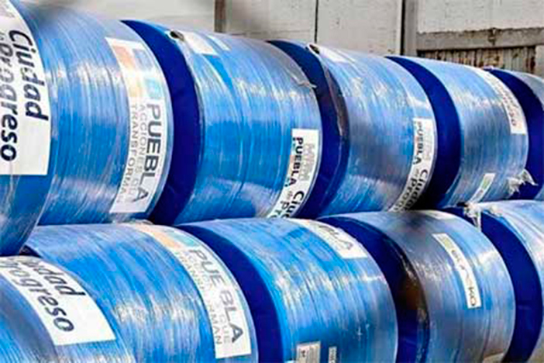
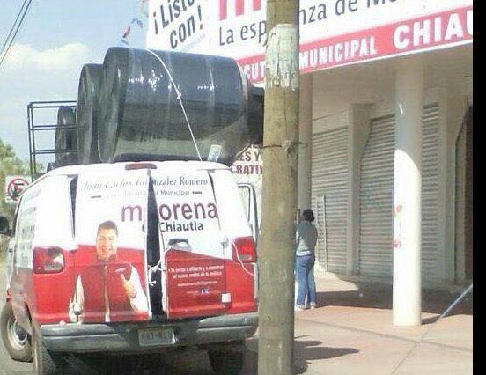
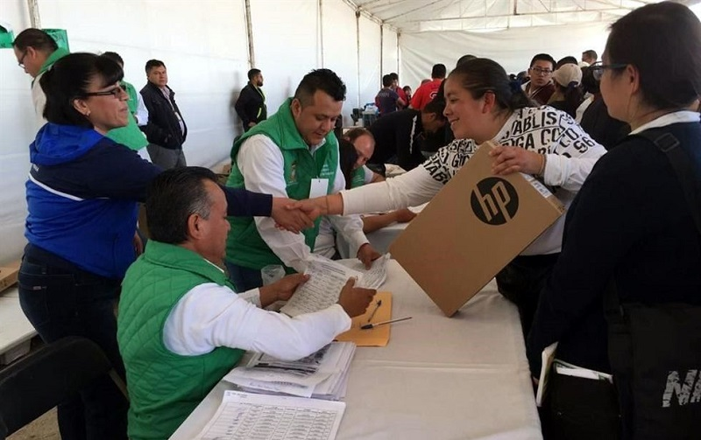
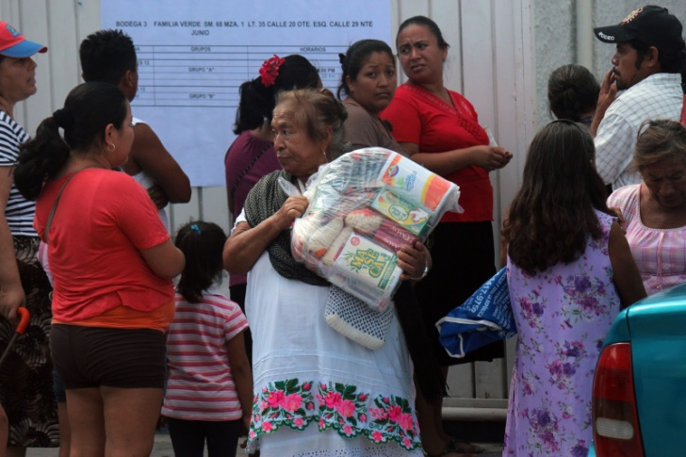
Do you see any differences?
Blue Water tanks in Puebla previous to elections (PAN)
Water tanks inEdoMex by (MORENA)
Laptops and USB in EdoMex (PRI)
Food Banks, CDMX Districts (PRD)

Slide 11
Political parties can’t do this
We NEED a Low Cost, Collective and Independent Movement
Civic Momentum
Degrees of Freedom Necessary to CHANGE the System
Money Out of Elections

Slide 12
Actions DO matter… We need people who can say NO to POWER in order to uphold a principle

Slide 13
Armando Ríos Piter
Independent Senator
Washington D.C.
May 2017

