Slide 1
(US Launch event 27 October 2017)
Director General Robert-Jan SMITS
European Commission - DG RTD

Slide 2
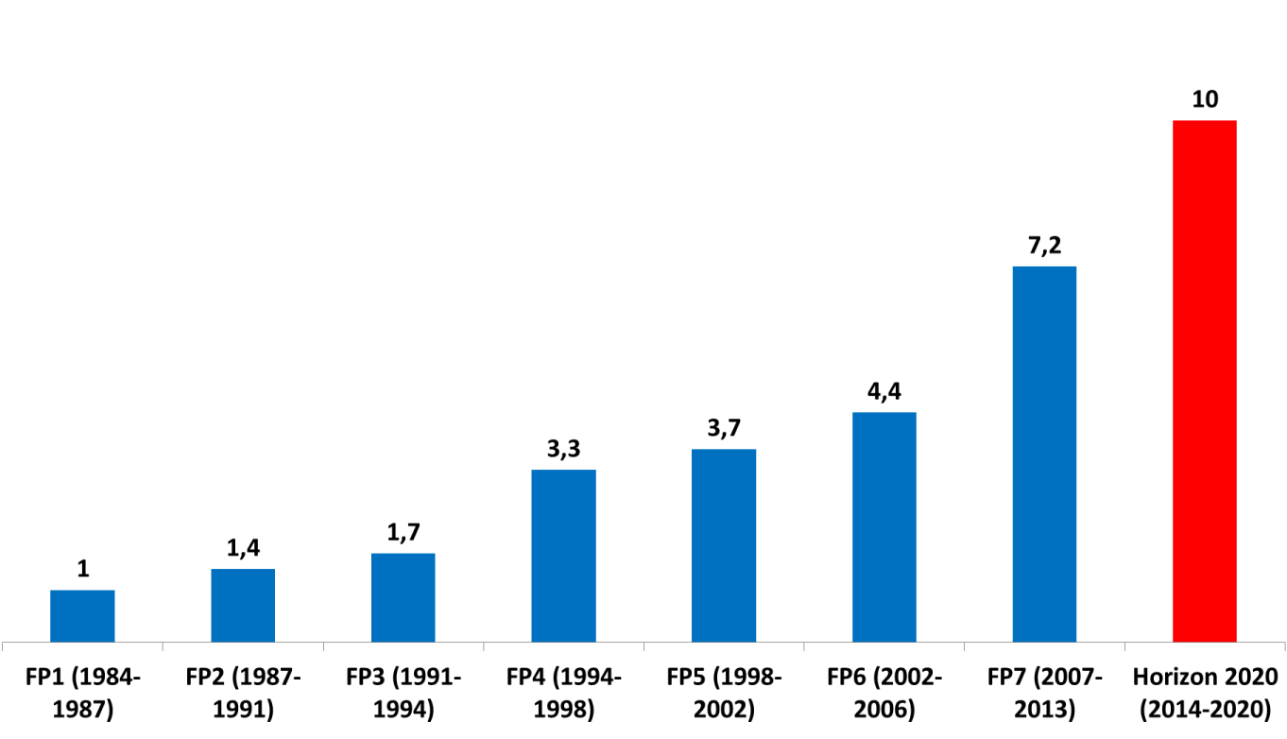
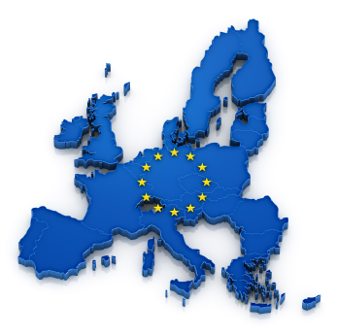


30 years of EU funded R&I ~average Annual budget (in b€)
EU-US S&T Agreement in 1998

Slide 3
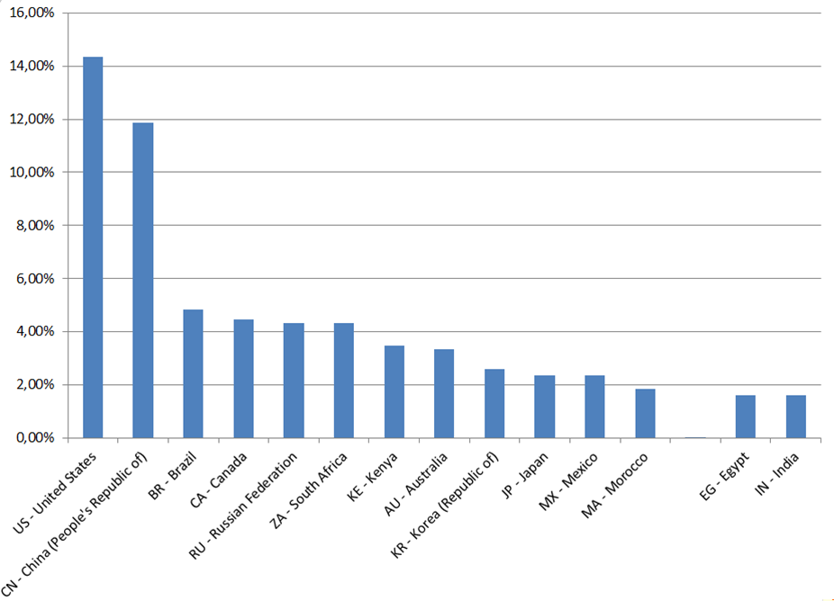
Horizon 2020 – Participation % of all 3rd countries

Slide 4
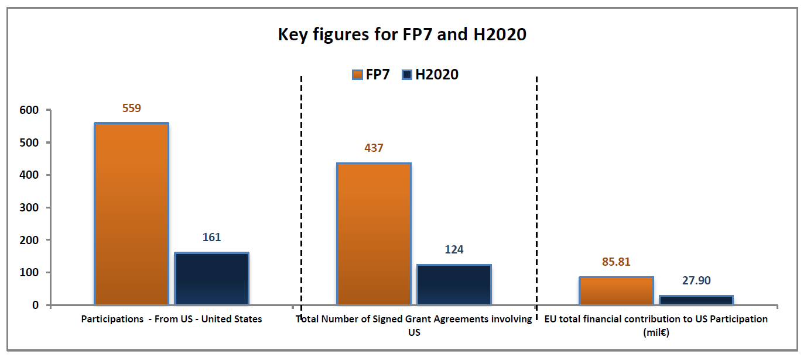
US Participation (2007-2017) last 10 years of collaboration
7 years of FP7 – 3 years of Horizon 2020

Slide 5
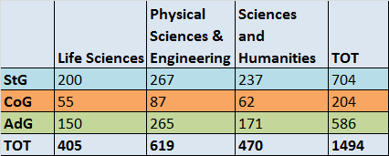
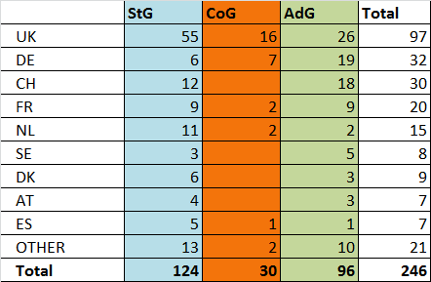
European Research Council (ERC) and the USA
(example Horizon 2020)
ERC evaluated proposals by researchers of US nationality, by scheme and domain
EC-USA Implementing Arrangement
(Opportunities for US NSF grantees to temporarily join ERC teams)
Signed on 13 July 2012
Results 2012-2016 period:
1935 ERC PIs expressed interest in hosting researchers from the US.
46 scientists of US nationality visited ERC project

Slide 6
Horizon 2020 - Outlook 2018-2020 After nearly 4 years of implementation
Interim Assessment
An attractive, simplified and well-performing € 77 billion programme, but underfunded (12 % success rate)
On track to deliver value for money and to meet its knowledge-creating objectives
Strong EU Added Value through unique opportunities, competition & access to new knowledge.
Participation (Oct. 2017)
15,000 grant agreements
with € 27 billion EU contribution
65,000 participations

Slide 7
Work Programme 2018-2020 prepared through Strategic Programming
Objectives
Provide for a coherent implementation of the Horizon 2020 objectives and the multiannual approach, taking account of the Interim Evaluation and first two work programmes (for 2014-15 and 2016-17)
Enhance relevance and impact by delivering against the EU policy priorities and three O's
Prepare for a bridge in the last years of the programme to enable a smooth transition to any successor to Horizon 2020

Slide 8
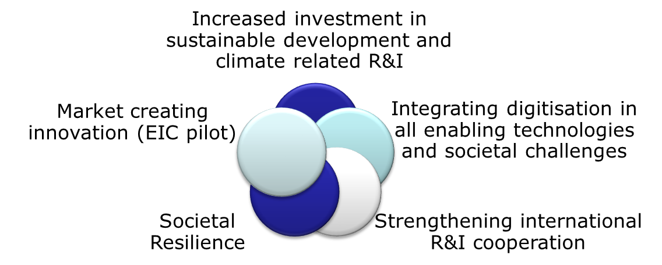
Work Programme 2018-2020
R & I investment of around 30 billion EUR for 3 years
Five mutually reinforcing strategic orientations addressing some main concerns of citizens:
Notes:
Background information to be released at WP launch:
Translation of five strategic directions into dedicated initiatives, including four focus areas (virtual calls) with a total budget of €7 billion :
1) Increased investment in sustainable development and climate related R&I:
Focus area 'Building a low Carbon, Climate-resilient Future' Budget: € 3.3 billion.
Focus area 'Connecting economic and environmental gains – the Circular Economy' – Budget: € 1 billion
2) Integrating digitisation in all enabling technologies and societal challenges:
Focus area 'Digitising and transforming European industry and services' - Budget: € 1.7 billion.
3)Strengthening international R&I cooperation:
30 International cooperation flagships – Budget: 1 billion
4) Societal Resilience:
Focus area 'Boosting the effectiveness of the Security Union'- budget: € 1 billion.
Additional focus on Migration (around € 200 million)
5) Market creating innovation:
EIC pilot – Budget: € 2.7 billion

Slide 9
Open Science
€ 2 billion channelled to direct/ indirect support for Open Science
European Open Science Cloud and European Data Infrastructure (€ 600M)
New: Open Research Europe platform for Horizon 2020 and successor framework publications
Open Innovation
EIC pilot
Open innovation test beds (€ 200 M)
Ca. 30 topics of € 300 million budget in the Societal challenges pillar
Open to the World
Over €1 billion investment for 30 international flagship initiatives: All Atlantic Research Alliance (US Flagship); Mission Innovation Initiative – energy (US Flagship); Canada-human data storage for personalised medicine; EU-Africa-food; EU-India-water;Russia-research infrastructure....
Strong international component in the European Research Council (ERC) and Marie Skłodowska-Curie actions, e.g. ERC expected to fund 240 more non- EU/AC nationals as Principal Investigators
Notes:
MSCA:
In 2018-2020, the possibilities for international cooperation will be further increased: the budget for the Global Fellowships - which enable European researchers to gain experience and skills outside of Europe and then bring them back - will be increased by 60%, from a yearly average of EUR 30 million in 2014-2017 to EUR 48 million in the work programme 2018-2020. (the average EU contribution for the Global Fellowships is EUR 233,759.08, so with the EUR 48 million you can fund 205 researchers per year (as opposed to only 128 per year before). This increase, together with a continued focus on international cooperation across all actions, and much simplified eligibility conditions in the Research and Innovation Staff Exchanges (RISE), will further boost the MSCA's international profile.
ERC:
In the last three years of H2020 the ERC will fund around 3,000 further PIs.
The ratios of non EU/AC nationals below have been relatively stable over time so therefore we can expect to fund around 240 more non EU/AC nationals as PIs and about 3,000 more non EU/AC nationals as PhDs and postdocs.

Slide 10
Examples of areas inviting US cooperation (US Flagships) Work Programme 2018-2020
Marine
Arctic
All Atlantic Ocean Alliance
Health
Mutual Opening for US,
Transport
Road automation,
Energy
Renewable fuels
Nano Safety
Regulations
Aviation – green and safe
Safe Design
Cryosphere and risks
Multilateral cooperation

Slide 11

EU - US Flagship cooperation examples
Automated Vehicles:
Call in 2019
30 million € funding
Specifically mentioned for EU-US project twinning with US entities participating in projects funded by the US Department of Transport
Additional countries invited
Nano-Safety:
Call in 2018
28 million € funding
EU-US Collaboration is strongly encouraged and all projects are expected to collaborate with similar projects under the Communities of Research of the US National Nanotechnology Initiative

Slide 12

Success story EU-US cooperation project – Global Health
Project details
Project acronym: EBODAC
Participants: UK (Coordinator), Ireland, United States
Total costs:
€ 25 740 856
EU contribution:
€ 20 328 856
Duration:
December 2014 to November 2017

Slide 13
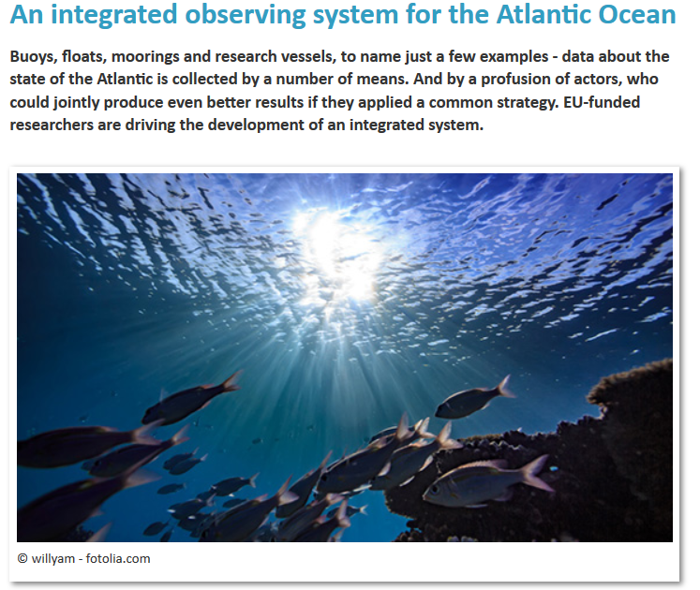
Success story EU-US cooperation project - Atlantic
Project details Project acronym: AtlantOS
Participants: Germany (Coordinator), UK, Ireland, Denmark, France, Poland, Norway, Spain, Portugal, Netherlands, Faroe Islands, Belgium, Italy, Croatia, Canada, Brazil, United States, South Africa
Total costs:
€ 20 652 921
EU contribution:
€ 20 652 921
Duration:
April 2015 to June 2019

Slide 14
Thank you! #InvestEUresearch www.ec.europa.eu/research Participant Portal www

