Slide 1
Argentina towards the second half of Mauricio Macri’s tenure
Alejandro Catterberg
alejandro@poliarquia.com
April 2018
Argentina

Slide 2
Macri’s administration:
The road traveled and the challenges ahead

Slide 3
2016-2017: The first two years of Cambiemos in government
Cambiemos achieved a very good first two years of government: it left behind 12 years of populism in a peaceful and orderly way; avoided an economic crisis; consolidated a unified political coalition; won comfortably in the midterm elections.
In that same period, Peronism showed lack of articulation, identity and leadership, deepened its internal divisions and emerged as a weak alternative in the face of 2019 presidential election.
Kirchnerism has become a relevant but minor actor with limited chances to return to power.

Slide 4
Macri’s power consolidation factors
Economic strengthening
Reforms / Central Bank reserves ⬆ / Investment ⬆ / GDP ⬆ / Inflation ⬇
Impressive Mid-term legislative victory
Boosted a change in political strength perception, more congressmen & public opinion support.
Peronism crisis
Disarticulated leadership, CFK polarizing figure, fiscal needs.
Unions crisis
Disarticulated leadership and leaders under corruption investigations
Growing influence in the Judicial branch
Advances in General Attorney office, Judicial Council & Judicial Reform
Public opinion support
Popular president & popular figures like Vidal, Carrió, etc

Slide 5
An impressive mid-term victory I
The articulation of a strong coalition that represents the middle class.
Total % of votes achieved nationwide
Number of districts won by Cambiemos
(+5 pts)
(+3 pts)

Slide 6
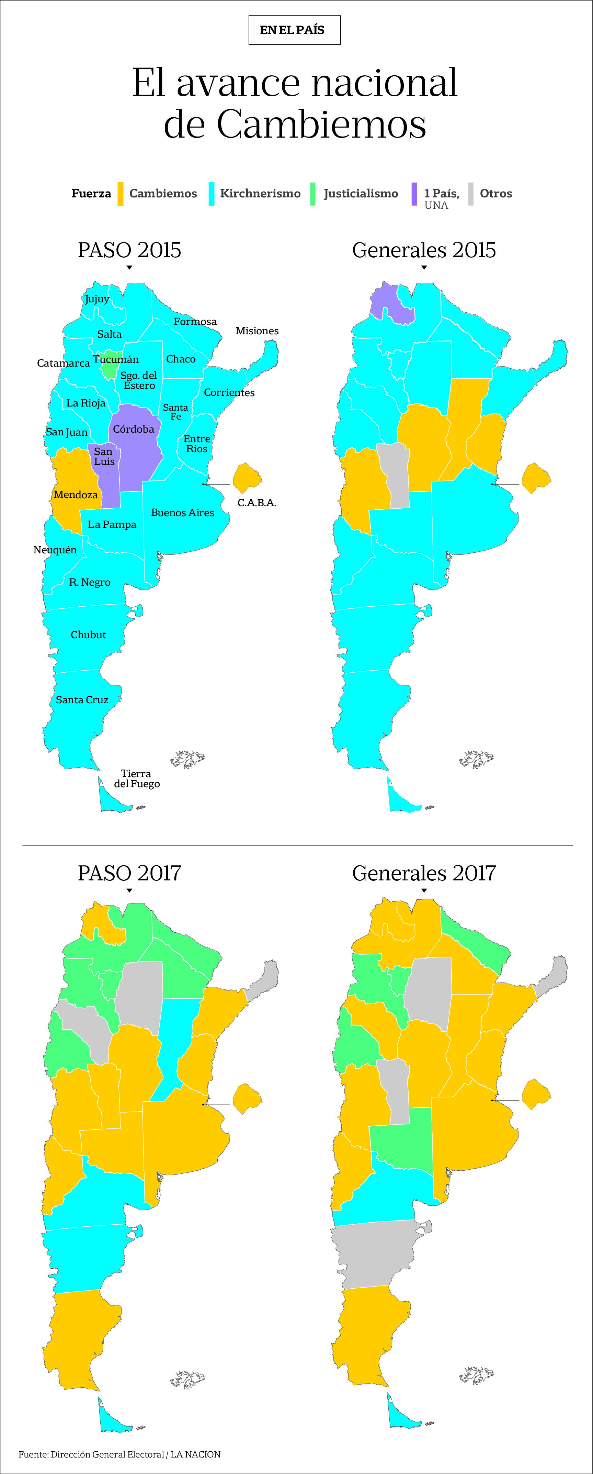
An impressive mid-term victory II
Most voted political force by district
Fuente: La Nación

Slide 7
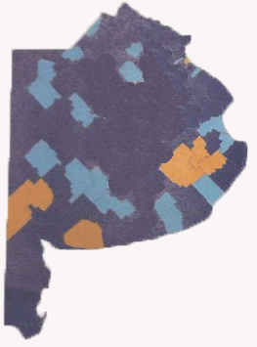
An impressive mid-term victory III
Most voted political force by district
PASO 2013
Kirchnerismo Progresistas
Massa
7

Slide 8

The House
More seats after de midterm election, but still not majorities
Soft Opposition
63
Cambiemos
108
Hard Opposition
85
▌PRO (52)
▌UCR (43)
▌CC (10)
▌FE ,CP, Salta somos todos (3)
▌Social Demócrata (4)
▌Argentina Federal (33)
▌UNA (20)
▌FCS (6)
▌FPV (65)
▌PPV (5)
▌CF(4)
▌Single legislative blocs (6)
▌FIT (3)
▌Elijo Catamarca (2)
▌Vacant (1)

Slide 9

The Senate
More seats after de midterm election, but still not majorities
Soft Opposition
34
Cambiemos
25
Hard Opposition
12
▌PRO (9)
▌UCR (13)
▌PJCambiemita (2)
▌MOPOF (1)
▌ Argentina Federal (25)
▌PJ Federal (5)
▌FCS (2)
▌FRC (2)
▌FPV (8)
▌Compromiso Federal (2)
▌Progresistas (2)
▌Others (1)

Slide 10
Why this time could be different?

Slide 11
This time can be different because… (I)
New kids on the block
Pro market & Globalization / Experience in the private sector/ Pragmatism & Management
Gradualism
There was not a huge crisis. Argentina is no longer moving from one end to the other
Reconfiguration traditional political parties
UCR and PJ crisis & New left
A generational change in the political leadership.
Less ideological and more pragmatic / Educated during the Democracy
National Government + PBA + CABA
1/3 of Argentina population in GBA
Public opinion support
Popular president & popular figures like Vidal, Carrió, etc

Slide 12
This time can be different because… (II)
7. Public expenditure
Opportunity to generate a revolution in social and physical infrastructure.
8. No external actors pushing for reforms.
The political, social and economic modernization process is coming from within
9. More transparency

Slide 13
2018 and beyond

Slide 14
Macri’s power consolidation threats
Economic Front
External Shock→ sudden stop of financial flow
Main
The “dark side” of politics & politic violence
Internal Front
Cambiemos crisis >> Elisa Carrió
Parliamentary Front
Legislative defeats in face of the strategic unity of PJ
Secondary
Union Front
Radicalization of unions (and social movements)
Public Opinion
Decrease in the support of public opinion

Slide 15


Strengths of main political sectors
Macrism
Cristinism
Peronism
IDENTITY
LIDERSHIP
POTENTIAL SUCCESSOR

Slide 16
Prospective scenarios
Prospective scenarios
- Macri is reelected.
- Achieves majority in the Lower House.
- Wins around 12 own governors.
- Macri is reelected in a run-off.
- No majority in the Lower House.
- Wins around 6 own governors.
- Peronism unifies under a clear leadership and Macri loses the Presidency.
- CFK is elected in 2019
- Return of populism to Argentina
p: 40%
p: 30%
p: 25%
p: 5%

Slide 17
Public Opinion Landscape

Slide 18
Fluctuations aggregated by periods
Impact of the Primary Elections, General Elections and Reforms and Tariffs
Notes:
18

Slide 19

Perceptions about the Pension Reform (I)
“As far as you know, a person who received 10,000 pesos in 2017, will receive more than 10,000 pesos in 2018, less than 10,000 pesos or will continue to receive the same?”
ACCORDING LEVEL OF INFORMATION
Very informed Quite informed Little informed
More than 10,000 pesos Will continue to receive 10,000 pesos
Less than 10,000 pesos Do not know
Notes:
19

Slide 20
Perceptions about the increase in public services fares (I)
“How much do you agree with the increase in energy / gas / public transport rates?”
78%
74%
72%
Notes:
20

Slide 21
Perceptions about the increase in public services fares (II)
“As far as you know, how will the tariffs increases generally be?
“As far as you know, how badly will your family economy be affected by the tariffs increases?”
17%
81%
Notes:
21

Slide 22
Presidential Job Approval
“Do you approve or disapprove Mauricio Macri’s job as President?”
MAURICIO MACRI’S GOVERNMENT
HISTORIC
NK
CFK1
CFK2
MM
Notes:
22

Slide 23
Public Opinion Barometer
STABILITY
CONFLICT
CRISIS
Source: Poliarquía Consultores' monthly national survey.

Slide 24
Argentina´s Retrospective and Prospective Situation
Retrospective evaluation
(vs. last year)
Prospective evaluation
(for next year)
Notes:
24

Slide 25
Personal Economic Situation
“How do you evaluate your personal economic situation?”
Notes:
25

Slide 26
Consumption indicators:
Appliances
“In the last month, have you bought appliances?”
Consumption
axis
% annual difference
Notes:
26

Slide 27
Consumption indicators:
Clothes and shoes
“In the last month, have you bought clothes or shoes?”
Consumption axis
% annual difference
Notes:
27

Slide 28
Consumption indicators
Good time to purchase appliances / cars / houses
“Do you think this is a good time to make purchases such as appliances?”
“Do you think this is a good time to make more important purchases like cars, or to change homes?”
Notes:
28

Slide 29
www.poliarquia.com

