Slide 1
Person-Centred Care Educating Health Professionals for the 21st Century
Canada – US Health Summit 2015
Washington D.C. Tuesday November 03
John H.V. Gilbert, C.M., Ph.D., FCAHS
Professor Emeritus, University of British Columbia.
Adjunct Professor & Senior Scholar, WHO Collaborating Centre on Health Workforce Planning & Research, Dalhousie University

Slide 2
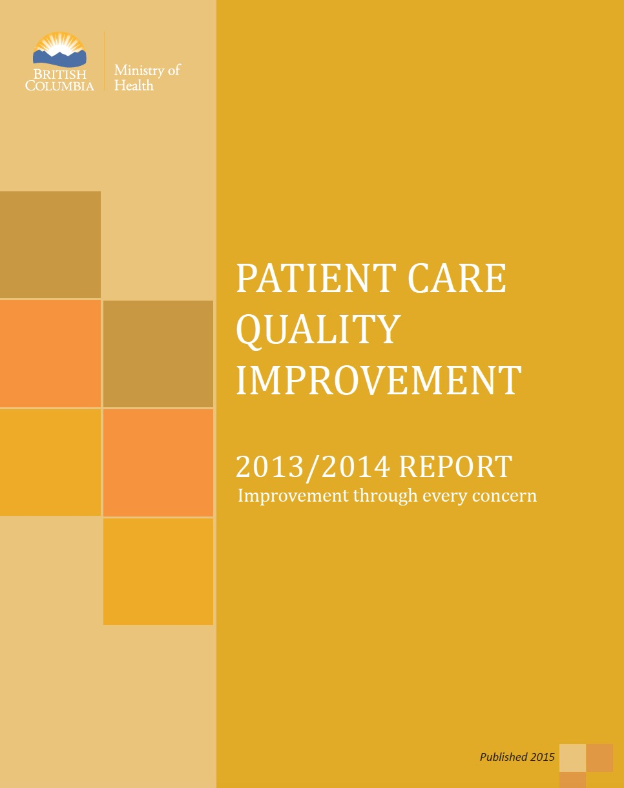

Slide 3
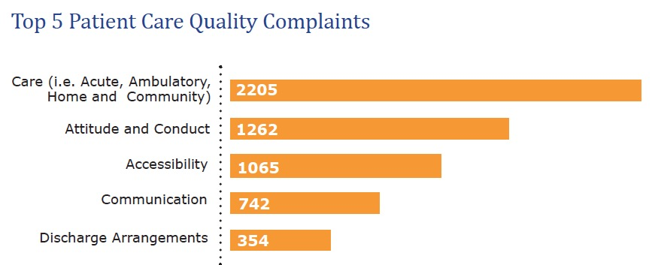
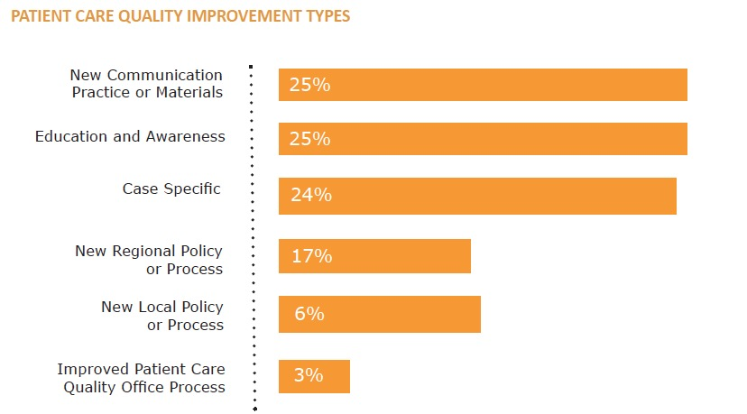

Slide 4
“Interprofessional” Getting the right word Getting the word right
IPE A three-part definition “Learning With, From and About, For the purposes of collaboration, To improve the quality of care”* Quality: Structure, Process, Outcome** *WHO (2010) Framework for Action on Interprofessional Education & Collaborative Practice – following the CAIPE definition (2002) **Donabedian A. Evaluating the quality of medical care. Milbank Memorial Fund Quarterly, 1966, 44: 166–206.

Slide 5
A Complex Challenge

