Slide 1
Stanford Coordinated Care Alan Glaseroff MD Co-Director
Canada-US Health Summit
Delivery System Reform
11/3/15

Slide 2
SCC Approach: “The Activation Model”
From:
“What bothers you the most?
To:
“Where do you want to be in a year?”
First step
Next step
Getting there…

Slide 3
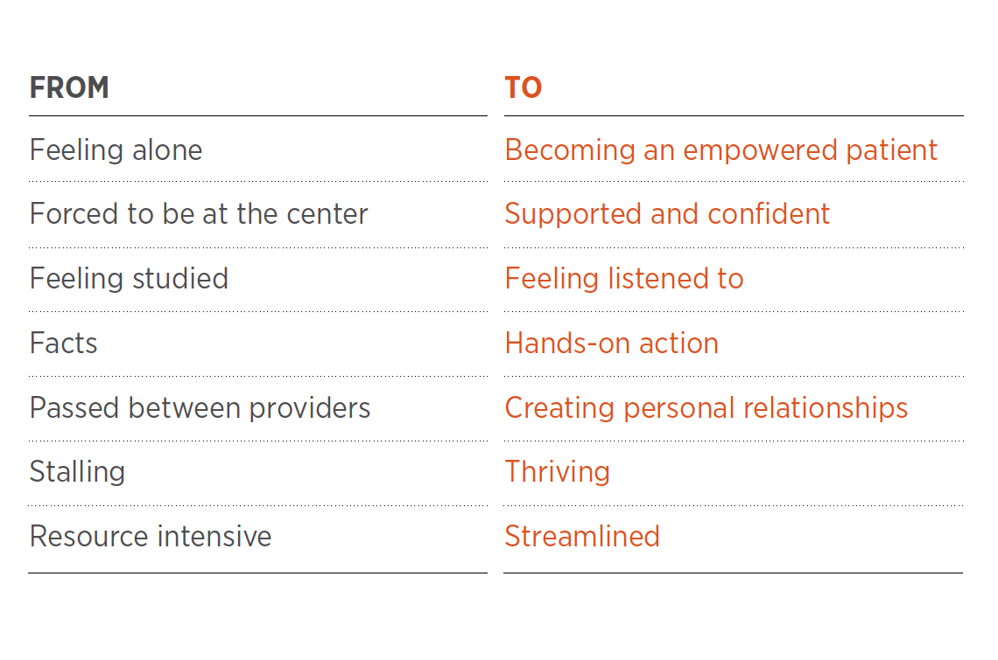
Human Centered Design

Slide 4
From “Cup Runneth Over”…
Medical Assistant/Care Coordinator
Provider
Nurse
Behavioral Health
Clinical Pharmacist
Physical Therapist
Notes:
If done successfully, can move from this….

Slide 5
To “Share the Care”
Provider
Medical Assistant/Care Coordinator
Nurse
LCSW/Behavioral Health
Physical Therapist
Clinical Pharmacist
Notes:
To this

