Slide 1
Implementing Transformation at Scale
William Golden MD MACP
Medical Director, AR Medicaid
UAMS Prof. Int. Med and Public Health

Slide 2
International Challenge
All Health Systems
Have Service Demand and Limited Resources
  Taxes vs. Premiums vs. Co-Pays vs. Access Limitations
Need Greater Stewardship
  Providers, Payers, Patients
Should Explore New Incentives to Shape Delivery
  Reward Outcomes, Effectiveness

Slide 3
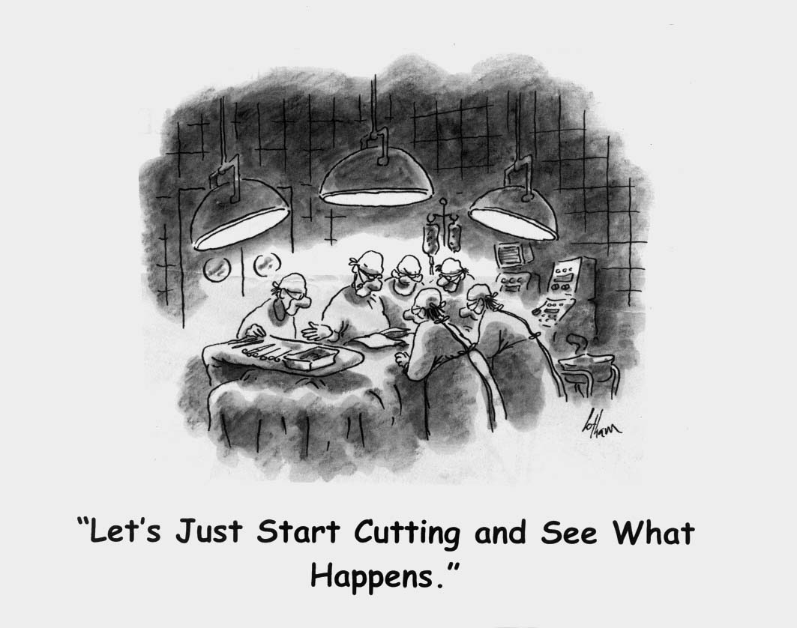

Slide 4
2011
Developing Vision

Slide 5
2012
Implementation

Slide 6
Engagement
Governor’s Office – Vision, Recruit Payers
Dept Human Services – Host Meetings, Develop Framework
Legislature – Approve Regulations
Private Insurers – Develop Internal Programs
Professional Societies – Cautious Support, Engagement
Clinical Leaders – Acceptance of Need for Change
Contractors – Outreach Activities, Data Management

Slide 7
PAPs that meet quality standards and have average costs below the commendable threshold will share in savings up to a limit
Shared savings
-
Pay portion of excess costs
Shared costs
High
No change
No change in payment to providers
Acceptable
+
Receive additional payment as share as savings
Commendable
Gain
sharing limit
Low
Individual providers, in order from highest to lowest average cost
Notes:
TALKING POINTS:
(1) For the vast majority of PAPs, things will remain unchanged, OR they will be sharing in the rewards of their performance
(2) The clear incentive mechanism being used is to attract PAPs toward improved performance – NOT to forcibly punish poor performers

Slide 8
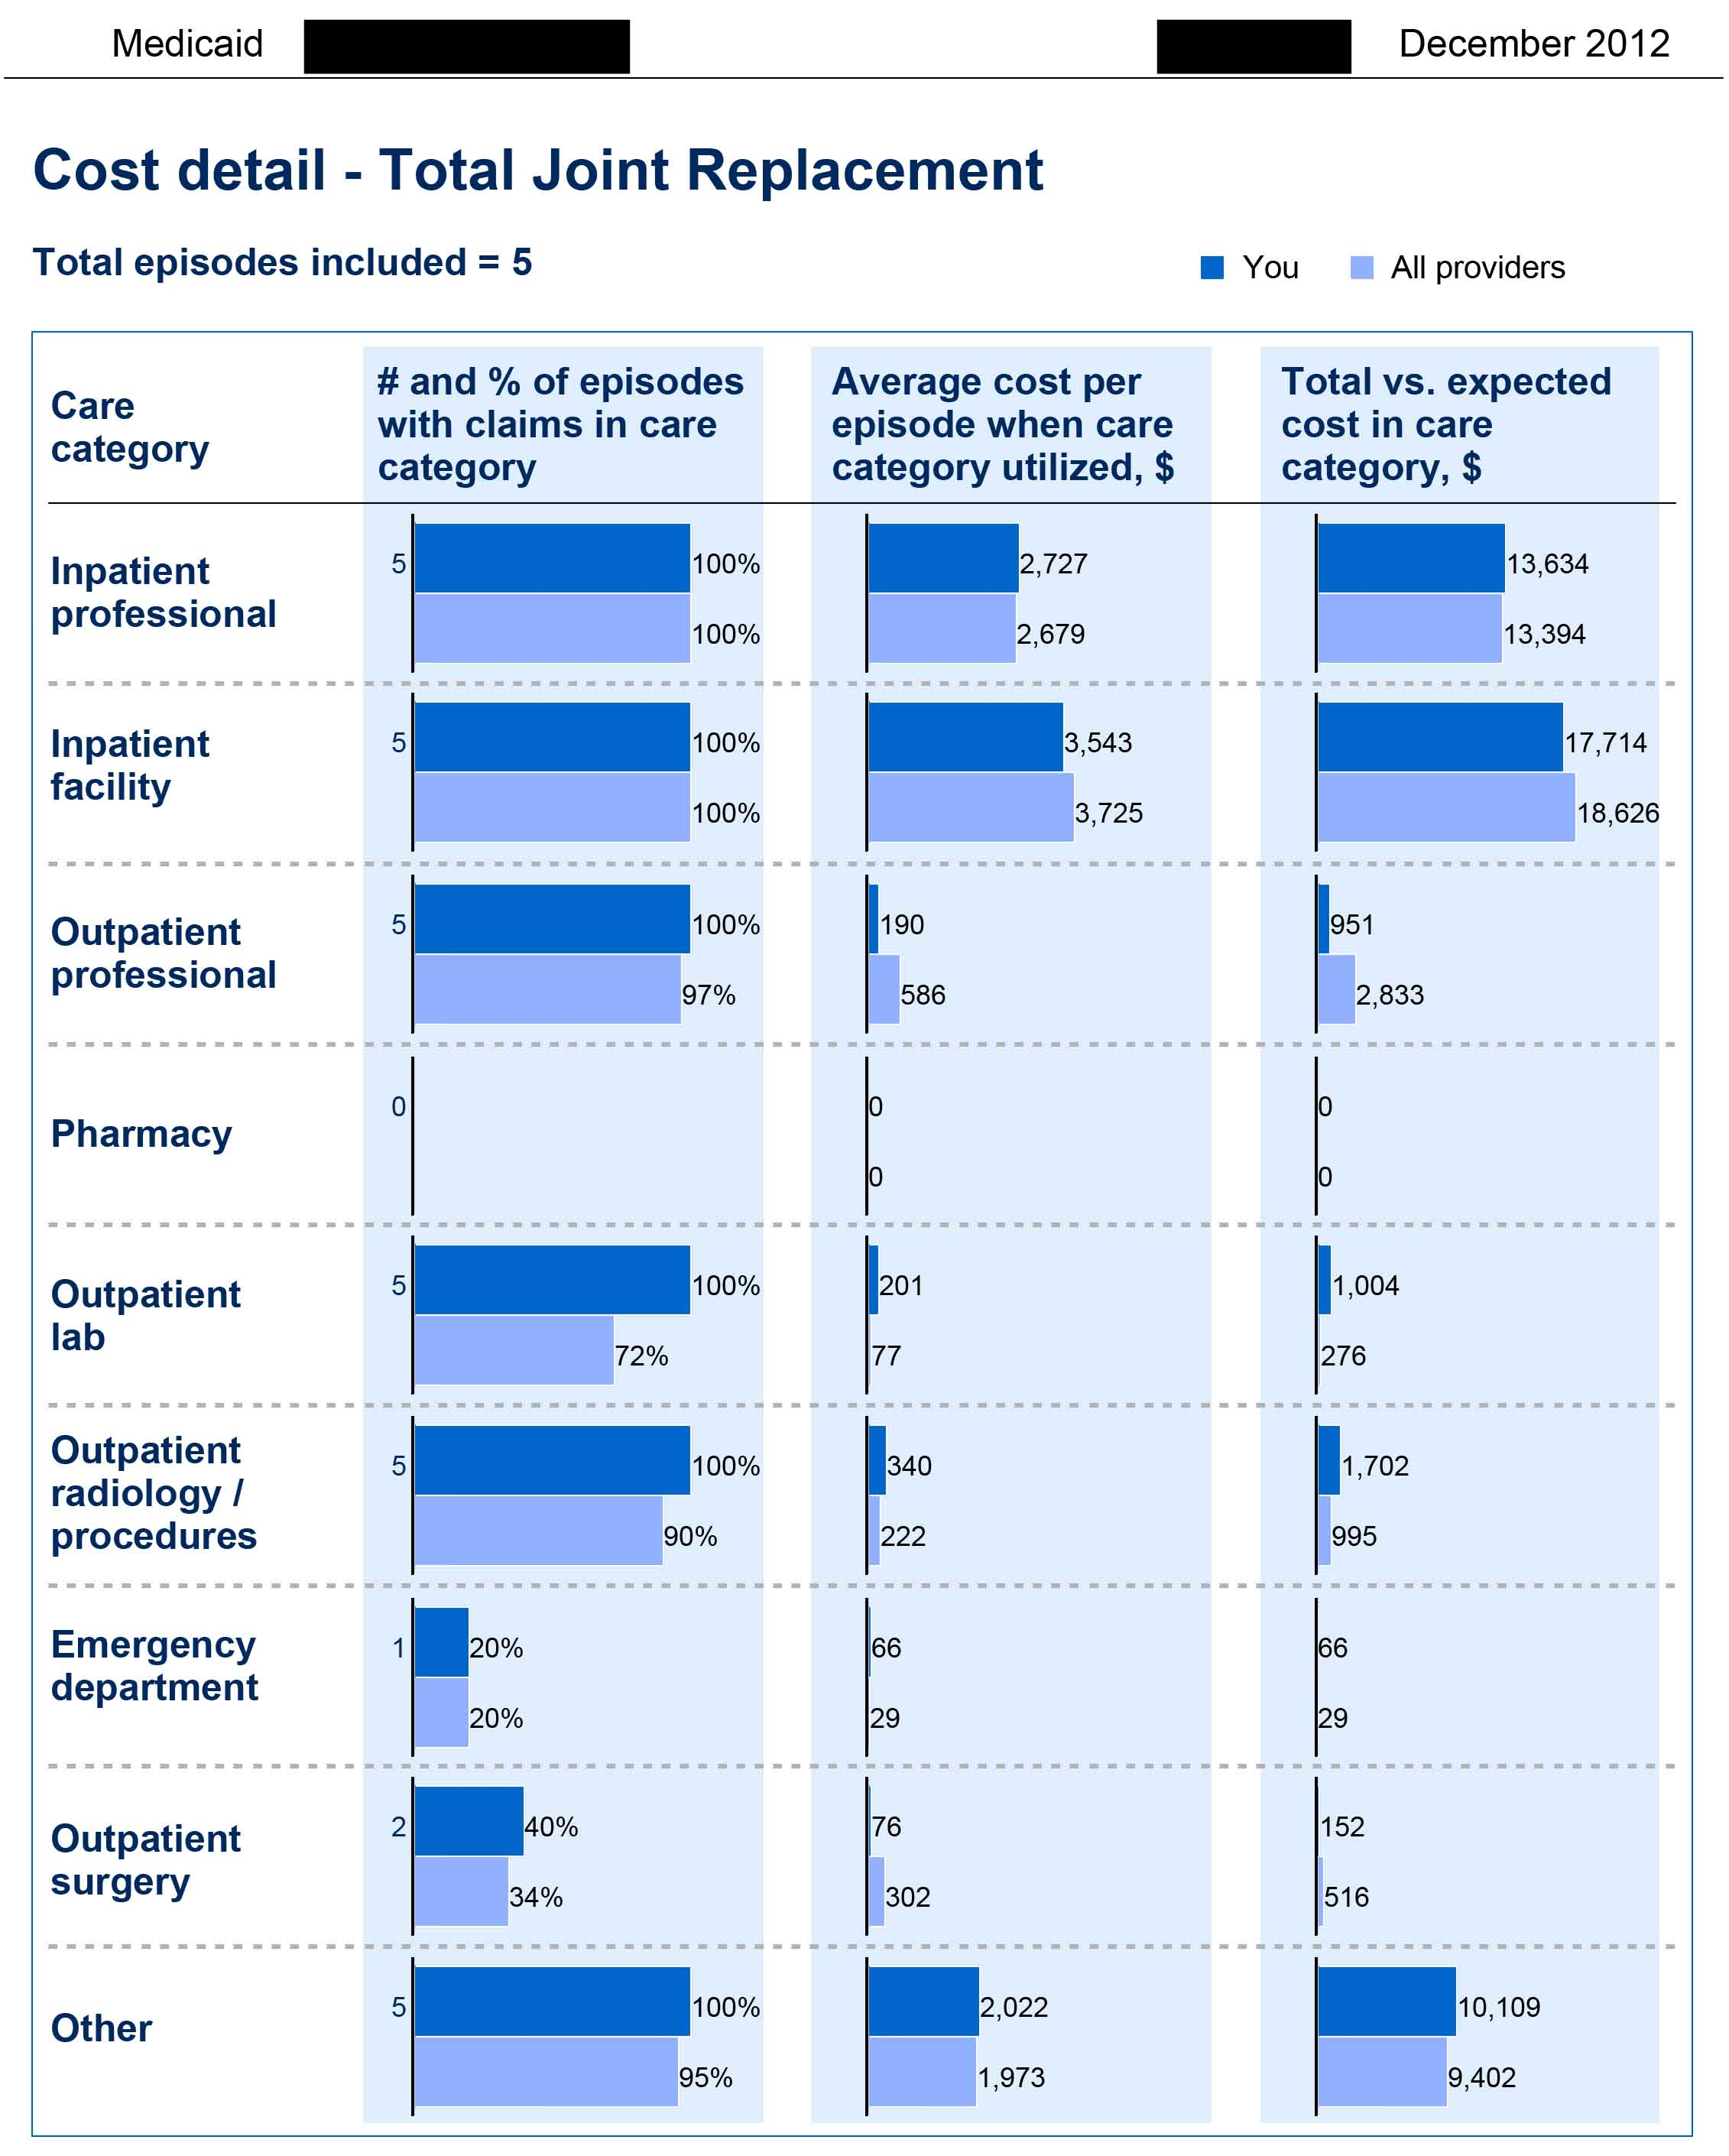

Slide 9
EOCs Progress to Date
Engine has processed 454.9 Million Claims
3.7 Million Episodes (before exclusions)
28,331 Reports
  13,834 EOC level payment or performance reports
  2,890 EOC level reconciliation reports
2,213 distinct PAPs
PAPs received a collective gain share of $793,337
Risk Share applied to PAPs for -$1,010,676
Notes:
All reports start as a historical report to allow providers to view data for a period of 2 time periods before the performance period starts. The performance period is a growing “year” period. January 2014 will mark the start of payments and adjustments for the first EOC, URI.

Slide 10
2014
PCMH

Slide 11


Providers can then receive support to invest in improvements, as well as incentives to improve quality and cost of care
2/3
2
Practice support
3
Shared savings
Invest in primary care to improve quality and cost of care for all beneficiaries through:
  Care coordination
  Practice transformation
Reward high quality care and cost efficiency by:
  Focusing on improving quality of care
  Incentivizing practices to effectively manage growth
  in costs
  DHS/DMS will also provide performance reports and patient panel information to enable improvement
11
Notes:
Enrollment in PCMH also gives providers and practices access to a great deal of support mechanisms to support their continued commitment to achieving PCMH’s goals.
Present the bullets re: Practice support and Shared savings

Slide 12
Activities tracked for practice support payments provide a framework for transformation
Completion of activity
and timing of reporting
Evolve your proce-sses
Month 12
Continue
to innovate
Commit to PCMH
Month 0-3
Start your journey
Month 6
Month 16-18
Activity
Month 24
1
  Identify office lead(s) for both care coordination and practice transformation¹
2
  Assess operations of practice and opportunities
  to improve (internal to PCMH)
3
  Develop strategy to implement care coordination and practice transformation improvements
4
  Identify top 10% of high-priority patients
  (including BH clients)²
5
  Identify and address medical neighborhood barriers to coordinated care (including BH professionals and facilities)
6
  Provide 24/7 access to care
7
  Document approach to expanding access
  to same-day appointments
8
  Complete a short survey related to patients’ ability to receive timely care, appointments, and information from specialists (including BH specialists)
9
  Document approach to contacting patients who have not received preventive care
10
  Document investment in healthcare technology or tools that support practice transformation
11
  Join SHARE to get inpatient discharge information from hospitals
12
  Incorporate e-prescribing into practice workflows³
13
  Integrate EHR into practice workflows
1 - At enrollment; 2 - Three months after the start of each performance period; 3 - At 18 months
Notes:
Key points
1. PBPM payments are investments in the practice
2. Activities provide a framework for transformation
The PBPM care coordination payments are investments in the PCMH to work towards the triple aim, as such there are activities that practices must meet in order maintain payments. These activities provide a framework for transformation and are due at various times over the course of the first two years.

Slide 14


Slide 15
Outcomes/Lessons
Learning System
  Stretch the Providers Who ----
  Provide Program Feedback ---
  That Modifies Requirements/Analytics ---
  Which Support Practice Transformation ---
  And Starts New Cycle of Dialogue

Slide 16
For more information …
Online
  More information on the Payment Improvement Initiative
  can be found at www.paymentinitiative.org
    Further detail on the initiative
    Specific details on all episodes
    Information on PCMH
Contacts
William Golden, M.D., Medical Director, Arkansas Medicaid
UAMS Professor of Medicine and Public Health
William.Golden@dhs.arkansas.gov
Lee Clark, MHSA, Episode Design and Delivery Manager, Arkansas Medicaid
Lee.Clark@dhs.arkansas.gov
E.J. Shoptaw, MS Senior Manager, Health Analytics & Fraud Prevention
General Dynamics Information Technology
Earnest.Shoptaw@gdit.com
Maggie Newton, Infrastructure and Implementation Manager, Arkansas Medicaid
Margaret.Newton@dhs.arkansas.gov
Lech Matuszewski, Policy and Research Director, Arkansas Medicaid
Lech.Matuszewski@dhs.arkansas.gov

