Slide 1

Health System Transformation
Post Affordable Care Act

Slide 2
Affordable Care Act Impact
Expansion of Health Insurance Coverage -> Decreased Uninsured Rates
Slower Growth in Health Care Costs
Improved Quality of Care
Source: Furman J, Fiedler M ─ Continuing the Affordable Care Act’s Progress on Delivery System Reform is an Economic Imperative.

Slide 3
Results: Higher Value, Lower Costs
According to the Congressional Budget Office, federal spending on major health care programs in 2020 will be $200 Billion lower than predicted in 2010.

Slide 5
Better Care, Smarter Spending, Healthier People
Focus Areas
Description
Incentives
Promote value-based payment systems
  Test new alternative payment models
  Increase linkage of Medicaid, Medicare FFS, and other payments to value
Bring proven payment models to scale
Care Delivery
Encourage the integration and coordination of services
Improve population health
Promote patient engagement through shared decision making
Information
Create transparency on cost and quality information
Bring electronic health information to the point of care for meaningful use
Source: Burwell SM. Setting Value-Based Payment Goals ─ HHS Efforts to Improve U.S. Health Care. NEJM 2015 Jan 26; published online first.

Slide 6
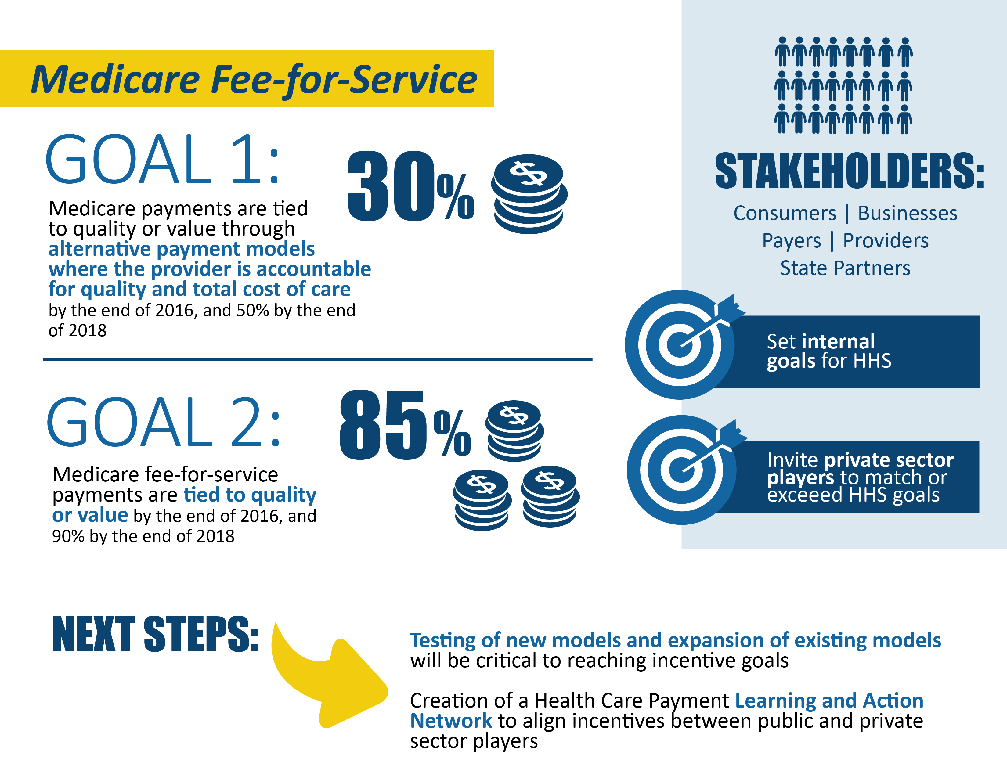
During January 2015, HHS announced goals for value-based payments within the Medicare FFS system
Notes:
Goals:
Goal 1: 30% of Medicare payments are tied to quality or value through alternative payment models (categories 3-4) by the end of 2016, and 50% by the end of 2018
Goal 2: 85% of all Medicare fee-for-service payments are tied to quality or value (categories 2-4) by the end of 2016, and 90% by the end of 2018
Purpose:
Set internal goals for HHS
Invite private sector payers to match or exceed HHS goals
Stakeholders:
Consumers
Businesses
Payers
Providers
State partners
Next Steps:
Testing of new models and expansion of existing models will be critical to reaching incentive goals
Creation of a Health Care Payment Learning and Action Network to align incentives for payers

Slide 7
Target percentage of payments in ‘FFS linked to quality’ and ‘alternative payment models’ by 2016 and 2018
Alternative payment models (Categories 3-4)
FFS linked to quality (Categories 2-4)
All Medicare FFS (Categories 1-4)
2011
2014
2016
2018
0%
~20%
30%
50%
68%
>80%
85%
90%
Historical Performance
Goals
Notes:
Version 2/15/2015

Slide 8
Center for Medicare and Medicaid Innovation

Slide 9

The CMS Innovation Center was created to develop, test, and implement new payment and service delivery models
Section 3021 of Affordable Care Act
“The purpose of the [Center] is to test innovative payment and service delivery models to reduce program expenditures…while preserving or enhancing the quality of care furnished to individuals under such titles.”

Slide 10
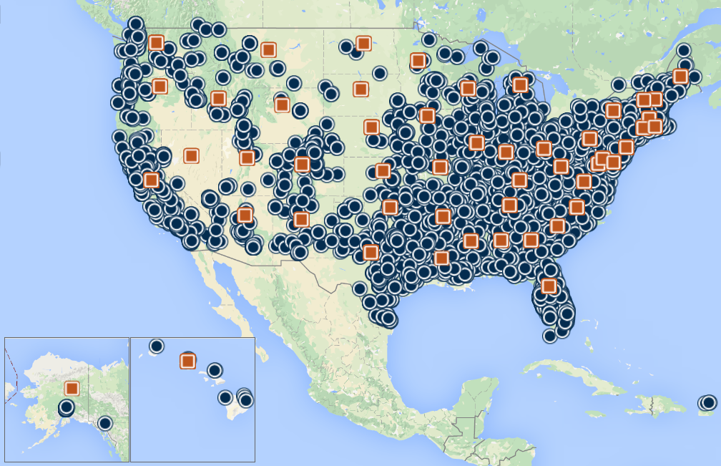
CMS has engaged the health care delivery system and invested in innovation across the country, every state and most territories
Sites where innovation models are being tested
Models run at the state level
Source: CMS Innovation Center website, January 2015
Notes:
Version 2/15/2015

Slide 11
The Innovation Center portfolio aligns with delivery system reform focus areas
Focus Areas
CMS Innovation Center Portfolio*
Pay Providers
Test and expand alternative payment models
Accountable Care
Pioneer ACO Model
Next Generation ACO
Medicare Shared Savings Program (housed in Center for Medicare)
Advance Payment ACO Model
Comprehensive ERSD Care Initiative
Primary Care Transformation
Comprehensive Primary Care Initiative (CPC)
Multi-Payer Advanced Primary Care Practice Demo
Home Health Value Based Purchasing
Federally Qualified Health Center (FQHC) Advanced Primary Care Practice Demonstration
Independence at Home Demonstration
Graduate Nurse Education Demonstration
Medicare Care Choices Model
Episode-Based Payment Initiatives
Bundled Payment for Care Improvement
Model 1: Retrospective Acute Care
Model 2: Retrospective Acute Care Episode & Post Acute
Model 3: Retrospective Post Acute Care
Model 4: Prospective Acute Care
Oncology Care Model
Comprehensive Care for Joint Replacement Model
Initiatives Focused on the Medicaid
Medicaid Emergency Psychiatric Demonstration
Medicaid Incentives for Prevention of Chronic Diseases
Strong Start Initiative
Medicaid Innovation Accelerator Program
Dual Eligible (Medicare-Medicaid Enrollees)
Financial Alignment Initiative
Initiative to Reduce Avoidable Hospitalizations among Nursing Facility Residents
Deliver Care
Support providers and states to improve the delivery of care
Learning and Diffusion
Partnership for Patients
Transforming Clinical Practice
Community-Based Care Transitions
Health Care Innovation Awards
State Innovation Models Initiative
SIM Round 1
SIM Round 2
Maryland All-Payer Model
Million Hearts Initiative
Distribute Information
Increase information available for effective informed decision-making by consumers and providers
Information to providers in CMMI models
Shared decision-making required by many models
* Many CMMI programs test innovations across multiple focus areas
Notes:
Version 2/15/2015
Only announced models are on this slide. Models in development include oncology care, Vanguard ACO, ACO investment model, Health plan innovation models, Ambulatory Care bundle, Million hearts model, Accountable Health Communities, Beneficiary engagement, Advanced Primary Care

Slide 12
Accountable Care Organizations (ACOs)

Slide 13

ACOs - Participation is Growing Rapidly
More than 400 ACOs participating in the Medicare Shared Savings Program
Almost 8 million assigned beneficiaries in 49 states, plus D.C. and Puerto Rico
Proposed MSSP rule seeks to build on this momentum.

Slide 14
Achieving the Goals
Accountable Care Organization (ACO) Models
  Pioneer ACO Model
  Next Generation ACO Model
  ESRD ACO Initiative
  Advance Payment Model
  ACO Investment Model
  Medicare Shared Savings Program – 3 Tracks
Value-Based Purchasing / Value-Based Modifier
Medicare Advantage also supporting ACOs
14
Notes:
On ACOs:
- Established by the ACA
- Aims to reduce Medicare costs while preserving or enhancing the quality of care
- Complements and informs the Medicare Shared Savings Program

Slide 15
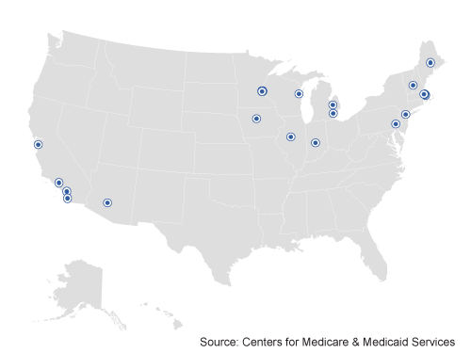
Pioneer ACOs provided higher quality and lower cost care to Medicare beneficiaries in their first two performance years
Pioneer ACOS were designed for organizations with experience in coordinated care and ACO-like contracts
Pioneer ACOs showed improved quality outcomes
  Quality outperformed published benchmarks in 15/15 clinical quality measures and 4/4 patient experience measures in year 1 and improved in year 2
  Mean quality score of 85.2% in 2013 compared to 71.8% in 2012
  Average performance score improved in 28 of 33 (85%) quality measures
Pioneer ACOs generated savings for 2nd year in a row
  $400M in program savings combined for two years† (Office of Actuary Certified expansion likely to reduce program expenditures)
  Average savings per ACO increased from $2.7 million in PY1 to $4.2 million in PY2‡
  19 ACOs operating in 12 states (AZ, CA, IA, IL, MA, ME, MI, MN, NH, NY, VT, WI) reaching over 600,000 Medicare fee-for-service beneficiaries
  Duration of model test: January 2012 – December 2014; 19 ACOs extended for 2 additional years
  Model certified by Actuary as likely to reduce expenditures and model improved quality
† Results from regression based analysis
‡ Results from actuarial analysis
Notes:
Version 2/15/2015

Slide 16
Next Generation ACO
Model Principles
Prospective attribution
Protect Medicare FFS beneficiaries’ freedom of choice;
Create a financial model with long-term sustainability;
Rewards quality;
Offer benefit enhancements that directly improve the patient experience and support coordinated care;
Allow beneficiaries a choice in their alignment with the ACO
Smooth ACO cash flow and improve investment capabilities through alternative payment mechanisms.
Notes:
Mitigates fluctuations in aligned beneficiary populations
Respects beneficiary preferences;
Ultimately transitions away from updating benchmarks based on ACO’s recent expenditures;

Slide 17
Primary Care

Slide 18
Post ACA
Primary Care Models improving Care
Comprehensive Primary Care Initiative
Independence at Home
Transforming Clinical Practice Initiative
Various Health Care Innovation Awards
State Innovation Model
FQHC Advanced Primary Care Practice Demonstration (Closed and being evaluated)
Chronic Care Management
Transitional Care Management Services

Slide 19
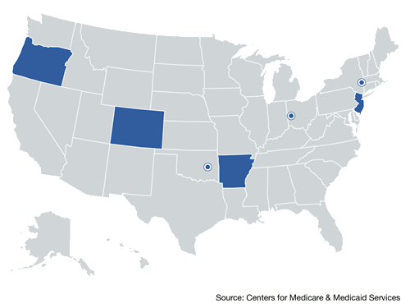
Comprehensive Primary Care (CPC) is showing early positive results
CMS convenes Medicaid and commercial payers to support primary care practice transformation through enhanced, non-visit-based payments, data feedback, and learning systems
Across all 7 regions, CPC reduced Medicare Part A and B expenditures per beneficiary by $14 or 2%*
  Reductions appear to be driven by initiative-wide impacts on reduced hospitalizations, ED visits, and unplanned 30-day readmissions
7 regions (AR, OR, NJ, CO, OK, OH/KY, NY) encompassing 31 payers, nearly 500 practices, and approximately 2.5 million multi-payer patients
Duration of model test: Oct 2012 – Dec 2016
* Reductions relative to a matched comparison group and do not include the care management fees (~$20 pbpm)
Notes:
Version 2/15/2015
CPC is similar to MAPCP in that it is a multi-payer PCMH initiative, except that CMS rather than the states are leading the effort and CMS-defined a standardized transformation approach across all 7 regions
CMS selected payers that were well-aligned in their strategies to support enhanced primary care
Enhanced payments include care management fees and shared savings
Approach to shared savings, relative to benchmark, threshold, MSR, savings calculated at regional level.
During the first year, across all attributed Medicare FFS beneficiaries, CPC appears to have reduced total monthly Medicare Part A and B expenditures per beneficiary (compared to what they would have been absent the CPC intervention) by $14, or 2 percent (not including care management fees paid). The reductions appear to be due to the favorable initiative-wide impacts on hospitalizations, ED visits (total and outpatient), and unplanned 30-day readmissions. Impacts were nearly large enough to offset CMS’s monthly care management fees, which average $20 per attributed beneficiary at participating practices. The reductions in expenditures for Medicare services render the initiative close to cost neutral for Medicare FFS as a whole, but suggest that CPC has not generated net savings during this first year. The expenditure and service use impact estimates differ significantly across regions, with the favorable initiative-wide results driven mainly by Oklahoma, where CPC generated favorable impacts on the key expenditures and service utilization outcomes (including Medicare expenditures, hospitalizations, and ED visits), and to a lesser extent by New Jersey (for Medicare expenditures), New York (for hospitalizations), and Oregon (for outpatient ED visits).

Slide 20
Spotlight: Comprehensive Primary Care, SAMA Healthcare
SAMA Healthcare Services is an independent four-physician family practice located located in El Dorado, a town in rural southeast Arkansas
Services made possible by CPC investment
Care management
  Each Care Team consists of a doctor, a nurse practitioner, a care coordinator, and three nurses
  Teams drive proactive preventive care for approximately 19,000 patients
  Teams use Allscripts’ Clinical Decision Support feature to alert the team to missing screenings and lab work
Risk stratification
  The practice implemented the AAFP six-level risk stratification tool
  Nurses mark records before the visit and physicians confirm stratification during the patient encounter
-Practice Administrator
“A lot of the things we’re doing now are things we wanted to do in the past… We needed the front-end investment of start-up money to develop our teams and our processes”

Slide 21
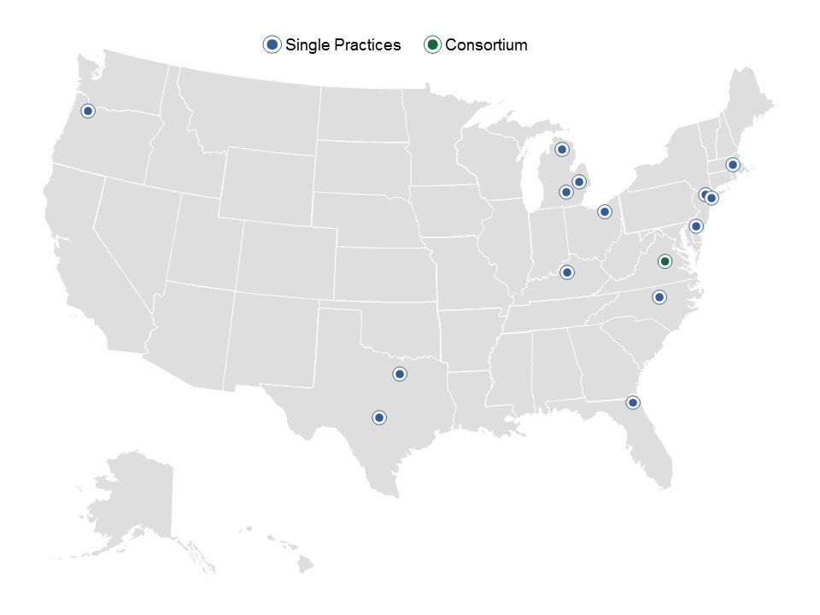
Independence at Home (IAH)
14 practices
1 consortium
~8,400 patients enrolled in first year
Duration: 2012-2015
IAH tests a service delivery and shared savings model using home-based primary medical care to improve health outcomes and reduce expenditures for high-risk Medicare beneficiaries.
First year results – good quality results and over $3000 per beneficiary per year savings
Notes:
Quarterly reporting

Slide 22
Bundled Payment Models

Slide 23
Bundled Payments for Care Improvement is also growing rapidly
The bundled payment model targets 48 conditions with a single payment for an episode of care
  Incentivizes providers to take accountability for both cost and quality of care
  Four Models
    Model 1: Retrospective acute care
    hospital stay only
    Model 2: Retrospective acute care
    hospital stay plus post-acute care
    Model 3: Retrospective post-acute
    care only
    Model 4: Acute care hospital stay only
102 Awardees and 167 episode initiators in phase 2 as of January 2015
85 new awardees and 373 new episode initiators entered phase 2 in April 2015
187 new awardees and 1,575 new episode initiators entered Phase 2 on July 1, 2015
* Current as of January 2015
Notes:
Early results are listed below in the event that you want to voice over the slides.
Quarterly reconciliation results for the second quarter of 2014 for Models 2 and 3 of the Bundled Payments for Care Improvement Initiative (BPCI).
Model 2 results included 14,528 acute/post-acute care episode cases and were mixed. The total CMS Discount Amount in Model 2 was $8.2 million, though this is not an estimate of BPCI savings. 30 out of 61 risk-bearing entities (Awardees and Awardee Conveners) achieved positive Reconciliation Amounts. Across risk-bearing entities, the average Reconciliation Amount was -$38,000 with a range from roughly -$1.5 million to $629,000. The aggregate Reconciliation Amount for Model 2 was -$2.3 million.
Model 3 results included 4,032 post-acute care episode cases and results were similarly mixed. The total CMS Discount Amount in Model 3 was $2.8 million. 5 out of 20 risk-bearing entities achieved positive Reconciliation Amounts, but the positive Reconciliation Amounts more than offset the negative Reconciliation amounts. Among risk-bearing entities, the average Reconciliation Amount was roughly $61,000, with a range from around -$520,000 to $909,000. The aggregate Reconciliation Amount for Model 3 was $1.1 million.
Results in the second quarter of 2014 were similar to results from the first quarter of 2014 for most of the 191 Model 2 and Model 3 Episode Initiators who participated in both quarters. 124 out of the 191 Episode Initiators that participated in both quarters received Reconciliation Amounts for the second quarter of 2014 that were the same sign as the Reconciliation Amounts for the first quarter of 2014. Of the remaining 67 Episode Initiators, 30 transitioned from negative to positive Reconciliation Amounts and 37 transitioned from positive to negative Reconciliation Amounts.
Duration of model is scheduled for 3 years:
Model 1: April 2013 to present
Models 2,3,4: October 2013 to present

Slide 24
What is the Comprehensive Care Joint Replacement model?
The model would test bundled payments for lower extremity joint replacement (LEJR) across a broad cross-section of hospitals.
The payment model would apply to most Medicare LEJR procedures within select geographic areas with few exceptions.
The payment model would be implemented through rule making, and the performance period proposed to begin on January 1, 2016.

Slide 25
CCJR Participants
Participants include Inpatient Prospective Payment System (IPPS) Hospitals in select Metropolitan Statistical Areas (MSA) not participating in phase II of the Bundled Payment for Care Improvement (BPCI) model for the lower extremity joint replacement clinical episode.
  BPCI Model 2 and Model 3 LEJR episodes initiated by participating physician group practices or post-acute care facilities would take precedence over Comprehensive Care Joint Replacement model episodes.
75 MSAs were selected in a two-step randomization process.
  MSA were placed into five groups based on their historic LEJR episode payment and their population size.
  Fifteen MSAs were then randomly selected within each group.

Slide 26
State Based Models

Slide 27
State Innovation Model grants have been awarded in two rounds: 38 States and Territories
Primary objectives include
  Improving the
  quality of care delivered
  Improving population health
  Increasing cost efficiency and
  expand value-based payment
Six round 1 model test states
Eleven round 2 model test states
Twenty one round 2 model design states
Notes:
CMS is testing the ability of state governments to utilize policy and regulatory levers to accelerate health care transformation
Near term CMMI objectives
Establish project milestones and success metrics
Support development of states’ stakeholder engagement plans
Onboard states to Technical Assistance Solution Center and SIMergy Collaboration site
Launch State HIT Resource Center and CDC support for Population Health Plans

Slide 28
Maryland is testing an innovative All-Payer Payment Model
Maryland is the nation’s only all-payer hospital rate regulation system
Model will test whether effective accountability for both cost and quality can be achieved within all-payer system based upon per capita total hospital cost growth
Quality of care will be measured through
  Readmissions
  Hospital Acquired Conditions
  Population Health
* US census bureau estimate for 2013
Notes:
Maryland has ~6 million residents*
Hospitals began moving into All-Payer Global Budgets in July 2014
95% of Maryland hospital revenue will be in global budgets
46 hospitals have signed agreements
Model was initiated in January 2014; Five year test period

Slide 29
Additional Models and Initiatives

Slide 30
Medicare Care Choices
Proposed in rule making
Concurrent hospice and palliative care services along with curative care
These services must be available 24/7, 365 calendar days per year.
CMS will pay a $400 per beneficiary per month fee to the Medicare Care Choices Model participating hospices.
Notes:
Providers and suppliers furnishing curative services to beneficiaries participating in Medicare Care Choices Model will be able to continue to bill Medicare for the reasonable and necessary services they furnish. The model will be phased in over two years with approximately half of the participants providing services from January 1, 2016 to December 31, 2020. The remaining participants will provide services from January 1, 2018 to December 31, 2020. Model participants were randomly be assigned to Phase 1 or Phase 2.

Slide 31
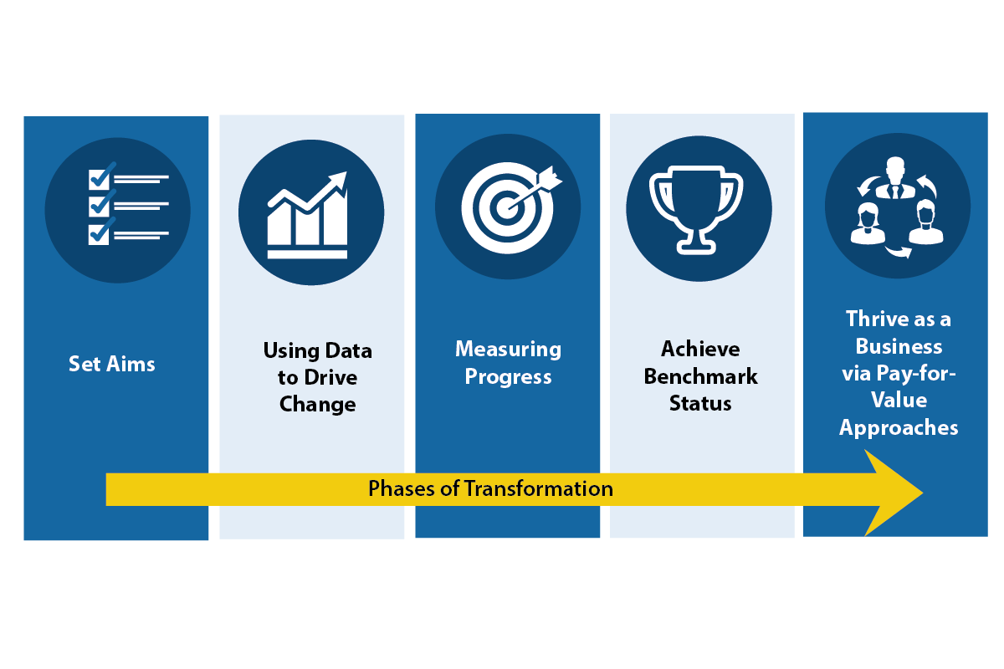
Transforming Clinical Practice Initiative is designed to help clinicians achieve large-scale health transformation
Two network systems will be created
  Practice Transformation Networks: peer-based learning networks designed to coach, mentor, and assist
  Support and Alignment Networks: provides a system for workforce development utilizing professional associations and public-private partnerships
Notes:
The model will support over 150,000 clinician practices over the next four years to improve on quality and enter alternative payment models

Slide 32
On the Horizon

Slide 33
What is “MACRA”?
The Medicare Access and CHIP Reauthorization Act of 2015 (MACRA) is a bipartisan legislation signed into law on April 16, 2015.
What does Title I of MACRA do?
  Repeals the Sustainable Growth Rate (SGR) Formula
  Changes the way that Medicare rewards clinicians for value over volume
  Streamlines multiple quality programs under the new Merit-Based Incentive Payments System (MIPS)
  Provides bonus payments for participation in eligible alternative payment models (APMs)
Notes:
Bullets edits

Slide 34

How will physicians and practitioners be scored under MIPS?
A single MIPS composite performance score will factor in performance in 4 weighted performance categories:
2
:
MIPS Composite Performance Score
a
Quality
Resource use
Clinical practice improvement activities
Meaningful use of certified EHR technology

Slide 35

How much can MIPS adjust payments?
Based on the MIPS composite performance score, physicians and practitioners will receive positive, negative, or neutral adjustments up to the percentages below.
MIPS adjustments are budget neutral. A scaling factor may be applied to upward adjustments to make total upward and downward adjustments equal.
9%
7%
4%
5%
Adjustment to provider’s base rate of Medicare Part B payment
MAXIMUM Adjustments
-4%
-5%
-7%
-9%
2019 2020 2021 2022 onward
Merit-Based Incentive Payment System (MIPS)
Notes:
Add -4%, -5%, -7%, -9%?

Slide 36
Recall: How MACRA get us closer to meeting HHS payment reform goals
The Merit-based Incentive Payment System helps to link fee-for-service payments to quality and value.
New HHS Goals:
2016
2018
The law also provides incentives for participation in Alternative Payment Models via the bonus payment for Qualifying APM Participants (QPs) and favorable scoring in MIPS for APM participants who are not QPs.
30%
50%
85%
90%
All Medicare fee-for-service (FFS) payments (Categories 1-4)
Medicare FFS payments linked to quality and value (Categories 2-4)
0%
Medicare payments linked to quality and value via APMs (Categories 3-4)
Medicare payments to QPs in eligible APMs under MACRA

Slide 37




What is an eligible APM?
Eligible APMs are the most advanced APMs that meet the following criteria according to the MACRA law:
Base payment on quality measures comparable to those in MIPS
Require use of certified EHR technology
Either (1) bear more than nominal financial risk for monetary losses OR (2) be a medical home model expanded under CMMI authority

Slide 38

How do I become a qualifying APM participant (QP)?
QPs are physicians and practitioners who have a certain % of their patients or payments through an eligible APM.
Beginning in 2021, this threshold % may be reached through a combination of Medicare and other non-Medicare payer arrangements, such as private payers and Medicaid.
eligible APM
QP
QPs:
Are not subject to MIPS
Receive 5% lump sum bonus payments for years 2019-2024
Receive a higher fee schedule update for 2026 and onward
Notes:
Connect eligible APM to provider

Slide 39



Independent PFPM Technical Advisory Committee
PFPM = Physician-Focused Payment Model
Encourage new APM options for Medicare physicians and practitioners.
G
2
*
Technical Advisory Committee
(11 appointed care delivery experts)
Secretary comments on CMS website, CMS considers testing proposed model
Submission of model proposals
Review proposals, submit recommendations to HHS Secretary

