Slide 1

Africa on the Move!: The role of political will and commitment in improving access to family planning in Africa
Woodrow Wilson Center
5 June 2012
Violet I Murunga, Nyokabi R Musila, Rose N Oronje and Eliya M Zulu
1
Notes:
HIV Project Consultative Meeting Draft Presentation
1

Slide 2
Outline
Background
Political will for family planning in sub-Saharan Africa
Case studies – Ethiopia, Rwanda and Malawi
How political will was generated
How political will manifested
How political will affected FP policies and programs
Challenges
Implications
Recommendations

Slide 3
Past pronatalist views in Sub-Saharan Africa
Population growth and size – traditionally sensitive and contentious issues among post-independence African leaders
They also believed they were protecting the reproductive aspirations of their constituents - to have many children
Link to international population conferences
Notes:
Population growth and size have traditionally been sensitive and contentious issues among post independence African leaders. They believed that westerners wanted to suppress African populations and resultantly suppress their role in global discourses and development. there was also the cultural aspect. They believed that they were protecting the reproductive desires of their people which was to have many children. Their position was bolstered by the surprising position adopted by the Reagan administration of the USA, who pushed the Mexico conference to adopt the position that population growth is not a major ingredient of development.

Slide 4
What is Political Will?
Political will refers to the commitment and support that leaders have and exhibit towards promoting FP.
It helps create a conducive policy environment for development and prioritization of FP programs within government and by development partners.
Leaders can also play a big role in generating demand for FP by changing negative attitudes that ordinary people may have about FP and family limitation.
Notes:
Various factors are responsible for increase in contraceptive use in these countries. But political will is a precursor to success in sub-Saharan Africa. it involves providing commitment and support to FP programs and or creating a conducive policy environment for FP programs to be implemented. Leaders can also play a big role in generating demand for FP by changing negative attitudes that ordinary people may have about FP and family limitation.
According to Shiffman (2007), we know priority is present when:
(1) national political leaders publicly and privately express sustained concern for the issue; (2) the government, through an authoritative decisionmaking process, enacts policies that offer widely embraced strategies to address the problem; and (3) the government allocates and releases public budgets commensurate with
the problem’s gravity.

Slide 5
Case studies
Ethiopia, Rwanda and Malawi
Notes:
We sought to characterize political will for FP using 3 case study countries – Ethiopia, Rwanda and Malawi.

Slide 6
Trends in contraceptive use among married women
Rwanda
Malawi
% uptake
Ethiopia
Year
Notes:
The three countries have seen rapid increases in contraceptive use in the last decade with Rwanda registering the fastest rate of increase at 4 percentage points per year; Malawi and Ethiopia have registered 1.9 and 1.6 percentage points per year respectively. Comparison to West Africa, median about 10%.

Slide 7
Trends in Total Fertility Rate and Contraceptive Use
Country | Year | Total fertility rate | Contraceptive prevalence rate (%)
Ethiopia | 1990 | 6.4 | 2.9
 | 2000 | 5.9 | 6.3
 | 2011 | 4.8 | 27.3
Malawi | 1992 | 6.7 | 7.4
 | 2000 | 6.3 | 26.1
 | 2010 | 5.7 | 42.2
Rwanda | 1992 | 6.2 | 12.9
 | 2000 | 5.8 | 4.3
 | 2010 | 4.6 | 45.1

Slide 8
Case Study Objectives
To examine factors that have propelled the change in attitudes of some political leaders to champion family planning
To assess how such political will has manifested in different contexts
To explore how political will affects the policy and program environment.
Notes:
To characterize political will for family planning in the three countries we investigated three things:- 1) factors that have propelled the change in attitudes of some political leaders to champion family planning (how political will was generated); 2) how such political will has manifested in different contexts; 3) how political will affects the policy and program environment.

Slide 9
How political will was generated
Evidence on:
Preference for fewer children and demand for family planning
The link between maternal and child health under the MDG framework
The decline of economic performance
gap between population growth rates and economic growth rate; cannot alleviate poverty with growing poor population
Notes:
Gill Walt and Lucy Gilson proposed a ‘Policy Analysis Triangle’ in 1994 to help policy analysts think more systematically about the multitude of factors (content, process, context and actors) affecting policy and the interrelations among these factors. Numerous studies on a range of health and health reform issues have used this framework to organise material to assist in elucidating what drove policy change.
Actors refer to individuals, organizations or the state, and their actions that affect health policy. All actors have their own interests and agendas. Examples of actors include individuals, international NGOs, national NGOs, pressure/interest groups, international organizations, bilateral agencies, funding organizations, private sector companies, and the media.
Context means systematic factors - political, economic, social or cultural, both national and international - which may have an effect of health policy. These include:
Situational factors- transient, impermanent conditions which can have an impact on policy (e.g wars, droughts)
Structural factors- relatively unchanging elements of society (e.g. the political system, type of economy, demographic features)
Cultural factors- religion, ethnicity, gender
International or exogenous factors- some policies require cooperation between national, regional or multilateral organizations
Content is the substance of a particular policy which details the subjects and topics covered.
Process is the way in which policies are initiated, developed or formulated, negotiated, communicated, implemented and evaluated. Policy formation falls into the process corner of the framework and is influenced by actors, content, and context. It is a process of negotiation and bargaining in order to satisfy various interests and build a coalition of support.
We also draw on Shiffman and colleagues (scholars in the field of political science) work. They argue that in order to generate either national or global political support for reproductive health four key factors need to be considered:-
Actor power – characterized by policy community cohesion, strong leadership within political/policy
community, strong institutions, civil society mobilization
Ideas – characterized by internal agreement by all involved actors on scope and frame of issue, and how to present it to the larger global or national community;
Political contexts characterized by awareness of and access to policy windows and advantageous political opportunities
Issue characteristics – use of credible evidence to show policymakers a problem existed; the generation of clear policy alternatives to demonstrate the problem was surmountable

Slide 10
How political will was generated cont’d
Sustained advocacy by local and international champions and organizations
Formation of Commodity Security Working Groups

Slide 11
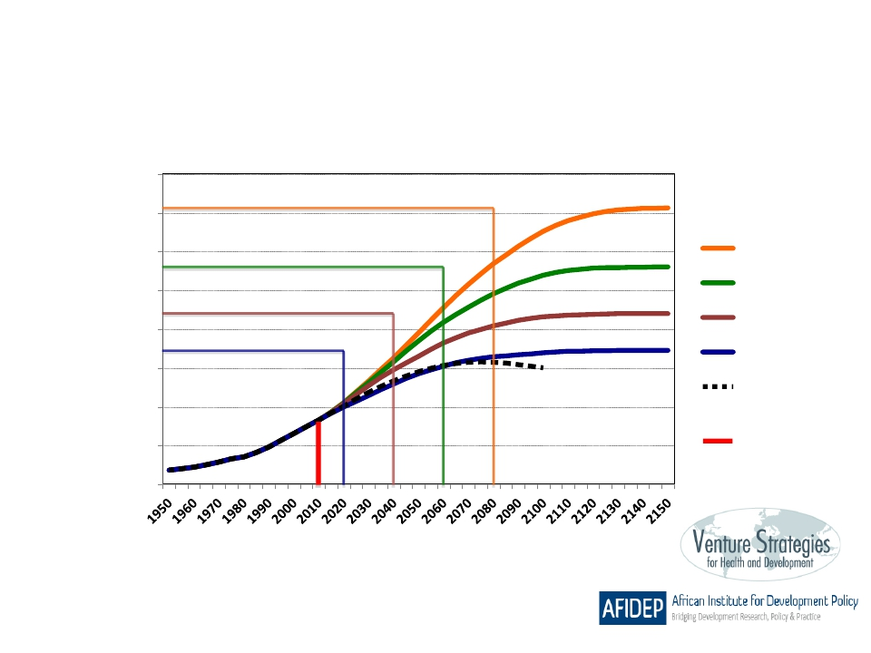
The year in which a country reaches replacement level fertility
has a major impact on its ultimate population size.
Ethiopia
400
350
population (millions)
2080
2060
2040
2020
UN Newest
Projection
2010 Current
population
300
250
200
150
100
50
0
Total fertility rate: 5.4
Unmet need for family planning: 34%

Slide 12
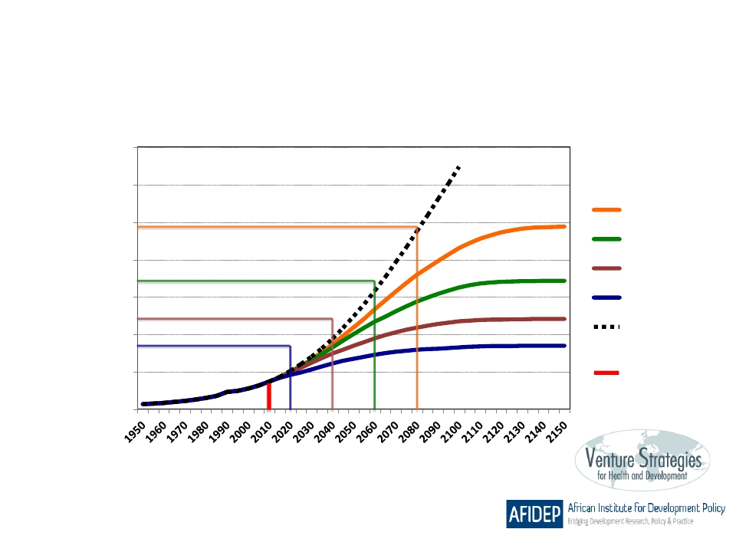
The year in which a country reaches replacement level fertility
has a major impact on its ultimate population size.
Malawi
140
120
population (millions)
2080
2060
2040
2020
UN Newest
Projection
2010 Current
population
100
80
60
40
20
0
Total fertility rate: 6.0
Unmet need for family planning: 27%

Slide 13
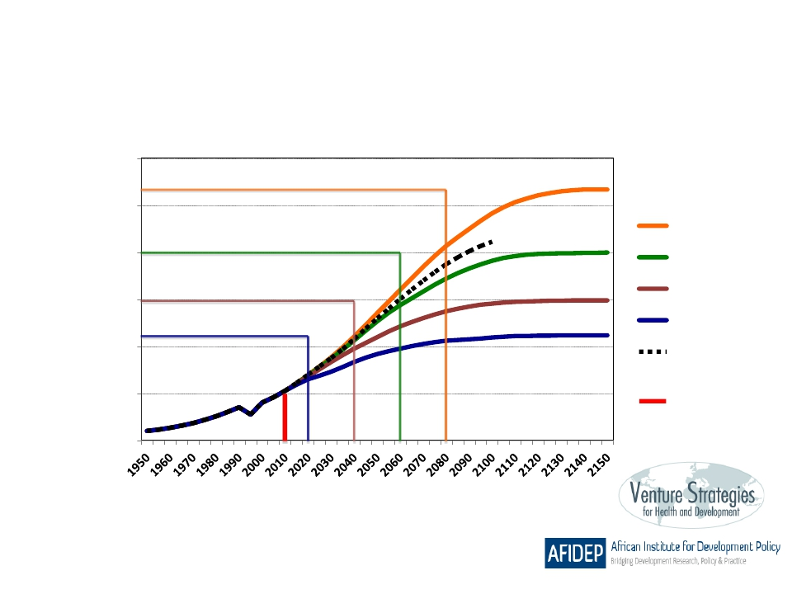
The year in which a country reaches replacement level fertility
has a major impact on its ultimate population size.
Rwanda
60
50
population (millions)
2080
2060
2040
2020
UN Newest
Projection
2010 Current
population
40
30
20
10
0
Total fertility rate: 5.4
Unmet need for family planning: 38%

Slide 14
Key milestones - Ethiopia
Year | Key Events
1993 | The new transitional government developed the country’s 1st population policy
2003 | The Health Extension Program (HEP) was launched – to bring key maternal, neonatal and child health interventions to the community. The package includes family planning services.
2004 | Formation of the FP Technical Committee
2005 | PASDEP 2005/06-2009/10 - poverty reduction strategy aiming aligned with CPR target of 60%
2009 | Implanon scale up initiative launched
2010 | Growth and Transformation Plan includes CPR target of 80% by 2015
2010 | Internally generated funds worth US$919,000 released for contraceptives for the first time
2010 | IUCD scale up initiative (2011-2013) launched
2011 | National Population Plan of Action 2010/11-2014/15 launched aligned to ICPD, the MDGs, the Beijing Conference on Women, and HSDP IV; CPR target of 66% by 2015

Slide 15
Key advocates
Dr. Tedros Adhanom Ghebreyesus, Minister of Health since 2005
Family Guidance Association of Ethiopia (FGAE)
Formation of the FP Technical Committee

Slide 16
Framing the issue – Development and health
“The government sought to achieve the high CPR target including meeting the unmet need for FP and improving the logistic supply chain management system with the ultimate aim of attaining the MDG 4 and 5 and indirectly MDG 1 – hence, repositioning FP from just a health issue to a key development issue” UNFPA/Ethiopia
Notes:
The Ethiopian government was interested in achieving its development plans but policy makers became increasingly aware that this would be difficult given its documented rapid population growth and predominantly rural population (80%). Top level leadership recognized the importance of family planning in helping curb rapid population growth towards achieving the MDGs and its vision of becoming a middle income country. Early marriage is a major issue in Ethiopia where majority of the population is rural. The health message is promoted at the grassroots level to tackle this strongcultural barrier.

Slide 17
Key milestones - Rwanda
Year | Key Events
1977 | FP goals included in five-year development plan (1977-1981) for the first time
1981 | National Office of Population (ONAPO) established.
1990 | National Population Policy developed goal to reduce TFR from 8.6 to 4.0 and increase CPR from 2 to 48 % by 2000
1994 | Genocide
2002 | Government gets support from USAID to improve contraceptive supply chain
2003 | ONAPO closed and the Ministry of Health to lead FP services and Ministry of Finance to lead population policy development and implementation
2005 | Formation of the FP TWG
2006 | Initiation of FP secondary posts
2008 | Economic Development and Poverty Reduction Strategy (EDPRS), 2008-2012 sets CPR target at 70% and reducing total fertility rate (TFR) to 4.5 children
2009 | FP is repositioned as a national priorty by Preseident Kagame at the Kivu retreat

Slide 18
Key advocates
Rwanda - Dr. Jean Damascene Ntawukuriryayo, former Minister of Health nicknamed ‘Mr Family Planning’ then later President Paul Kagame “Family planning is priority number one—not just talking about it, but implementing it”
Association Rwandaise pour le Bien-Etre Familial (ARBEF)
Formation of the Family Planning Technical Working Group (FPTWG)

Slide 19

“We cannot develop into a middle income country without addressing high population growth” Dr. Ntawukuliryayo, Senate President, Rwanda
Notes:
Former Minister of Health, mobilised parliamenterians to support FP
Despite post-genocide sensitivities, recognition of role of FP in development, impact on land

Slide 20
Key milestones - Malawi
Year | Key Events
1964-1982 | Family planning banned
1982 | ‘Child Spacing’ program initiated
1987 | GOM launched a development policy plan (1987-1996) with very little reference to child spacing
1988 | Community based distribution and social marketing objectives expanded
1994 | National Population Policy launched
1994 | Child Spacing Program renamed Malawi Family Planning Program
1996 | Family Planning Policy and Contraceptive Guidelines (2nd edition) liberalized provision of contraception
1997 | The Family Health Unit is reformed into the Reproductive Health Unit & FP became an integrated part of RH services.
1997 | System for improving supply chain introduced
1998 | CBD agent training manuals and guidelines are developed
2008 | Community Based Injectable Contraceptive Services Guidelines-2008

Slide 21
Key advocates
Dr Lucy Kadzamira, Director of Nursing Services in the Ministry of Health and Dr. Chiphangwi, member of Family Planning Association of Malawi
Formation of a multisectoral SRH Commodity Security Sub-Committee

Slide 22
Framing the issue – Health issue initially, recently development issue
President (Banda) convinced to lift ban on FP in early 1980s – “modern contraceptives will reinforce traditional child spacing to save the lives of mothers who were dying from having children too close together convinced”
Notes:
Malawi has struggled with high maternal deaths for decades. It was of interest to Banda to reduce maternal deaths. This became the selling point for FP advocates to him. The Country was also undergoing economic difficulties and rapid population growth was an issue however the push was not as strong from this angle because of the sensitivities of the issue.

Slide 23
How political will has manifested
Ideal but rare
The norm
Top level leadership championing of family planning (President/Prime Minister)
Creation of an enabling environment by top level leadership for the Ministry of Health to lead efforts

Slide 24
Rwanda
President H.E. Paul Kagame publicly champios family planning
Rwanda has a strong governance structure in which family planning is firmly entrenched
2009 Kivu retreat – FP was identified as a key development priority
30 District Mayors and relevant Ministers sign performance contracts with the president – one of the targets is to increase contraceptive use
Family contracts are also being encouraged
Monthly Umuganda

Slide 25
Ethiopia and Malawi
No top level champions
Ethiopian top leadership has created space for the Ministry to expand FP with strong community involvement

Slide 26
Effect of political will on policy & program environment
Political Will
Improved reproductive health/fertility outcomes
Increased financial and technical assistance
Increased access to quality services
Notes:
Does this make sense?

Slide 27
Effect of political will on policy & program environment
Enabling policy and program environment
Increased financial and technical resources from government and development partners
Financing for commodities
Budget line for FP (Rwanda and Ethiopia)
Increased government expenditure on FP
Increased public promotion of family planning
President Kagame and Umuganda (community meetings) in Rwanda
Notes:
According to Sullivan (undated) countries that adopted population policies received, on average, more funding from the United States Agency for International Development (USAID) (Barrett and Tsui 1999). Second, countries with population policies experienced statistically greater fertility declines between 1987 and 2002 than those without such policies: 21% compared to 14% (author’s calculations from World Bank(2009)). Third, countries with population policies have a greater potential to improve gender and human rights because the policies motivate discussion of sex, generation and power, and provide language to groups promoting such rights (Robinson 2009).

Slide 28
Despite progress, challenges continue to persist
Sub-Saharan governments could invest more in RH/FP
competing development priorities compounded with scarce resources
Malawi’s total fertility rate remains high despite relatively good contraceptive use rates
Unmet need for family planning is still high in these countries
Notes:
Unmet need ranging between 25 and 40 in these countries.

Slide 29
Implications for sub-Saharan African countries
Generation of political will, its manifestation and impact depends on unique political, cultural and socio-economic contexts of countries
Ethiopia, Rwanda and Malawi are all very different
Contextual barriers can be overcome over time through sustained advocacy

Slide 30
South – South Recommendations
Awareness of the unique political, cultural and socio-economic contexts and identification of policy windows
Involvement of actors from Ministry of Health
Mobilization of other key policy actors –nationals, able to lead &/or add strong voice, knowledgeable & passionate and able to contextualize & communicate effectively

Slide 31
South – South Recommendations cont’d
Involvement of strong institutions (established FP providers and advocates) and CSOs
Make the case for family planning by contextualizing it

Slide 32
North – South Recommendations
Direct additional support for family planning and reproductive health programs in sub-Saharan Africa
investment in reproductive health programs translates to increase in contraceptive use and decline in fertility (USAID 2011)
African governments are responding to effects of population pressure by embracing family planning as one key tool

Slide 33
Thank you!

