Slide 1
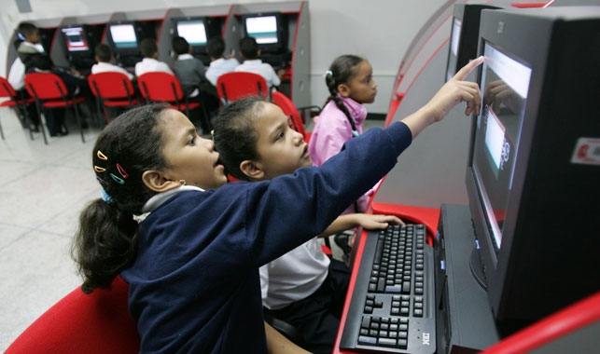

May 10, 2021
Presentation to Woodrow Wilson Center
Narrowing Latin America’s Digital Divide

Slide 2
COVID has hit the Latin America and Caribbean Region harder than any other Region
A Health Crisis
  Over 20 million Covid cases in LCR since the start of the pandemic (about 1/5 of global cases (March 2021));
  Highest fatality rates among WBG client regions are in LCR;
  Key drivers of the pandemic in LCR:
    High levels of urbanization (80% vs. 55% globally);
    High levels of informality;
    Aging Population (LAC is aging faster than any other region (defined as highest change in the percentage of over 65 in total population).
An Economic and Social Crisis
  Expected contraction of 6.9% in 2020 (GEP January 2021)—the worst performance in the developing world: two-fifths of LAC economies have experienced per capita GDP setbacks of 10 or more years. Small island economies hit particularly hard
  The debt-to-GDP ratio is expected to remain above other regions, at more than 80%
  A decade lost in poverty gains
  Sharp increase in inequality, food insecurity and learning poverty
Increased Awareness of Role that Digital can play in Economies and Societies

Slide 3

Achieving good country-led outcomes in digital transformation requires an ecosystem approach
5 Foundational Pillars of the Digital Economy
DIGITAL PLATFORMS
Presence and use of digital platforms that can support greater digital exchange, transactions and access to public and private services online
DIGITAL ENTREPRENEURSHIP
Presence of an ecosystem that supports new and young firm growth to drive employment, innovation, and new technologies and business models
DIGITAL INFRASTRUCTURE
Availability of affordable, high speed internet, which is instrumental to bringing more people online
DIGITAL FINANCIAL SERVICES
Ability to pay, save, borrow, and invest through digital means, enabling access to and usage of digital services and increasing rate of online transactions
DIGITAL SKILLS
Development of a tech-savvy workforce, with basic and advanced digital skills to support increased technology adoption and innovation
Notes:
Sources:
https://www.ericsson.com/en/mobility-report/dataforecasts/mobile-traffic-update
http://pubdocs.worldbank.org/en/275791607471359158/Analytical-Insights-Series-Dec-2020.pdf
Katz, Jung, Callorda. Can digitization mitigate the economic damage of a pandemic? Telecommunications Policy, 2020
ITU. Economic impact of COVID-19 on digital infrastructure. 2020.
Telecom Advisory Services. Covid-19 and the Economic Value of Wi-Fi. Dec 2020.
https://www.mckinsey.com/~/media/mckinsey/industries/retail/our%20insights/how%20covid%2019%20is%20changing%20consumer%20behavior%20now%20and%20forever/how-covid-19-is-changing-consumer-behaviornow-and-forever.pdf

Slide 4
LAC’s Digital Economy gaps are alarming
Digital Infrastructure: 46% of fixed broadband access in the region, compared to 57% in Eastern Europe, 87% in Western Europe and 59% in the Asia Pacific region.
Digital public platforms: Argentina, Brazil, Chile and Uruguay are among the top 50 performers in 2018, performing slightly below the OECD average. Belize, Cuba, Haiti and Nicaragua were among the worst LAC performers.
Digital financial transactions: In 2019, the LAC region experienced the lowest growth rate (+2.5%, Western Africa 14.5%) in the number of registered mobile money accounts and the lowest growth rate in transactions value (+1.4, Western Africa +34.9%)
Digital business: Venture capital investments present a positive trend. In 2019 Brazil and Mexico led the region in terms of number of deals and volume transacted (LACVA 2020). However, the region attracts less investment than Asia Pacific. (KPMG 2019)
Digital skills: The levels of education and training in the region are low in relation to advanced countries. It is estimated that there are more than 450 thousand unfilled jobs in the technology area due to the lack of trained professionals. (IDC 2017).

Slide 5
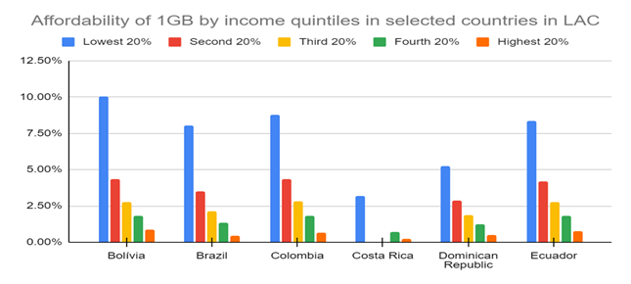
Digital Infrastructure is the foundation of the Digital Economy…yet LAC has significant gaps in terms of connectivity, usage and affordability
Unequal and unachieved fixed-broadband agenda, especially in fiber
On average less than half of the population (46.7%) in the Region have fixed broadband connectivity and even when they have it is of low quality (9.9% fiber to the home penetration)
Advanced mobile broadband is lagging in LAC
4G covers 87% of the population with actual usage/penetration much lower (37%)
Rural vs. urban digital divide varies significantly across LAC countries
Rural areas are overrepresented in coverage and usage gaps
Affordability remains a major barrier to Internet access and usage
In developing countries, the cost of Internet access is often above 2% of GNI per capita for 1GB of mobile data. Device affordability is also major bottleneck.
.
Sources: A4AI, 2019
Notes:
Sources:
https://www.ericsson.com/en/mobility-report/dataforecasts/mobile-traffic-update
http://pubdocs.worldbank.org/en/275791607471359158/Analytical-Insights-Series-Dec-2020.pdf
Katz, Jung, Callorda. Can digitization mitigate the economic damage of a pandemic? Telecommunications Policy, 2020
ITU. Economic impact of COVID-19 on digital infrastructure. 2020.
Telecom Advisory Services. Covid-19 and the Economic Value of Wi-Fi. Dec 2020.
https://www.mckinsey.com/~/media/mckinsey/industries/retail/our%20insights/how%20covid%2019%20is%20changing%20consumer%20behavior%20now%20and%20forever/how-covid-19-is-changing-consumer-behaviornow-and-forever.pdf

Slide 6
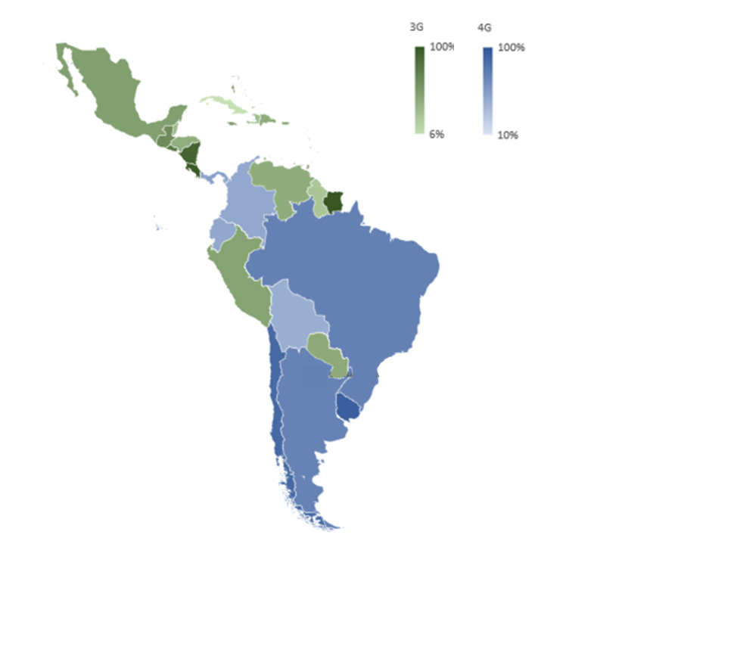

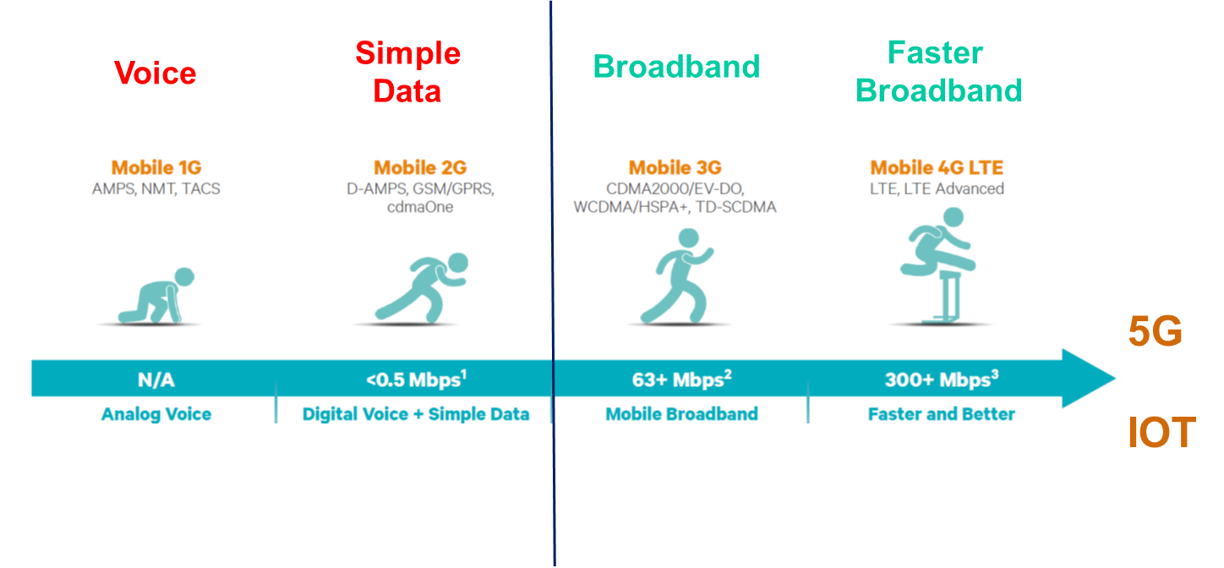
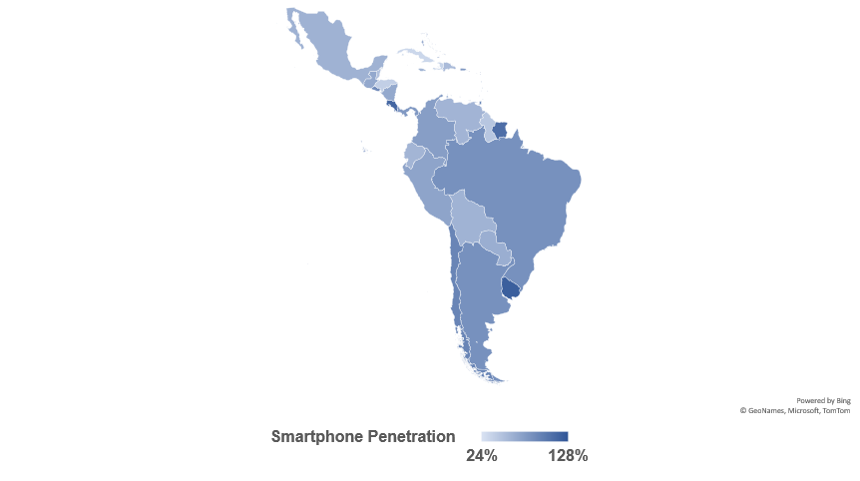
MX and CA have not fully migrated to 4G; 5G remains a long shot - greatly limiting the ability for rich media content and applications (e.g. e-learning, e-health)
1.0 +Gbps
5G Commercial
(GSMA 2021)
69% average smart phone ownership
(GSMA 2020)
Notes:
Sources:
https://www.ericsson.com/en/mobility-report/dataforecasts/mobile-traffic-update
http://pubdocs.worldbank.org/en/275791607471359158/Analytical-Insights-Series-Dec-2020.pdf
Katz, Jung, Callorda. Can digitization mitigate the economic damage of a pandemic? Telecommunications Policy, 2020
ITU. Economic impact of COVID-19 on digital infrastructure. 2020.
Telecom Advisory Services. Covid-19 and the Economic Value of Wi-Fi. Dec 2020.
https://www.mckinsey.com/~/media/mckinsey/industries/retail/our%20insights/how%20covid%2019%20is%20changing%20consumer%20behavior%20now%20and%20forever/how-covid-19-is-changing-consumer-behaviornow-and-forever.pdf

Slide 7
WB Advisory Services and Analytics (ASA) to close the Digital Divide – ex. Colombia, Chile
Chile Case Study: Proyecto de Fibra Óptica Austral
Objective: Provide fiber backbone and last mile local access service high-capacity telecommunications infrastructure for the south of Chile
Budget: US $100 million
Investment Model: PPP, subsidy award of Treasury Infra Fund (self funded)
Policy Drivers:
PPP framework
Open Access and non-discriminatory, price capped tariff
Award of spectrum (4G and 5G) / build out obligations
ASA project assesses last mile rural community and peri-urban extension, additional policy and regulatory gaps (e.g. infrastructure sharing) and assess impact on buildout obligations and investment costs
Colombia Case Study Part A: Program for Policy Reforms
DPO Support:
Objective: Increase competition and inclusion
Key Measures:
Subsidy and innovative award schemes
Establish in-kind payments in exchange of spectrum use (up to 60% to total spectrum fee)
Promotion of small operator subsidies as new entrants/competition
Infrastructure sharing and interconnection regime
Colombia Case Study Part B: Program to Increase Access
Investment Support- Connect 1 million households (1 millón de hogares)
Objective: Increase the current fixed broadband penetration in households in Strata 1 and 2 in Colombia by 5 percentage points in order to reach the target of 50% by 2022
Budget: est. US $300-400 million (TBD)
Investment Model: PPP, subsidy award of FONTIC (Universal Service fund)
Notes:
Sources:
https://www.ericsson.com/en/mobility-report/dataforecasts/mobile-traffic-update
http://pubdocs.worldbank.org/en/275791607471359158/Analytical-Insights-Series-Dec-2020.pdf
Katz, Jung, Callorda. Can digitization mitigate the economic damage of a pandemic? Telecommunications Policy, 2020
ITU. Economic impact of COVID-19 on digital infrastructure. 2020.
Telecom Advisory Services. Covid-19 and the Economic Value of Wi-Fi. Dec 2020.
https://www.mckinsey.com/~/media/mckinsey/industries/retail/our%20insights/how%20covid%2019%20is%20changing%20consumer%20behavior%20now%20and%20forever/how-covid-19-is-changing-consumer-behaviornow-and-forever.pdf

Slide 8
Policy and Financial Support by the World Bank
Bridging the digital divide
Leaping into the digital economy
Digital Infrastructure
(Broadband and Cloud)
Digital Platforms
Digital Financial Services
Digital Skills
Strategic pillars
Foundational DI regulation
Promoting infrastructure sharing
Market liberalization, competition
Eliminate regulations that prevent development of private platforms
Keep a level playing field
Sector diagnostics and policy based lending to increase competition in financial sector, ensure technology neutrality, and regulatory framework
Digital skills advisory work to fund deployment of digital skills programs by public and private sector
World Bank policy support
(DPOs, ASA, RAS)
Public investment in DI where private sector investment is not possible or economically feasible
Investment in public sector platforms in social sectors including education and health, favoring a PPP model
Public investment to crowd in private sector to support service deployment to rural areas or disadvantaged groups
Fund government programs in education and vocations training
World Bank investment
(IPFs)
Interventions build on each other as countries move towards more sophisticated solutions

