Slide 1
Accessing Justice: Femicide and the Rule of Law in Latin America
El Salvador case
Georgiana Braga-Orillard
UNDP El Salvador
Resident Representative

Slide 2
Gender inequality remains a historical and major barrier to human development
2005-2009
2010-2017
Indicated bias in one or fewer
questions from
the World Values Survey
Women
Men
40
44
29
31
Indicated bias in two or more
questions from
the World Values Survey
Women
Men
57
60
49.3
26.1
69
71
Fuente: Mukhopadhyay, Rivera and Tapia (2019), base on the World Values Survey.

Slide 3
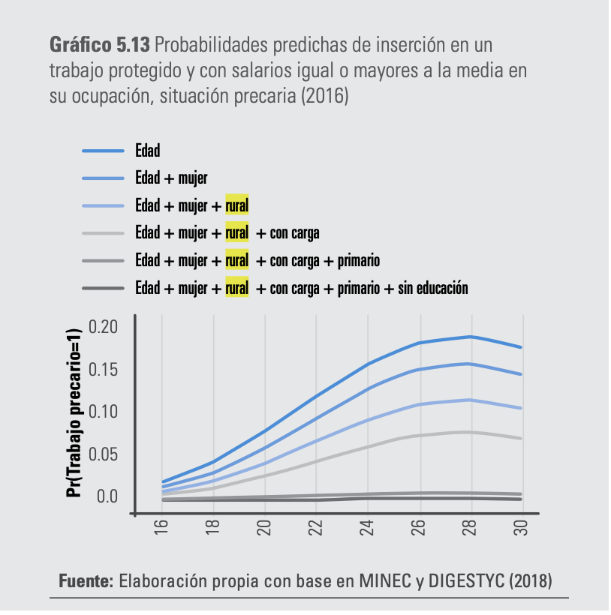
Cumulated vulnerabilities
Age
Age + gender
Age + gender + rural
Age + gender + rural + care giving
Age + gender + rural + care giving + elementary school
Age + gender + rural + care giving + no education

Slide 4
Gender-based violence requires a multidimensional approach as a new way of work
Human Development
Citizen Security
Humanitarian approach
Human Rights

Slide 5
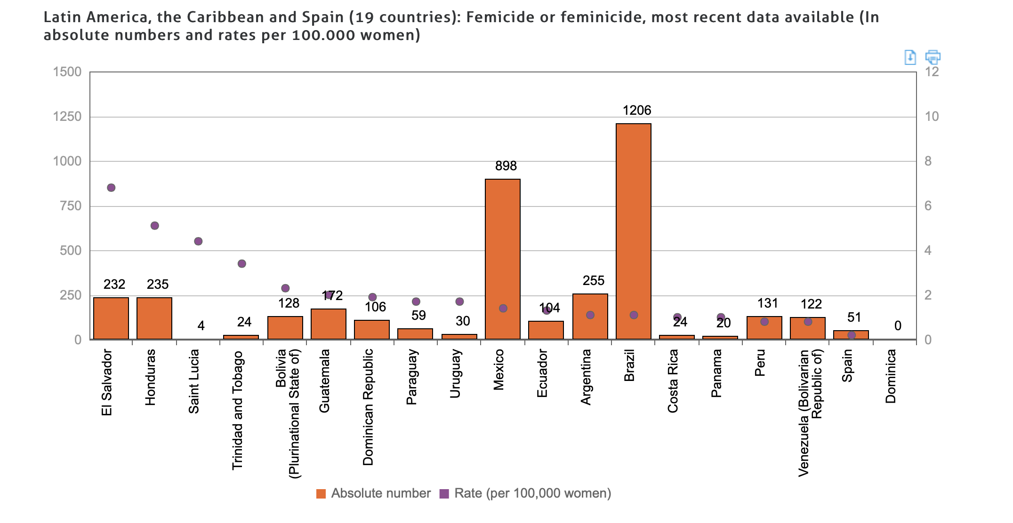
Source: ECLAC Gender Equality Observatory for Latin America and the Caribbean

Slide 6
Feminicides reduced in 57% from 2016 to 2019
Women homicides and feminicides rate per 100,000 inhabits
---------- Homicides – of women ---------- Feminicides
Source: Infosegura, 2020

Slide 7
Strengths of El Salvador in the fight against Gender-based violence
Legal framework
Institutional framework
Policies and protocols
Basic services
Strengthen capacities

Slide 8
Continue efforts to access justice for women and girls under COVID-19
Reduction in homicides (61% until 30 April 2020)
Online and telephone complaint mechanisms were activated
Campaings to promote reporting and new complaint mechanisms.
Decreasing of the generation of information on violence against women in public institutions

Slide 9
Challenges to improve access to justice
Enhancing legal framework
Access to justice near women
Funding
Gender-based violence at the center of public policy
Coordination
Diversify the services for victims
Information and data

Slide 10
“UNDP will work closely with different sectors to promote a new generation of innovative laws, policies, and programs, oriented to change discriminatory beliefs and violent practices, in order to achieve gender Equality” Achim Steiner
Thank you!

