Slide 1
Is there a role for forests in addressing the root causes of migration in the Northern Triangle?
Iliana Monterroso, PhD
Scientist, Equity, Justice, Gender and Tenure Team
Center for International Forestry Research (CIFOR), Guatemala
Notes:
1/5 The creation of the #MayanBiosphereReserve 25 years ago represents a switch in #Guatemalan government policy regarding land use and tenure, moving from a focus on agriculture, putting conservation outcomes at the center of the process leading to one of the largest certified forests managed collaboratively by communities.

Slide 2
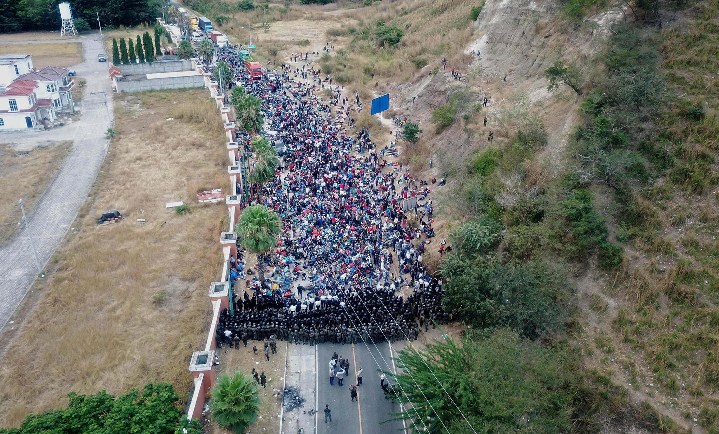
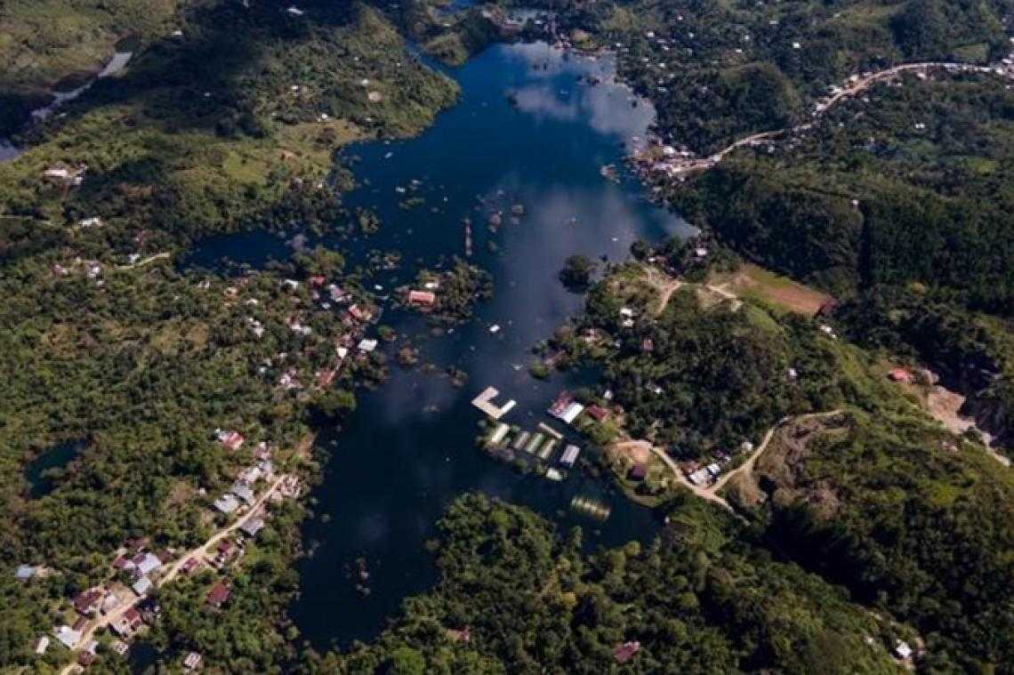
Migration: roots and links with socio environmental crisis
Migrant caravan: Honduras/Guatemala border, January, 2021. 7,000 – 8000 people
Foto: @estebanbiba
Community of Campur (Alta Verapaz) after ETA and IOTA
Picture: Unicef
Notes:
https://www.congress.gov/116/bills/hr2615/BILLS-116hr2615rfs.pdf
Any effort that addresses the roots causes of migration should draw from thorough analysis of increased vulnerability in the region, characterized by poverty conditions affecting about 51% of the population of both Guatemala and Honduras and 8 out 10 people in some highlands regions of Totonicapan and las Verapaces.
Underlined in the crisis left after ETA and IOTA huricannes which impacted over 4million in the region aggravating food insecurity and chronic malnutrition which already affects over 5 out of 10 childer under five years old in Guatemala.
locally grounded, investable and scalable solutions for more inclusive and equitable pathways for a climate-resilient
Forest are critical to address climate change agenda, they not only play a key role in mitigating greenhouse gas emissions, they are also crucial for building adaptation, providing livelihoods and enhancing resilience to crisis be them natural disasters, economic or pandemic shocks. In fact recent evidence suggests that over 1.6 billion indigenous peoples and local communities live in and around forests and depend on them.
Left: Community of Campur (Alta Verapaz) after ETA and IOTA
Picture: Unicef

Slide 3

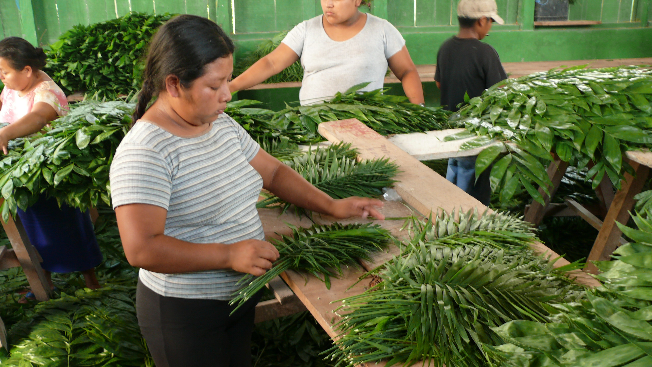
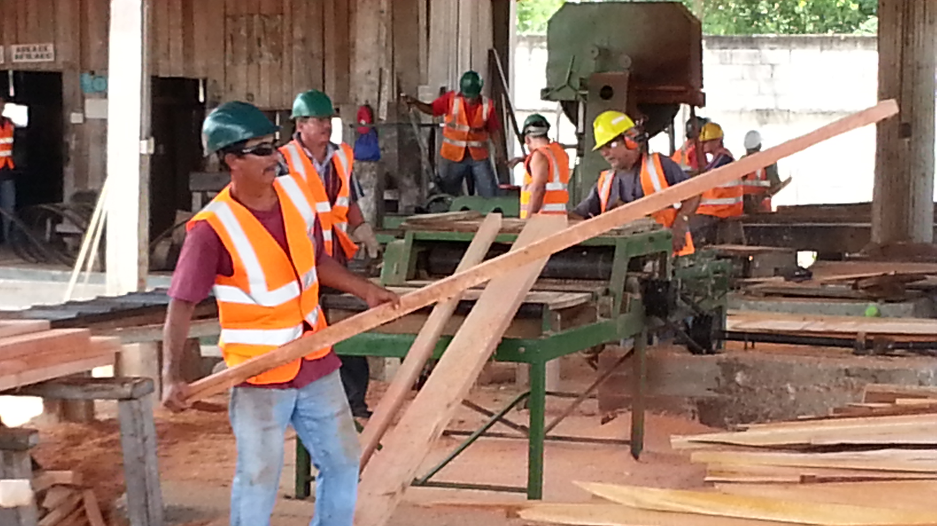
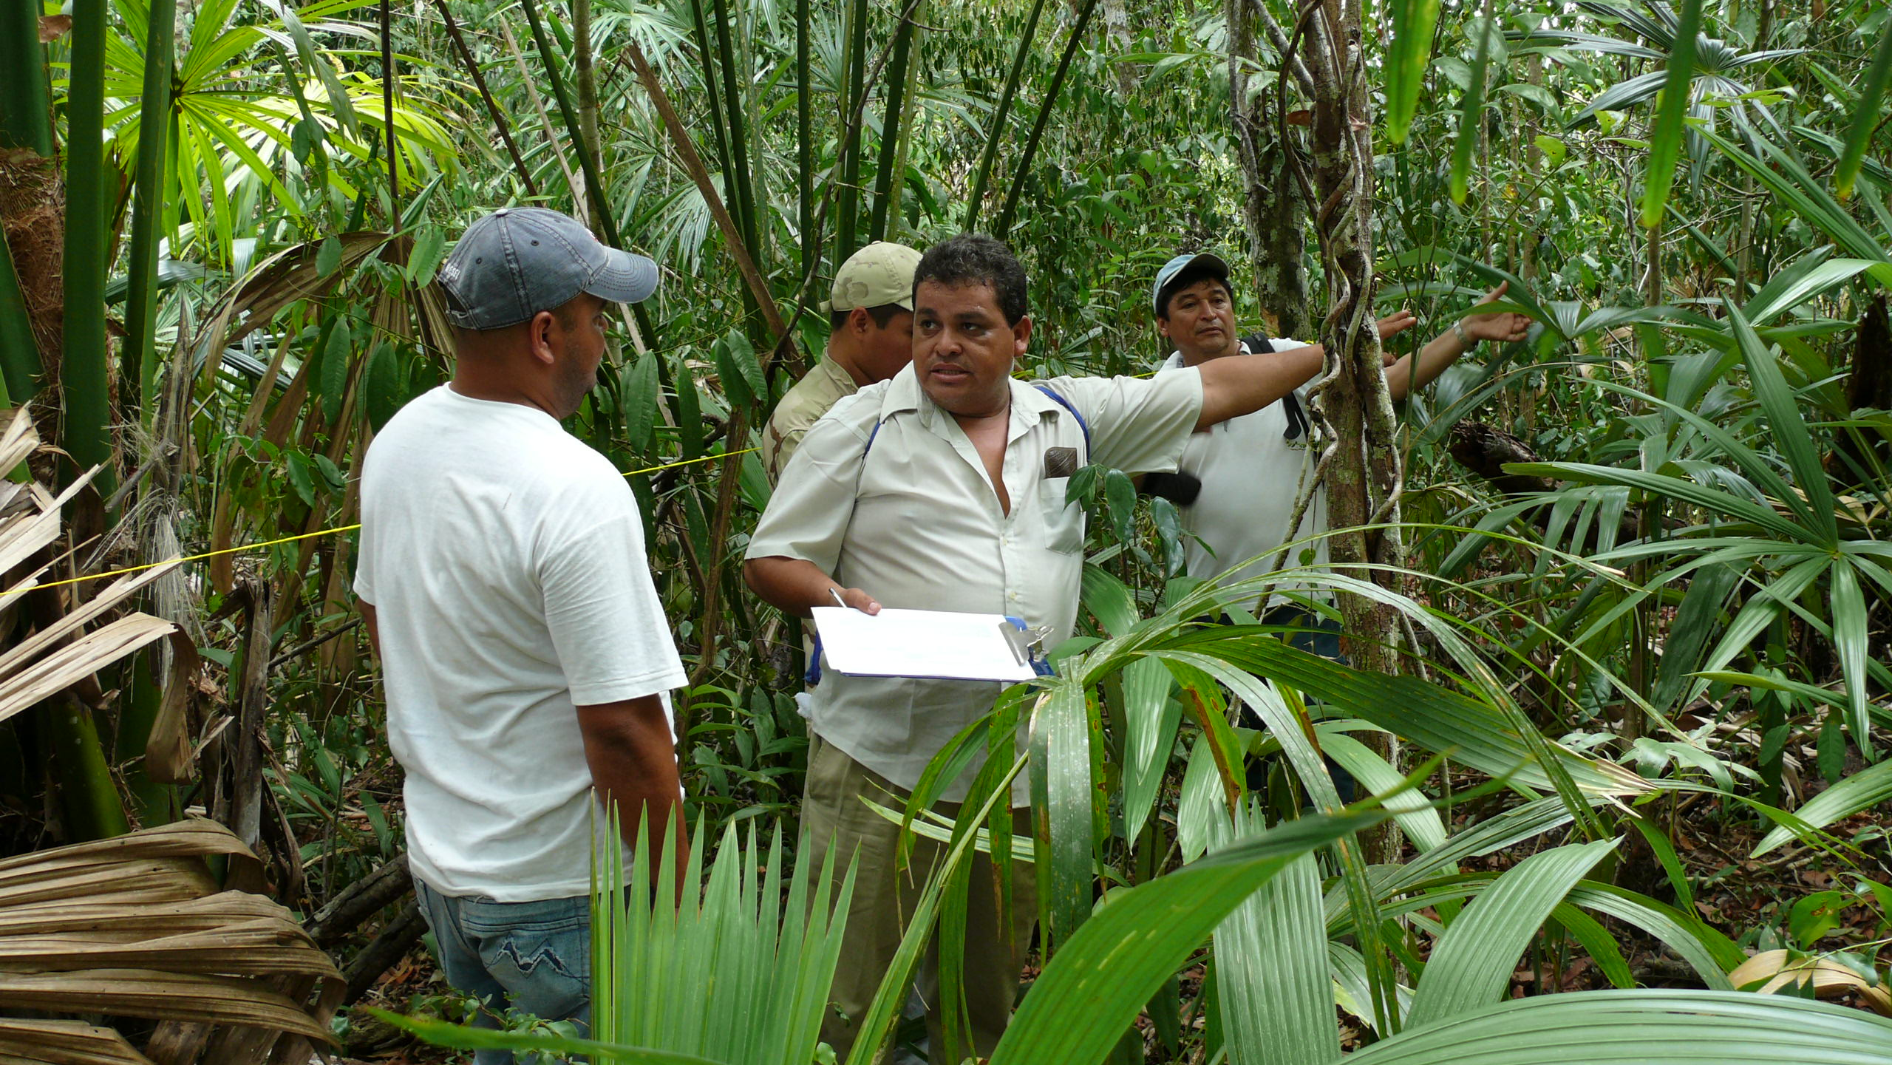
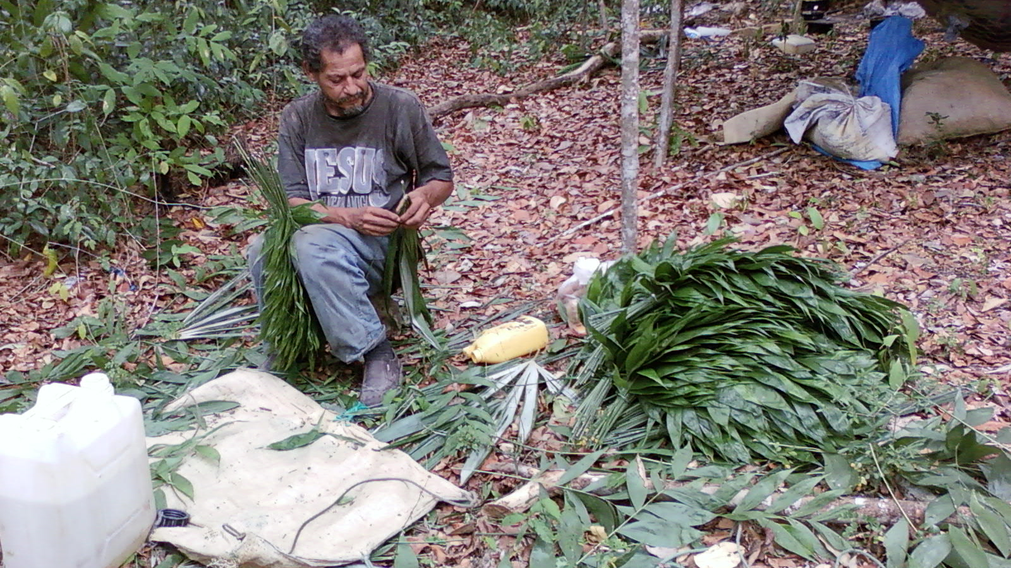
25 years of community forest management

Slide 4
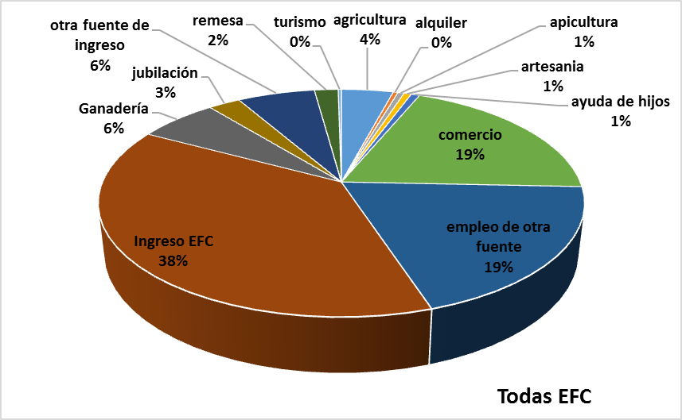
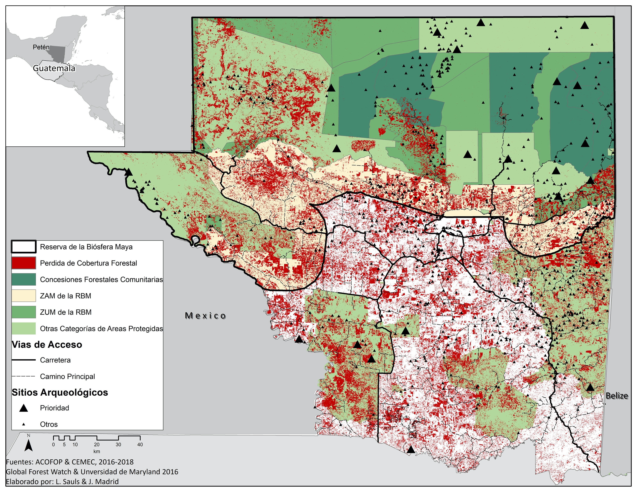
Community Forest Concessions in the Mayan Biosphere Reserves Peten
Income from other sources
remittances
tourism
agriculture
leasehold
beekeeping
retirement
crafts
Support from their children
Cattle ranching
Trade
Forest Income: 38%
Other income sources
Average data for 11 Community Forest Enterprises
N=292 households
Source: ACOFOP y CEMEC 2016, 2018 en Monterroso et al., 2019
Source: Stoian et al., 2019

Slide 5
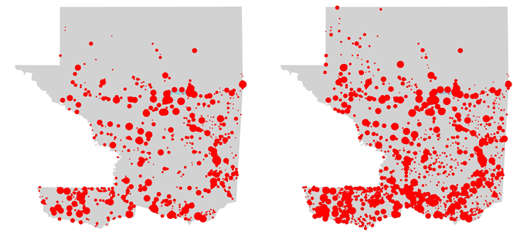
Investments of forest management at the household level
Percentage of CFE members
Housing improvement
Health
Education
Housing improvement
Health
Education
Population Dynamics
2010 - 2020
Elaborated by CEMEC, CONAP together with Aldo Rodas
Investments based
on CFE employment
Investments based
on CFE dividend
Source: Stoian et al., 2019
Notes:
Las contribuciones de los ingresos forestales entre los asociados a las 9 EFC activas varían entre 11 y 63% y están completados por ingresos provenientes de pequeños negocios y otras fuentes.

Slide 6
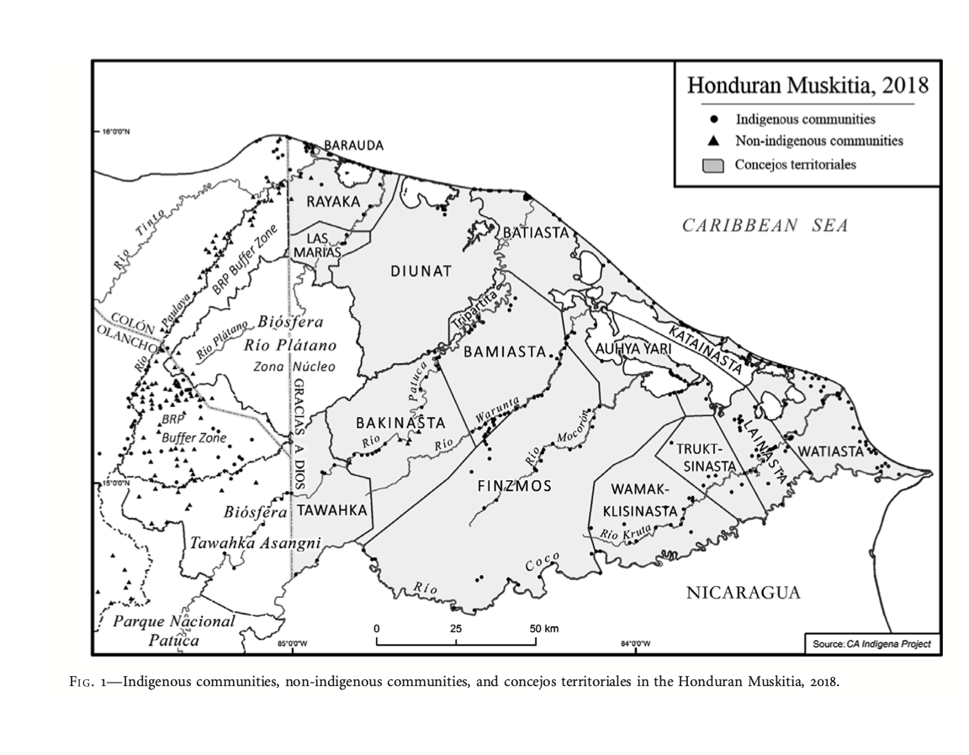
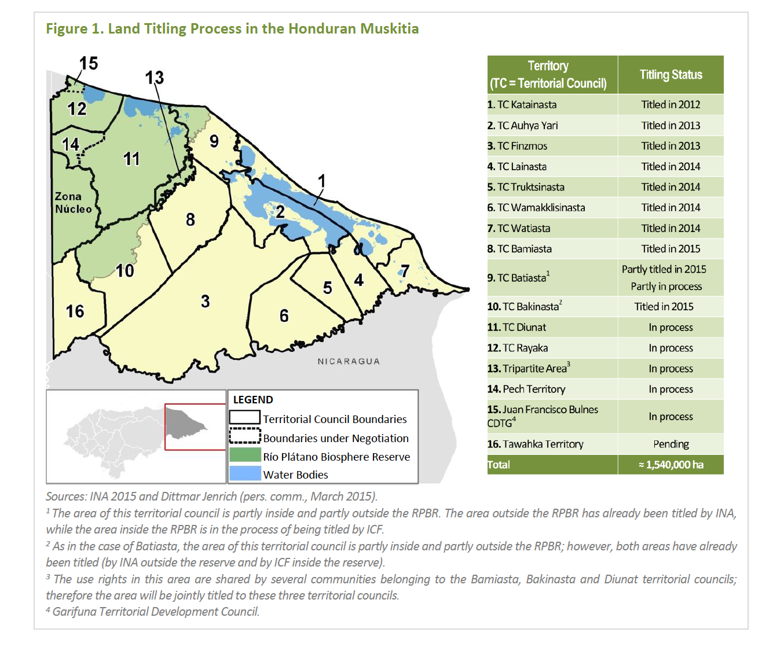
Indigenous territories in Honduras
Source: Right Herlinhy and Tappan, 2019:71; Left: Forest Trends, 2015
Notes:
https://www.tandfonline.com/doi/full/10.1111/gere.12309

Slide 7
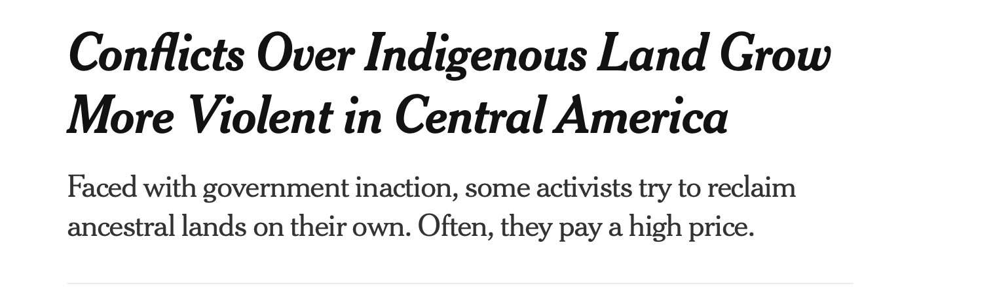


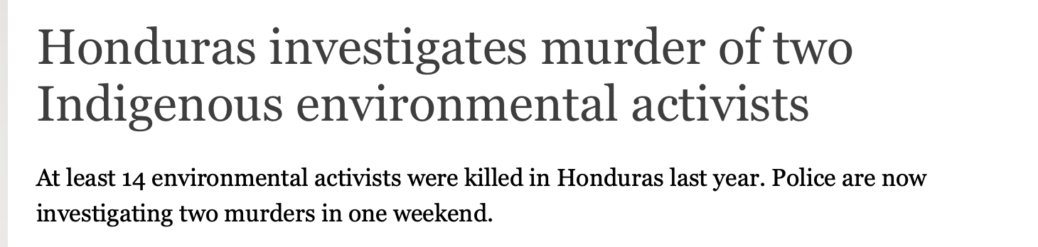


Slide 8
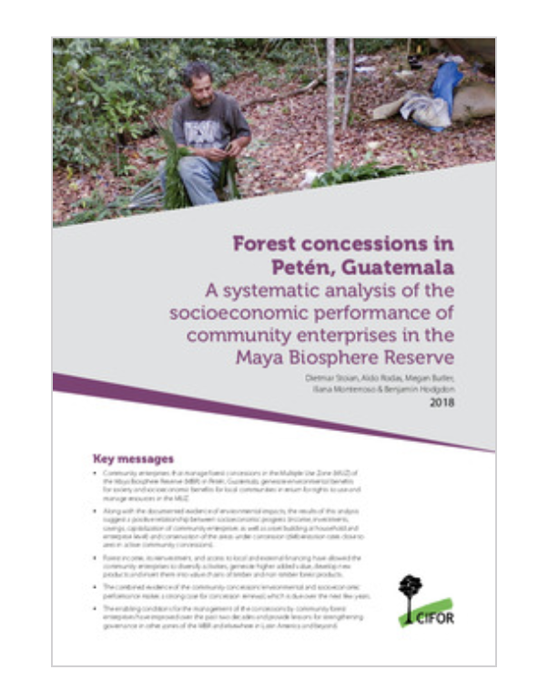
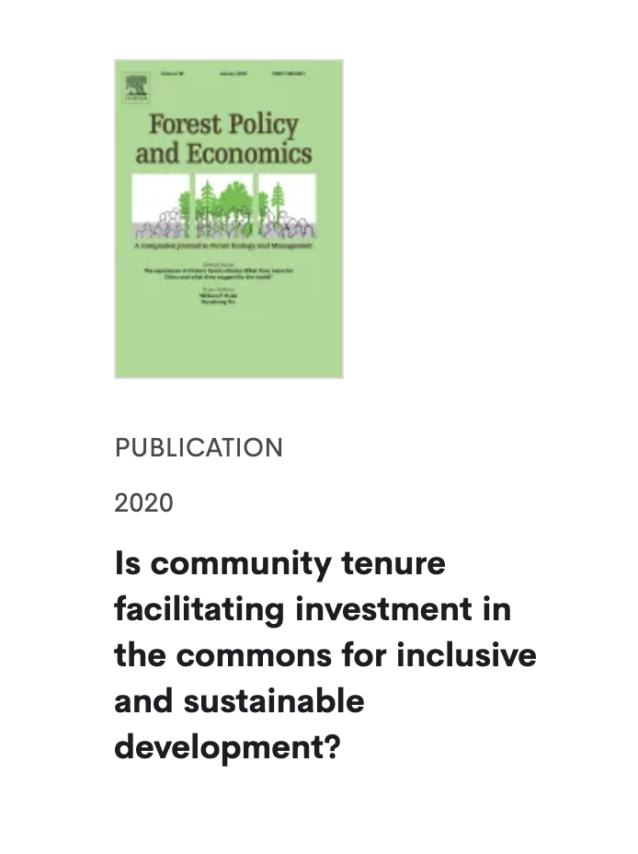
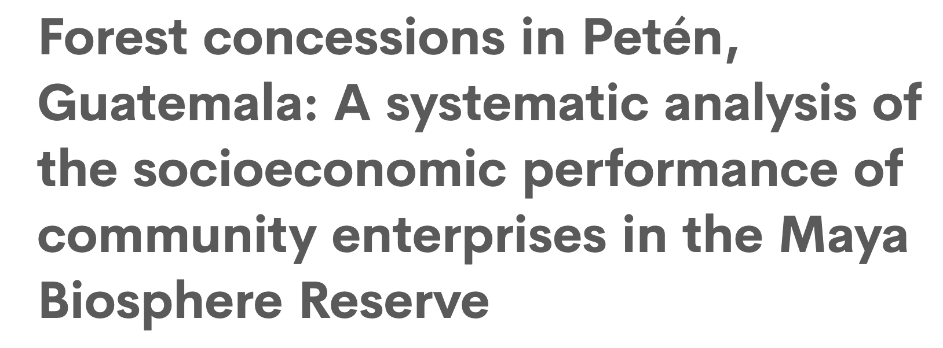

Thank you
Monterroso, Stoian, Lawry & Rodas (2018)

