Slide 1
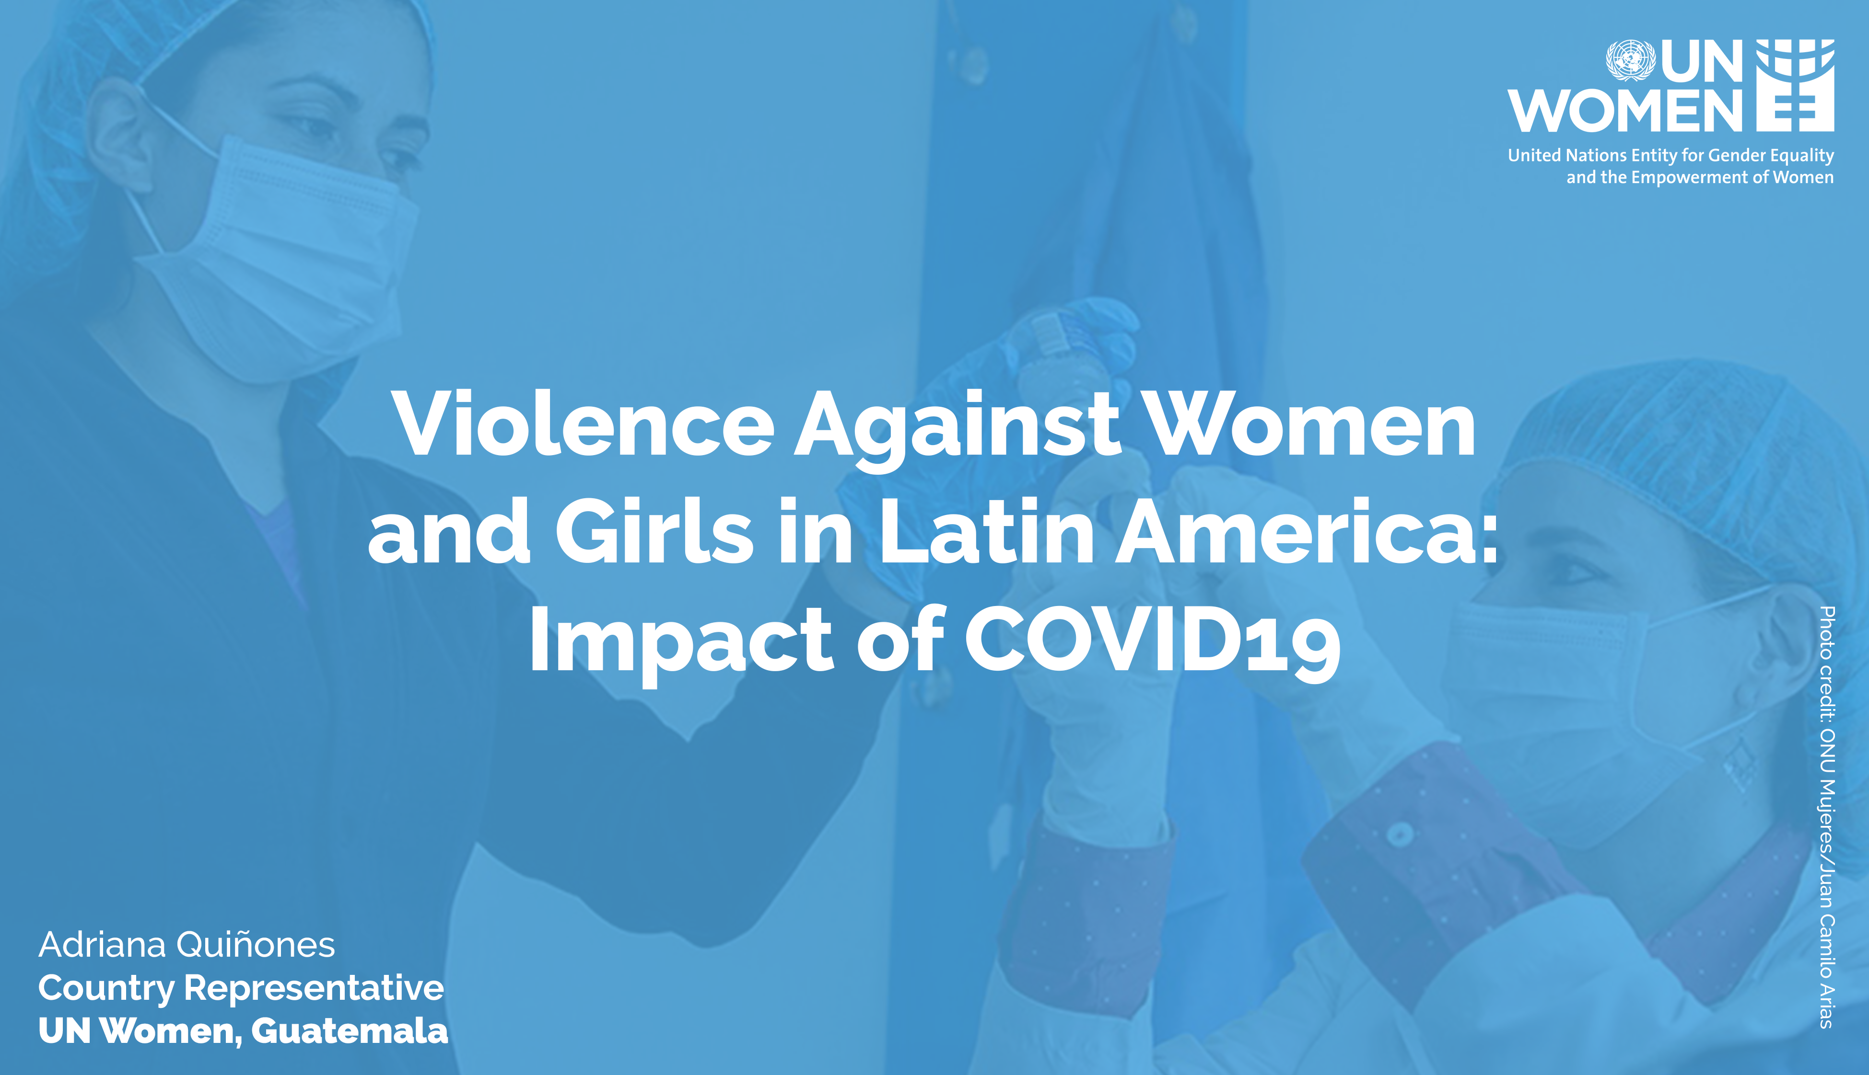

Slide 2

Challenges to adress violence against women and girls in Latin America Region before COVID-19
Lack of implementation of specialized laws to prevent and eradicate violence against women and girls
Limited investments and resources to prevent, sanction and eradicate violence against women and girls
Lack of harmonized and comparable statistics and data
Weakened institutional mechanisms for advancement of women’s rights
Lack of harmonized procedures and protocols for investigations of femicide and other forms of violence against women and girls
Social norms that naturalize and tolerate violence against women and girls
Structural barriers and intersectional discrimination (indigenous women, women with disabilities, among others)
Gender stereotypes in the Justice systems and other institutions.

Slide 3
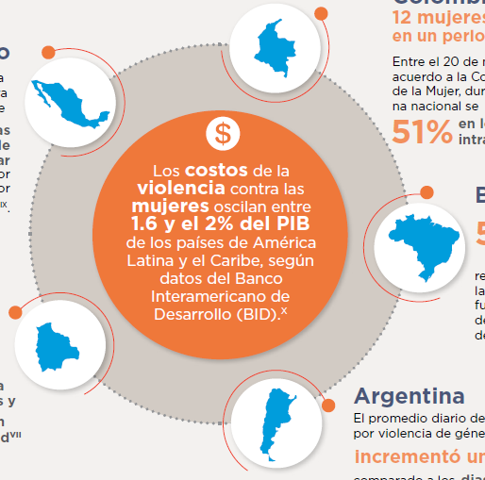

Trends and emerging data on VAWG in Latin America Region during COVID-19
COLOMBIA:
12 women were killed from March 5 to Apr 4. Reports of domestic violence have increased 51% from previous months.
MEXICO:
State of Nuevo México. VAWG by a relative increased over 30%. Before COVID-19, 2 or 3 cases or rape were reported per day. After the lockdown, 5 cases per day are reported.
BRAZIL:
In Rio de Janeiro, reports of VAW increased 50% during quarantine.
In Latin America
12% (Aprox. 19.2 million)
Women and girls between 15 and 49 years of age were subject to physical or sexual violence by its current or former intimate partner in the 12 previous months
BOLIVIA:
By April 15, 1,200 cases of VAW, including 33 cases of rape against minors, were reported.
GUATEMALA:
Reports of VAWG have dropped 34% in March: 55 reports per day average compared to 155 reports per day average from previous months. In May, 11 rapes per day have been reported average. Daily, 5-6 missing women. 7 femicides since the lockdown. The Public Prosecutor has expressed a deep concern about the increasing number of suicides in women under quarantine.
CHILE:
Reports of domestic violence have dropped during quarantine, compared to the same period in 2019, but calls to helplines seeking for support increased 60%.
ARGENTINA:
In March, after the beginning of quarantine, daily reports to the emergency helpline for VAWG (144) increased 25% .
Sources: UNW (2020). Estimations based on Official Data from Public Ministry of Guatemala (2020).
UNW (2020) COVID-19 and ending violence against women and girls with based on data from the Ministry of Women, Genders and Diversity (Argentina), RCN Radio (Colombia) El Norte (México) and Clarín (Brazil).

Slide 4


Inequalities and discrimination against women and girls in Latin America before Covid-19
29.4%
34%
37%
of women have no source of income of their own, compared to 10.7% of men
is the gap in labour force participation rate between women and men with primary education
is the gap in labour force participation between women and men in rural areas
23%
77.6%
41%
46 hours
Is the gap in labor market participation between women and men in urban areas
of women are dedicated exclusively to unpaid work (care of children, dependents and domestic labour, volunteering)
is the average weekly time that women in Latin America devoted to unpaid (before COVID)
Sources: UN Women. Progress of the World's Women: Transforming economies, realizing rights.

Slide 5





Additional impacts of COVID-19 on women and girls in Latin America Region
Essential services are being compromised, especially access to sexual and reproductive health care.
Online violence
against women is increasing. Also, there are reports on sexual violence against women and girls committed by the police or members of the armed forces
Claims for alimony and child-support obligations are been used to blackmail women to back into a violent relationship
Gender digital
Divide that increased barriers to seek for help
Loss of incomes as result of unemployment and lack of security and social protection (for example, the domestic workers)
Sources: UNW (2020). Estimations based on Official Data from Public Ministry of Guatemala (2020).
UNW (2020) COVID-19 and ending violence against women and girls with based on data from the Ministry of Women, Genders and Diversity (Argentina), RCN Radio (Colombia) El Norte (México) and Clarín (Brazil).
IADB in UNDP (2020) América Latina Genera.

Slide 6




Some examples of responses to adress VAWG from Government and Women’s organizations during COVID-19
High level commitment to end VAWG. Continuity of access to specialized courts
Automatic extension of active protection and security measures for VAW survivors
Protocol for health personnel to detect and direct cases of VAWG towards the judiciary and other institutions
Services for VAWG have been considered essential and continue to work nation-wide
All Countries: Women’s organizations have been at the forefront of response efforts: continuing to offer guidance and support to survivors of VAWG; conducting advocacy and engagement of different actors to address violence against women and girls during COVID-19. Concern for return to victim language and domestic spaces
Sources: UNW (2020). Estimations based on Official Data from Public Ministry of Guatemala (2020).
UNW (2020) COVID-19 and ending violence against women and girls with based on data from the Ministry of Women, Genders and Diversity (Argentina), RCN Radio (Colombia) El Norte (México) and Clarín (Brazil).
IADB in UNDP (2020) América Latina Genera.

Slide 7

(1) Ensure women’s participation in decision-making processes of the national response strategies and plans. Women at the center as agents of building back better, not victims of VAW
(2) Ensure that the needs of women and girls are included in the national response to mitigate the economic impact of the lockdown and in the early economic recovery plans
(3) Allocate additional resources and include evidence-based measures to address the inequalities and discrimination against women and girls in COVID-19 national response plans (affirmative actions).
(4) Collect sex-disaggregated data on impact of COVID19
(5) Ensure support for grassroots women’s organizations
RECOMMENDATIONS FOR ACTIONS

Slide 8


