Slide 1
Covid-19 and Procurement Challenges in Latin America
Daniel Sabet
Fellow, Woodrow Wilson Center
June 29, 2020

Slide 2
Most of the region’s corruption scandals have been procurement related
Country | Description
Brazil: Lava Jato (2013-2014) | Collusion and bribery to divide contracts with Petrobras. (US$349 million Odebrecht)
Argentina: Bribe Notebooks (2005-2015) | Alleged cash bribes in exchange for government contracts. (~US$10s millions)
Colombia: Contract Carousel (2008-2011) | Procurement corruption by former mayor Bogota and other municipal officials (US$58.8 million)
Honduras: Social Security Institute (2010-2014) | Money siphoned through shell companies and bribes for contracts (US$360 million)
Mexico: Estafa Maestra (2010-2017) | Subcontracts to shell companies (US$192 million)

Slide 3
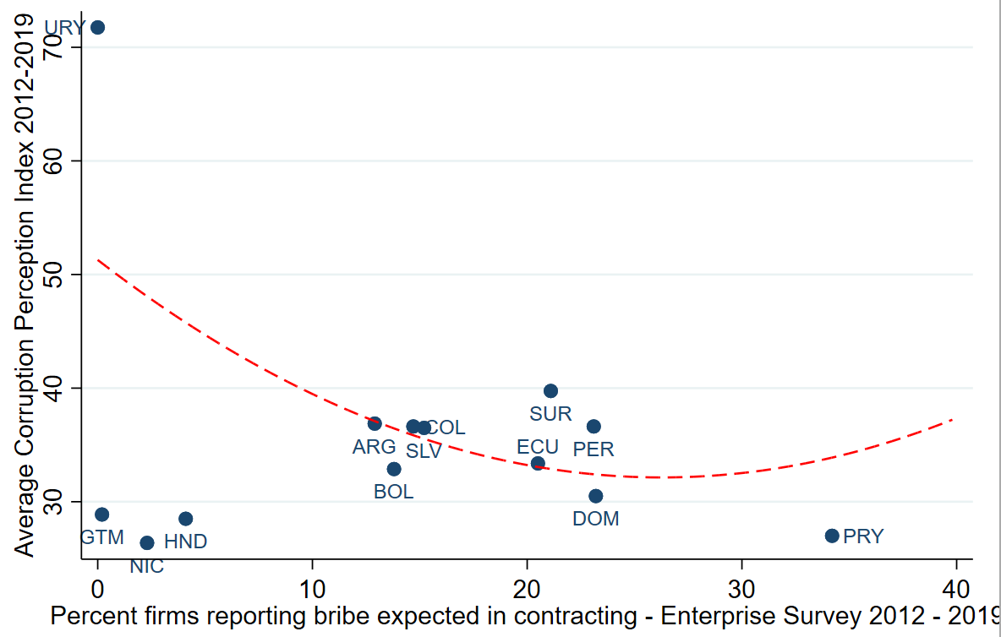
Corruption perceptions and reported bribe solicitations in procurement (TI, WB)

Slide 4
Keys to effective procurement systems
Rules requiring competition
Transparency
Accountability mechanisms
Internal auditors
Supreme audit institutions
Prosecutors
Legislature
Civil society/media oversight
There is a tension between integrity and efficiency, but they are not mutually exclusive.

Slide 5
Variation in procurement response to the Coronavirus
Approach | Country
Minimal exceptions to normal rules | Uruguay
Relax requirements, increase transparency | Guatemala
Relax requirements, increase transparency, increase accountability actions | Chile, Brazil*
Relax requirements but no significant measures to prevent corruption | Ecuador

Slide 6
Procurement problems in times of crisis
Corruption problems
Corrupted officials abuse flexibility for personal gain
Schemers abuse urgency for personal gain
Collusion between the two
Non-corruption problems
Goods that aren’t needed
Goods that are needed but don’t meet specifications
Expensive
Suppliers inability to provide the goods
Governments inability to use the goods (capacity, complementary items)

Slide 7
Honduras response to Covid-19
Relaxed requirements
Gave emergency procurement authority to well-respected INVEST-H (purchase over US$80 million)
Civil society groups (CoST, FONAC, COHEP) are supposed to provide oversight
Association for a More Just Society (ASJ-TI) to conduct a social audit.
National Anti-Corruption Commission not invited

Slide 8
Test kits (250,000)
Good price (US$7.50), good quality, good promised timeframe for delivery.
BUT
Poor documentation justifying firms, prices, type of kits
No penalties for late delivery or quality guarantees
Laboratories only have the capacity to test 500 per day

Slide 9
Personal protective equipment
Standard items, reasonable delivery timeframe promised
BUT
High prices
Five companies contracted quickly without clear rational (inadequate capacity, no contracting experience, wrong industry, red flags)
4/5 orders were cancelled when firms couldn’t deliver
1 order comes through 65 days late

Slide 10
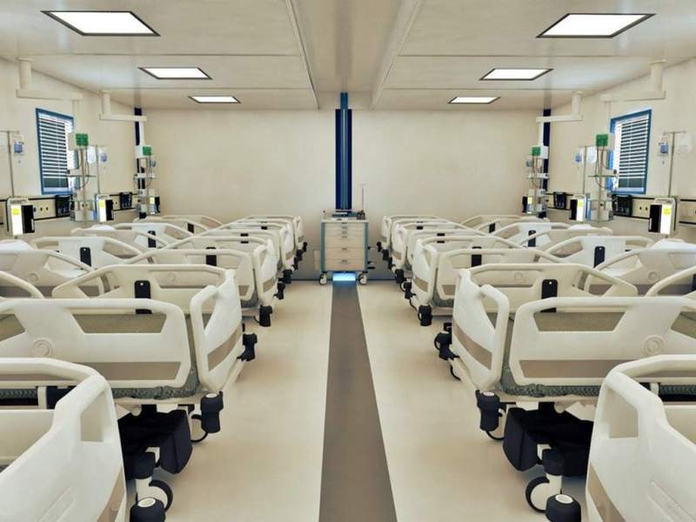
Mobile Hospitals
US$47 million for 7 mobile hospitals from Turkey through US based intermediary
Not well justified
Multimillion-dollar mark-up; paid 100% in advance; without guarantees or penalties
Manufacturer reports that no order was made
Notes:
ASJ estimates US$12.3 minimum overmarkup

Slide 11
In Conclusion
Procurement was a problem prior to the pandemic
Relaxation of rules can be offset by increases in transparency and accountability measures
Some countries in the region have responded well
Honduras as a case of likely fraud, failure to obtain materials, and the decline of a reform body

Slide 12
Overflow

Slide 13
Bribes paid by Odebrecht as reported in US court
Country | Estimated Bribe amounts (US$ millions)
Brazil | $349
Venezuela | $98
Dominican Republic | $92
Panama | $59
Angola | $50
Argentina | $35
Ecuador | $34
Peru | $29
Guatemala | $18
Colombia | $11
Mexico | $11
Mozambique | $1
Total | $786
Source: US District Court Eastern District of New York

Slide 14
World Bank Public Procurement Performance Ratings (2017)
Global (n=144)
Latin America (n=17)
Bid Preparation | Bid and Contract Management | Payment of Suppliers | Overall Index

Slide 15
References
ASJ Social Audits
CNA reports
Lawyers Council regional analysis

